Slide 1
Chapter 8
Advanced TCP/IP Network Design
https://cis.BBent.com/Courses/CSIS202/Lessons/8

Slide 2
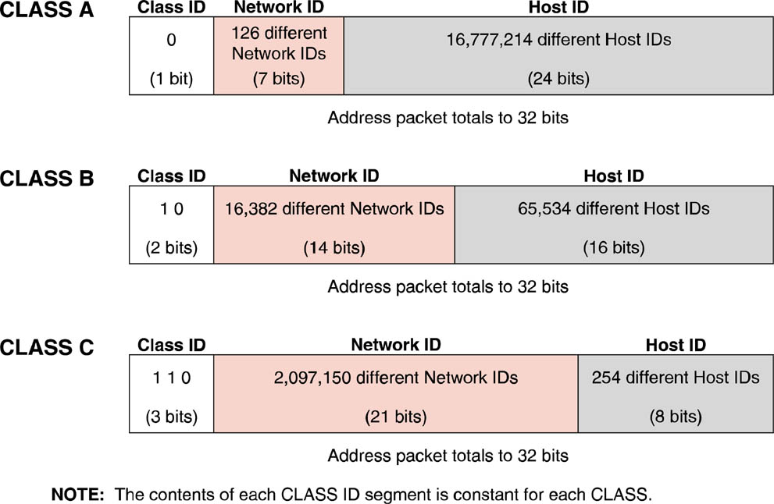
Classful IP Addressing
There are three basic classes of addresses known as class A, B, or C networks

Slide 3
Classful IP Addressing
Classful addresses are broken apart on octet boundaries.
The first few bits of each segment address is used to denote the address class of the segment.
The class ID plus network ID portions of the IP address are known as the network prefix, the network number, or the major network.

Slide 4
Subnetting
When IP address classes were established, networks were composed of a relatively small number of relatively expensive computers.
As time went on and the PC exploded into LAN’s, the strict boundaries of the classful addressing address classes became restrictive and forced an inefficient allocation of addresses.
Class C address with its limit of 254 hosts per network is too small for most organizations, while a Class B address with its limit of 65,534 hosts per subnet is too large.

Slide 5
Subnetting
Networks grew and needed to be divided or segmented in order to improve traffic flow.
Routers join two separate networks.
Networks that are separated by routers must have different network IDs so that the router can distinguish between them.
This accelerated the depletion of IP addresses.

Slide 6
RFC 950
RFC 950 gave users a way to subnet, or provide a third layer of organization or hierarchy between the existing network ID and the existing host ID.
Since the network IDs could not be altered, the only choice was to “borrow” some of the host ID bits.
These “borrowed” bits constitute the subnet portion of the address.
A subnet mask identifies which bits are used for the subnet ID.

Slide 7
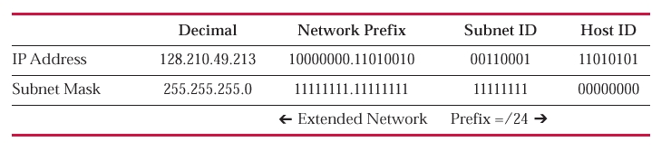
Extended Network Prefix
The extended network prefix is the classful network prefix (/16 in the case of a Class B address) plus the number of bits borrowed from the host ID.
This figure illustrates the network prefix, extended network prefix, subnet mask in binary and decimal, network ID, subnet ID, and host ID.

Slide 8
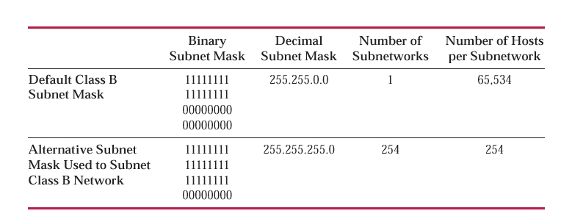
Subnet Masks
Alternative Subnet masks for a Class B network

Slide 9
Limitations of Classful Addressing and Fixed-Length Subnet Masks
Wasted addresses … only one subnet mask can be used for a network prefix.
A shrinking pool of available IPv4 addresses.
Routing protocols such as RIP are unable to transmit subnet masks or extended network prefix information along with network IDs and IP addresses.

Slide 10
Limitations of Classful Addressing and Fixed-Length Subnet Masks
All routers, servers, and workstations within a given network all have the same subnet mask.
A fixed subnet mask implies a fixed subnet size for all subnets of a given network ID.
Subnets must be sized to accommodate the largest required subnet within a given network ID, resulting in wasted host addresses that cannot be recovered or used by other subnets.

Slide 11
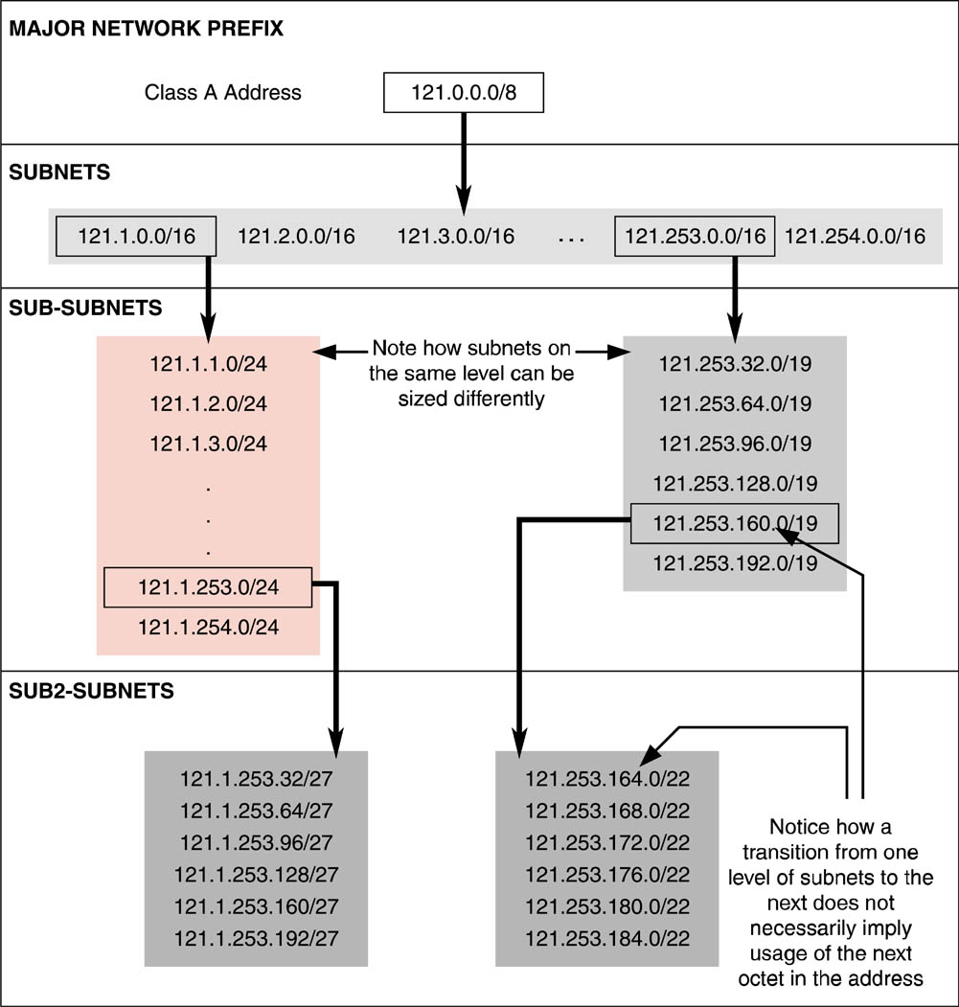
Classless Addressing and Variable-Length Subnet Masks
Classful Subnet Masks
/8 (Class A)
Binary: 11111111.00000000.00000000.00000000
Decimal: 255.0.0.0
/16 (Class B)
Binary: 11111111.11111111.00000000.00000000
Decimal: 255.255.0.0
/24 (Class C)
Binary: 11111111.11111111.11111111.00000000
Decimal: 255.255.255.0

Slide 12
Variable-Length Subnet Masks – RFC 1009
RFC1009 specifies how a single network ID can have different subnet masks among its subnets.
Minimizes the wasted IP addresses forced by a single subnet mask per network ID as defined by the original RFC 950 Subnetting technique.

Slide 13
Implementing VLSM
The routers on the network where VLSM is implemented must be able to share subnet masks and/or extended network prefixes with each router advertisement.
Routing protocols such as OSPF and IS-IS do this, whereas RIP and IGRP do not.
  RIPv2 (RFC 1388), added support for VLSM.
All routers supporting VLSM must support a longest match routing algorithm.
The implemented network topology must match the distribution of addresses and definition of subnets.

Slide 14
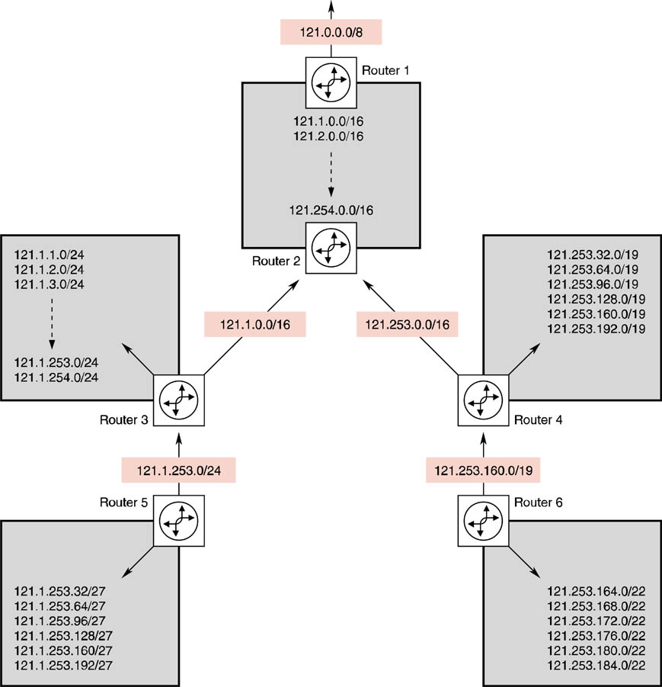
Route Aggregation with VLSM
Level 3 networks are subnetworks of the level 2 networks, i.e. the level 3a network 121.1.253.32 is a “chunk” of addresses taken from the 121.1.253.0 level 2a network.
Level 2 networks are subnetworks of the level 1 network, i.e. the level 2 network 121.1.1.0 is a “chunk” of addresses taken from the 121.1.0.0 network at level 1
Level 1
Level 2a
Level 2b
Level 3a
Level 3b

Slide 15
Classless Inter-Domain Routing
CIDR was announced in September 1993 and is documented in RFCs 1517, 1518, 1519, and 1520.
CIDR is also sometimes referred to as supernetting.

Slide 16
Implementing CIDR
CIDR addresses are issued in blocks known as CIDR blocks.
The first octet is meaningless in determining how many subnets or host IDs can be defined for a given CIDR block.
The only factor that determines the capacity of a CIDR block is the network prefix assigned by the Internet authorities when the CIDR block is issued.

Slide 17
Implementing CIDR
The network prefix issued by the Internet authorities indicates the number of bits used for the major network ID.
These bits are reserved and cannot be used by the end users for subnet IDs or host IDs.
For example, if a CIDR block were issued with a network prefix of /18, that would imply that the first 18 bits from left to right were reserved for the network Id and leave 14 bits (32–18) for subnet IDs and host IDs.

Slide 18
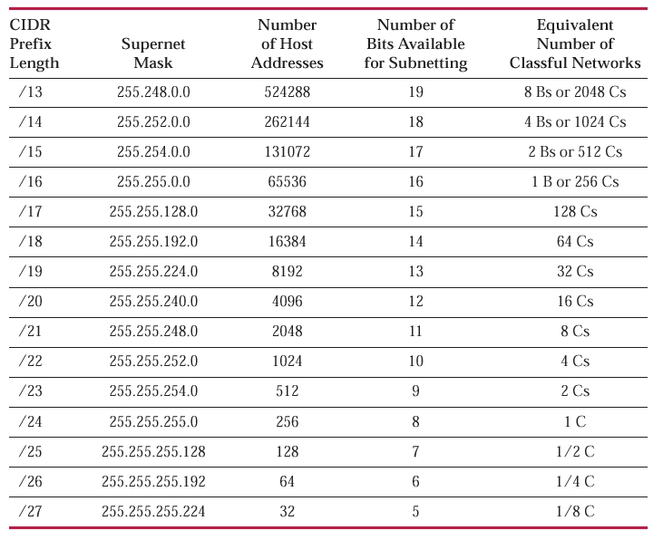
CIDR Block Capacity

Slide 19
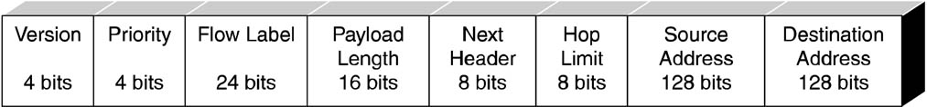
IpV6 Packet
The Internet Engineering Task Force developed IPv6, also known as IPng (Next Generation), in December 1998 to address the limitations of IPv4.

Slide 20
IPv6
Expands IP addresses to 128 bits.
Eliminates packet fragmentation and its resulting processor overhead.
Utilizes fixed-length field headers.
Packets can be set to authenticate their origin.
Packets can also be encrypted at the network layer.

Slide 21
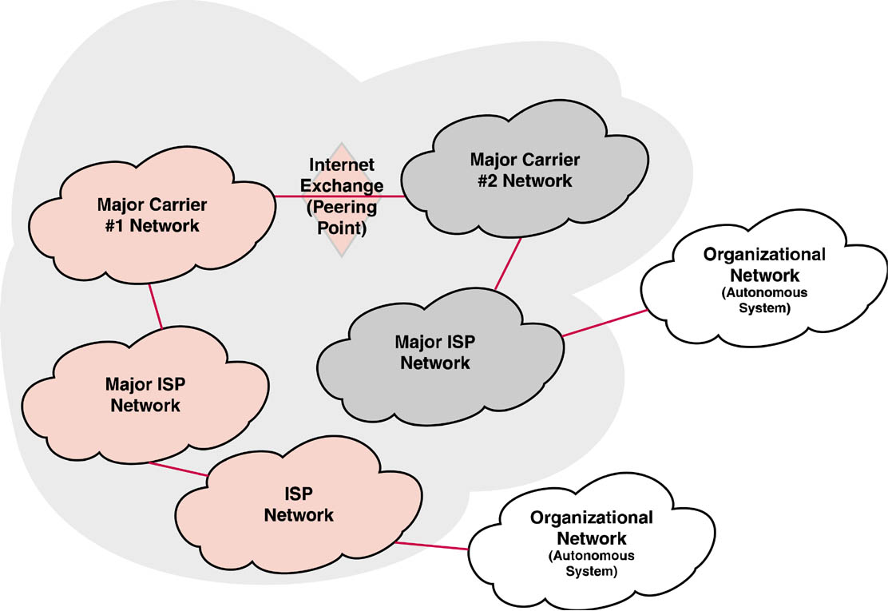
Structure of the Internet
The major carrier’s networks are interconnected at Internet Exchange Points aka peering points or Network Access Points (NAPs).

Slide 22
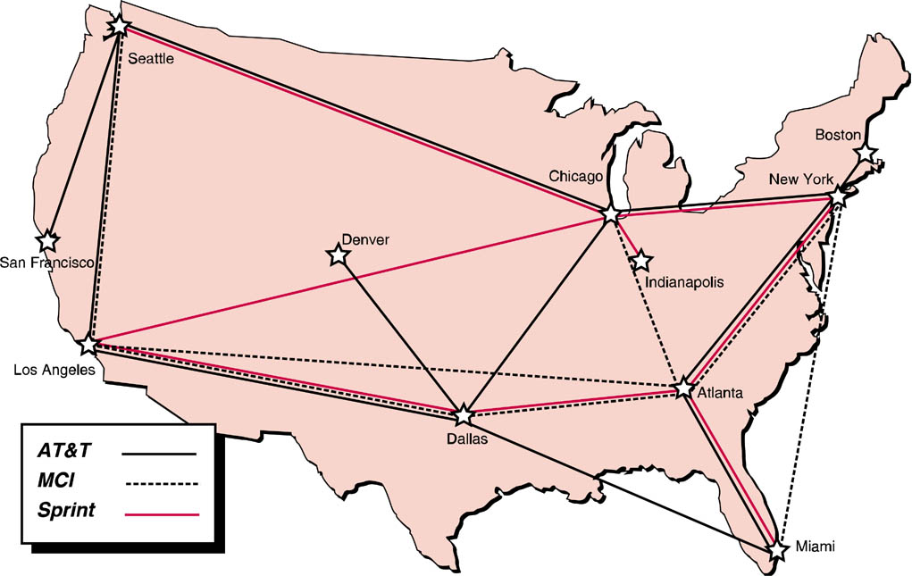
Carrier Network Geography
Major network carriers and their NAP’s

Slide 23
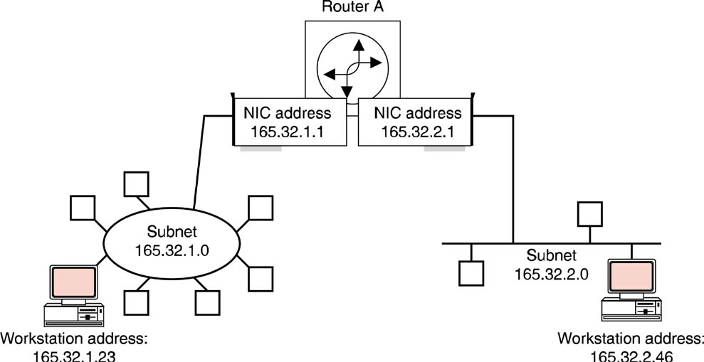
IP Routing
Routers serve as intelligent-forwarding devices between subnets and networks.

Slide 24
IP Routing
The router acts as a gateway to each subnet.
The router actually has a network interface card that participates in each subnet.
The routers use the subnet mask to determine the subnet IDs of all traffic that the subnet mask is asked to process.

Slide 25
Dynamic vs. Static Routing
Routes to specific networks can be entered into that routing table in two different ways:
  A network administrator can manually enter static routes into a router’s routing table
  Dynamic routing is achieved when routers build routing tables based on route advertisements received from other routers.
Dynamic routing runs the risk of having one misbehaving router create a cascading negative impact on other routers

Slide 26
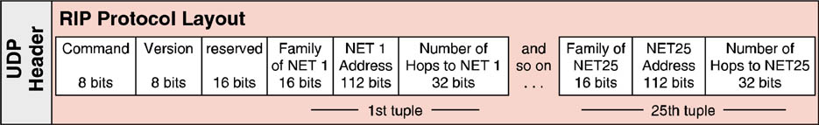
RIP Protocol Layout
The most basic routing protocol used in the TCP/IP protocol suite is RIP or the Routing Information Protocol.
There are two versions of RIP: RIPv1 and RIPv2
RIPv2 supports passing the extended network prefixes required for the use of VLSM and CIDR

Slide 27
OSPF Protocol
OSPF or Open Shortest Path First is an IP link state routing protocol developed to overcome some of RIP’s shortcomings such as the 15 hop limit, full routing table broadcasts every 30 seconds, and slow network convergence.
As an interior gateway protocol, OSPF is used to share routing information inside of an autonomous system

Slide 28
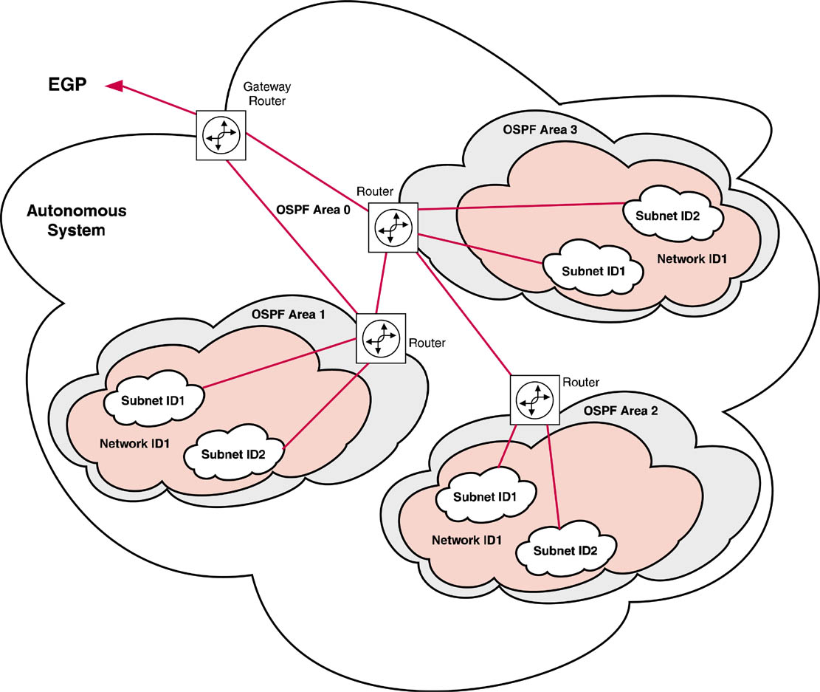
Open Shortest Path First - OSPF
The hierarchy of an OSPF area implementation has four tiers: autonomous systems, OSPF area, network ID, subnet ID

Slide 29
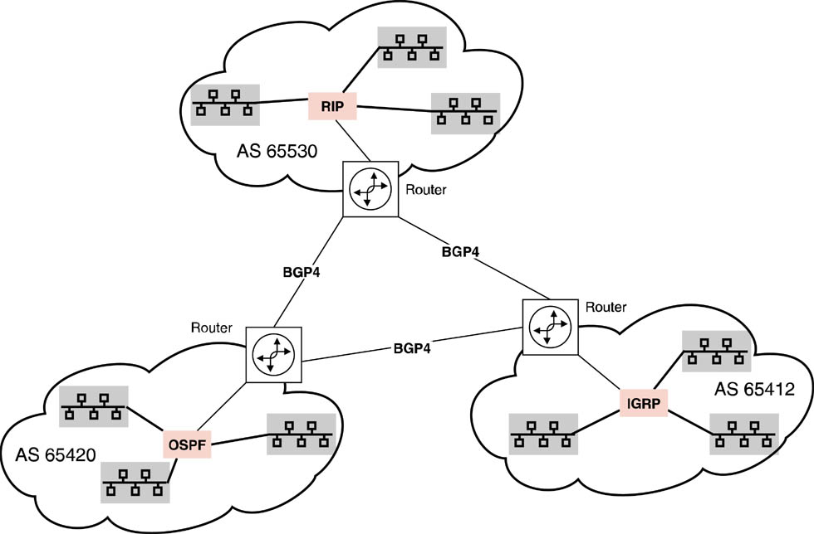
Border Gateway Protocol
The most commonly used exterior gateway protocol is BGP4 (Border Gateway Protocol Version 4).

Slide 30
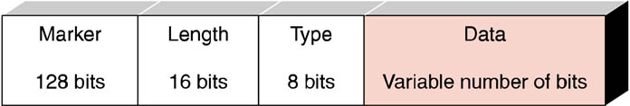
BGP4 Protocol Layout
BGP4, is an exterior gateway protocol that performs routing between multiple autonomous systems (AS) or domains and exchanges routing and reachability information with other BGP systems.
To the outside world, the AS is seen as a single entity.

Slide 31
Border Gateway Protocol
Each AS runs its own IGP (interior gateway protocol) independent of any other AS.
Any network can talk to any other network via the Internet because, regardless of what routing protocols those networks may speak internally, they all speak the same language (BGP) externally

Slide 32
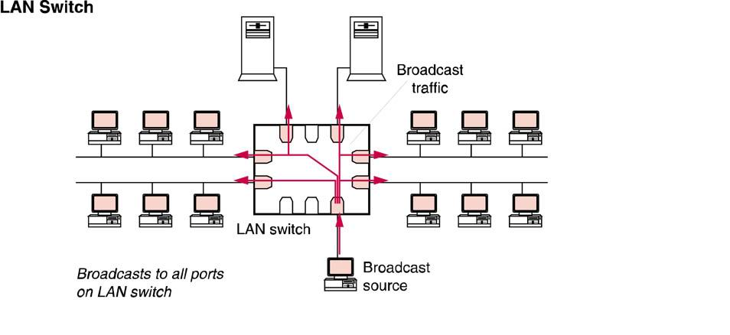
LAN Switch
A switch can dynamically create connections between two ports independent of the other ports.

Slide 33
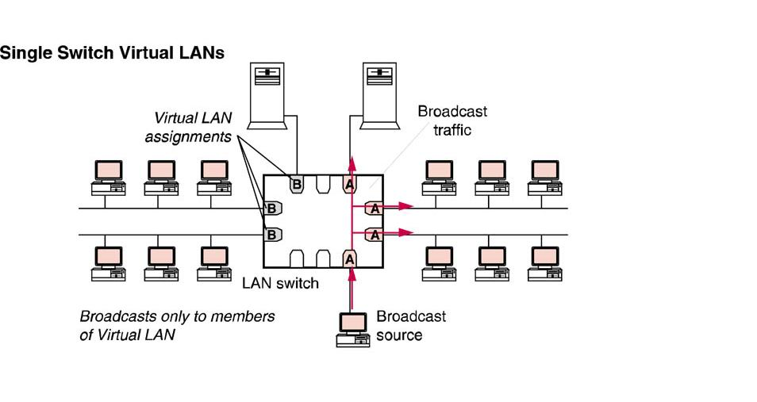
Single Switch Virtual LAN
LAN switches that support virtual LANs use OSI layer two bridging functionality to logically segment the traffic within the switch into distinct virtual LANs

Slide 34
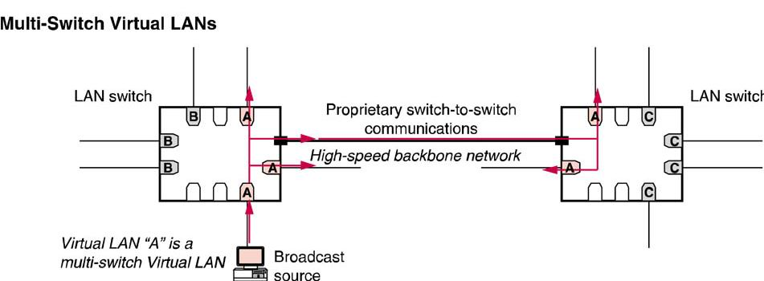
Multiple Switch Virtual LAN
When members of the same virtual LAN are physically connected to separate LAN switches, the virtual LAN configuration information must be shared between multiple LAN switches.

Slide 35
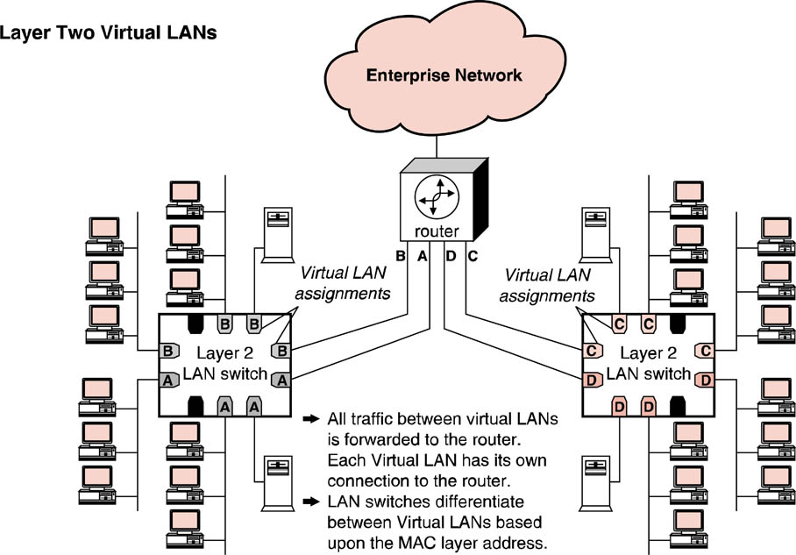
Layer Two VLAN Routing
Regardless of the number of switches in the VLAN environment layer two, virtual LANs still require the use of an external, stand-alone router to route traffic from one VLAN to another.

Slide 36
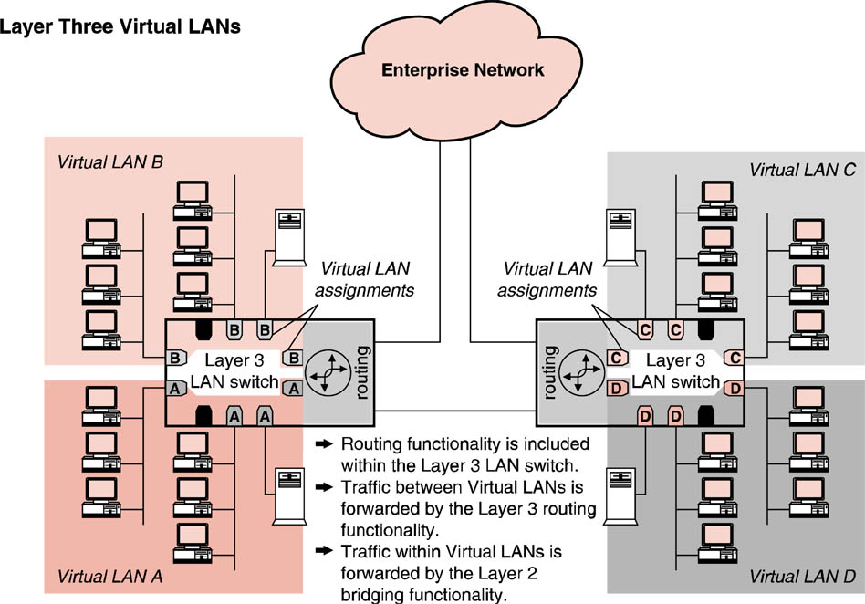
Layer Three VLAN Routing
Layer three or routing switches:
  Eliminate the need for external routers to connect LAN segments.
  Provide a performance boost by operating at both layers two and three of the OSI model.

