Slide 1
Chapter 7
Local Area Network Communications Protocols
https://cis.BBent.com/Courses/CSIS202/Lessons/7

Slide 2
The Network Layer
The third layer of the OSI Model is the Network layer.
The Datalink layer provides a means for two hosts on a common network segment to communicate.
Technologies such as Ethernet and Token Ring provide this intra-segment connectivity.
The Network layer is concerned with providing a means for hosts to communicate with other hosts on different network segments.
Technologies like TCP/IP and IPX/SPX provide this inter-segment connectivity.

Slide 3
The Network Layer
Network layer protocols provide a means of delivering data between network segments
Addressing is the process of defining where on the internetwork a host is located
Routing is the process of determining the best path to the destination host

Slide 4
Frames and Packets
The Data Link layer transmits frames of data
The Network Layer transmits packets of data

Slide 5
Networks and Segments
Single network segments are commonly referred to as segments, sub-networks, or subnets
Inter-connected segments are referred to as networks, internetworks, or intranets

Slide 6
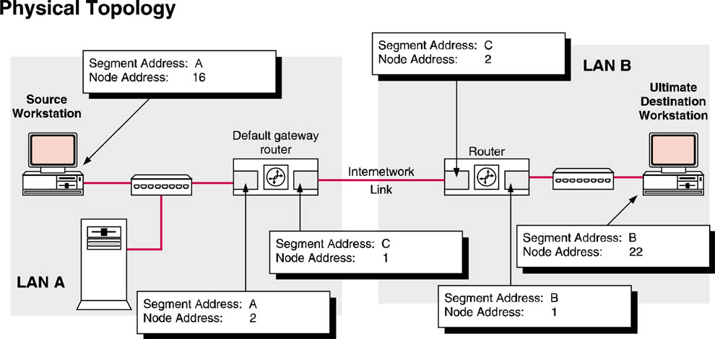
Network Layer Addressing
The network layer provides end-to-end or inter-segment communications
The host address must be unique within a network segment.
The packet will be routed to the network segment of the correct host based on the segment address

Slide 7
Network vs. Datalink Layer Addressing
The Datalink layer uses the physical address (also known as the MAC addresses) of the NIC to deliver data rather than the network layer host address.
For the Network and Datalink layers to successfully interact to deliver data, a direct, one-to-one mapping must be made between the Network layer address and the Datalink layer physical address.

Slide 8
Address Resolution
The process of determining the Data Link layer address (MAC address) of an NIC from the Network layer address is known as address resolution.
Each NIC is assigned a single Data Link layer physical address and one or more Network layer addresses (multi-homed).

Slide 9
Address Resolution Protocol (ARP)
Maps Network layer address to Data Link layer address in ARP table.
Open a command prompt (view this link for help)
(http://cis.msjc.edu/media/CSIS202/command_prompt.html).
At the command prompt type:
arp –a (for more info type arp /?)

Slide 10
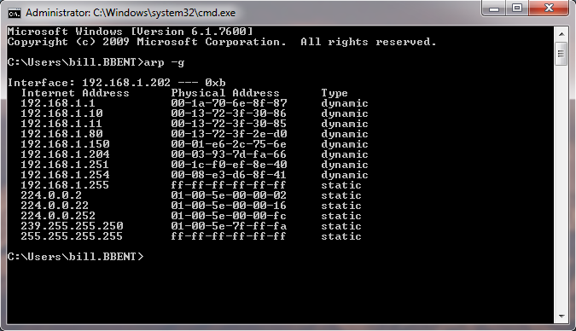
ARP Table
ARP table maps Network layer (Internet) addresses to Data Link layer (physical) addresses

Slide 11
Protocol Encapsulation
A packet of data from the Network layer is placed in the data section of a Datalink layer frame.
This is encapsulation

Slide 12
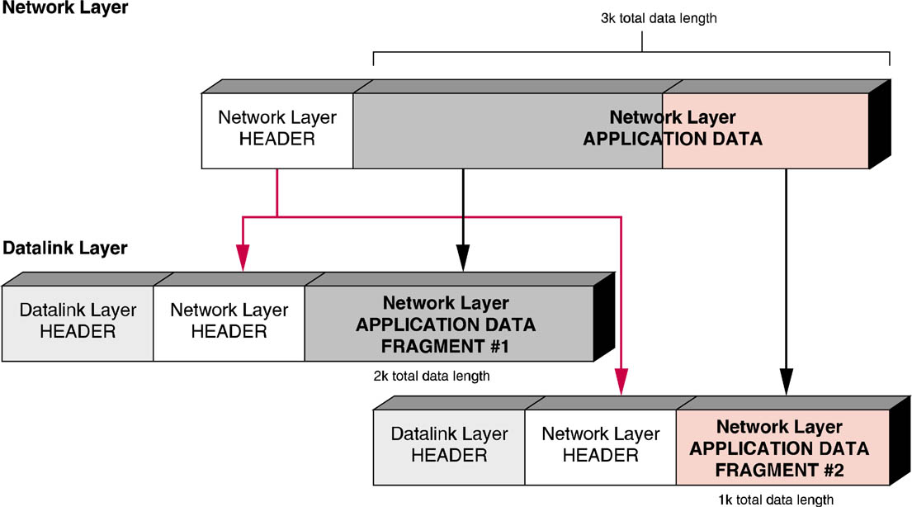
Packet Fragmentation
Fragmentation allows large quantities of data to be sent across the network in smaller, more manageable “chunks” of data.

Slide 13
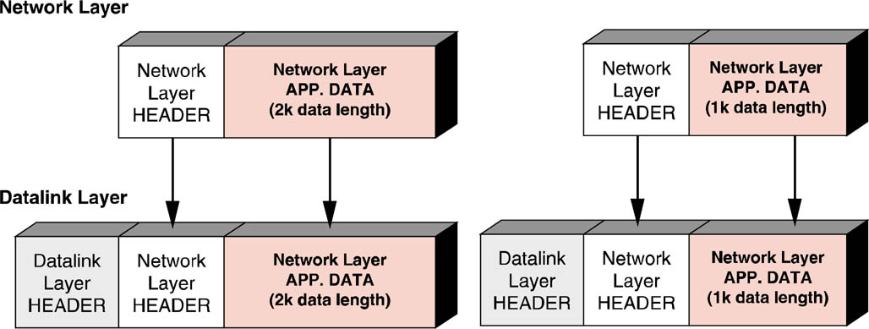
Packet Fragmentation Eliminated
Repeated packet fragmentation and reassembly places a large processing burden on routers, effectively reducing their overall routing capacity.
Solution? Lower Layer 3 packet size!

Slide 14
Routing
Routing is the process of moving data across network segments toward its final destination.
Routers receive frames of data, de-encapsulate the layer three packet, examine the Network layer packet header, determine the next hop of the packet, package the packet into a new data frame and transmit the new frame.

Slide 15
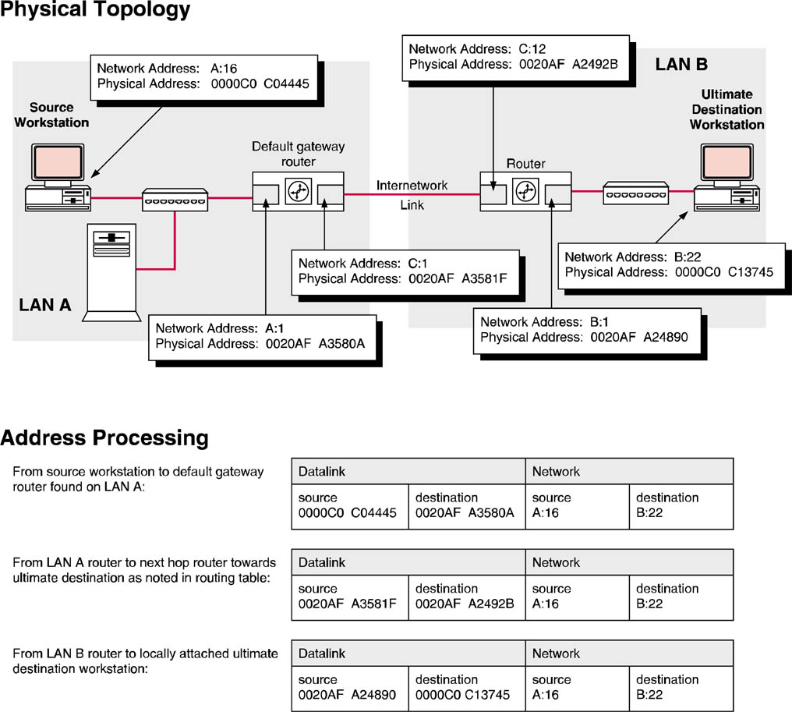
Routing as Address Processing

Slide 16
Routing Tables
Hosts and routers decide where to send packets by looking up the destination address in their routing table.
A routing table consists of a series of destination networks, the address of the local router that provides service to the destination network, and a cost associated with the route.
The cost is used to determine the best route in the event that there are multiple routes to the destination available.
Routing tables are protocol specific with different layer three protocols adding different fields to the routing table.

Slide 17
Routing Tables
To view your devices routing table, type “route print” at the command prompt.

Slide 18
Routing Protocols
There are two classes of routing protocols: interior and exterior gateway protocols.
The difference between interior and exterior gateway protocols is the scope of the routing information they distribute.
Interior gateway protocols distribute routing information within a hierarchical address space.
These Autonomous Systems (AS), can be interconnected into an internetwork.
Exterior gateway protocols reference the AS number of a network.

Slide 19
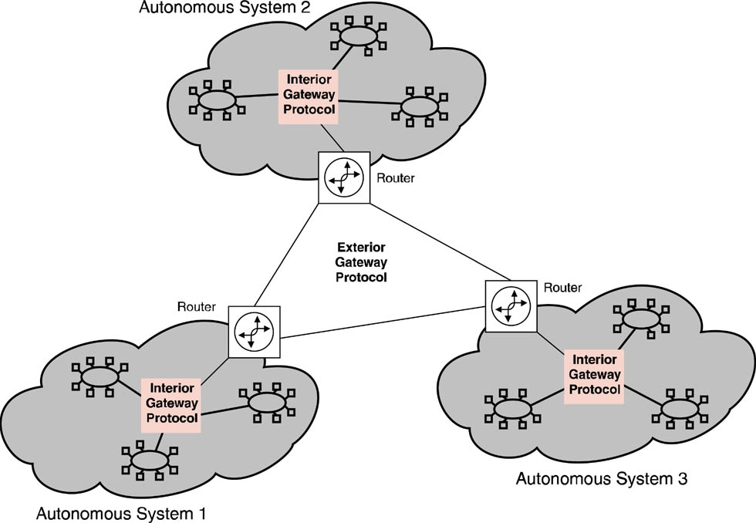
Routing Protocols

Slide 20
Interior Routing Protocols
Interior routing protocols come in two types:
Distance Vector
Link State
Distance Vector Routing Protocols:
Broadcast entire routing table periodically.
Slow to update changes to network.
Link State Routing Protocols:
Transmit a more complete picture of the network by using Link State Packets (LSP).
Each router is informed of entire network structure.
Faster to update network/more informed route selection.

Slide 21
The Transport Layer
The fourth layer of the OSI Model is the Transport layer (a.k.a. Host-to-Host layer)
Transport layer protocols are usually connection-oriented and therefore provide “reliable” data transmission.
Transport layer also provides error control and correction, and flow control.

Slide 22
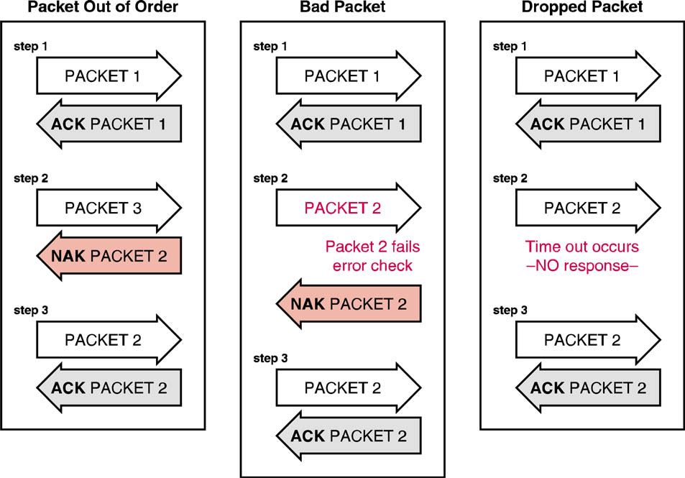
Connection-Oriented Error Correction
The destination host acknowledges the correct receipt of a packet by sending an ACK.
If a packet fails the error check upon receipt, the destination host responds with a NAK.
If destination host sends no response, sending host re-transmits packet.

Slide 23
The Session Layer
The fifth layer of the OSI model is the Session layer
Maps to the top part of the TCP/IP Transport layer in the DOD model
Responsible for establishing, maintaining, and terminating logical sessions between applications
Uses ports and sockets

Slide 24
Port Numbers
A port number is how a computer knows which (Application Layer) API should process a message
Common Port Numbers
20, 21 = FTP
23 = Telnet
25 = SMTP
53 = DNS
67 = BootP Server/DHCP
80 = HTTP
110 = POP

Slide 25
Sockets
Sockets consist of:
Port # + Transport Layer Protocol + Network Address
Example:
25 + TCP + 192.168.1.45

Slide 26
The Presentation Layer
Layer 6 of the OSI model is the Presentation layer.
Responsible for formatting data.
Encryption and compaction of data.
Converts between data communications codes (EBCDIC to ASCII).

Slide 27
The Application Layer
Layer 7 of the OSI model is the Application layer
Provides data transmission services to user applications
Services are provided via Application Programming Interfaces (APIs)
APIs include: http, ftp, snmp, smtp, tftp, telnet, DHCP, and DNS

Slide 28
Local Area Network Protocols
IPX/SPX
Apple Talk
TCP/IP
NetBEUI/NetBIOS
DLC

Slide 29
Netware Protocol Suite
The IPX/SPX protocol suite was originally developed by Novell for its NetWare network operating system
IPX/SPX is also found in older Microsoft client operating systems and in Microsoft Server OS

Slide 30
IPX
IPX serves as a basic delivery mechanism for upper-layer protocols such as SPX, RIP, SAP, and NCP.
This delivery mechanism is accomplished through encapsulation
Upper-layer protocols are encapsulated within properly addressed IPX “envelopes.”

Slide 31
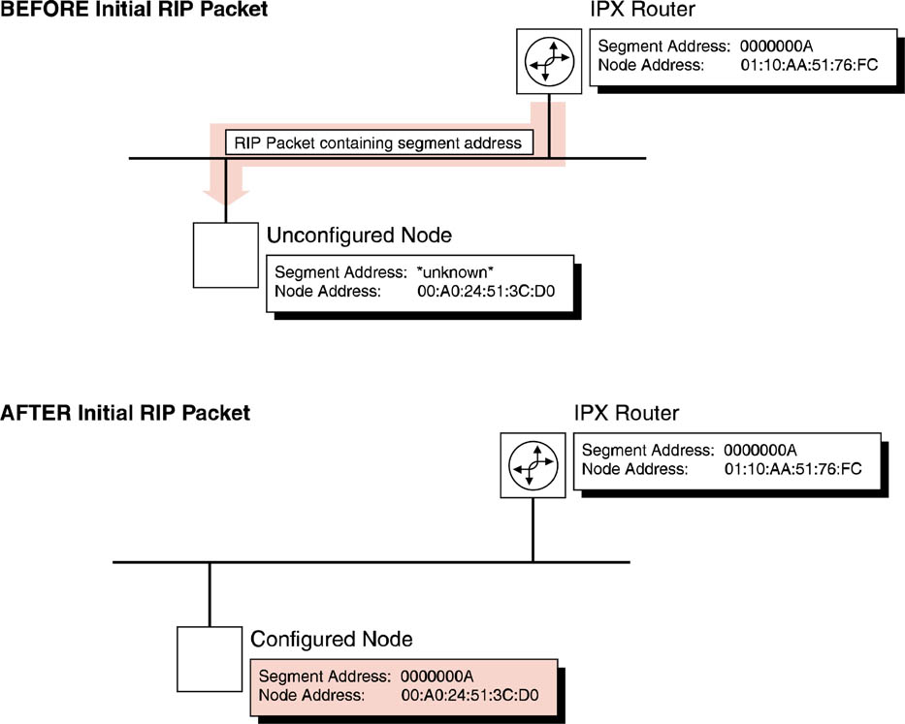
IPX Segment Address Assignment
Assignment of segment address to IPX network hosts is a two-part sequence

Slide 32
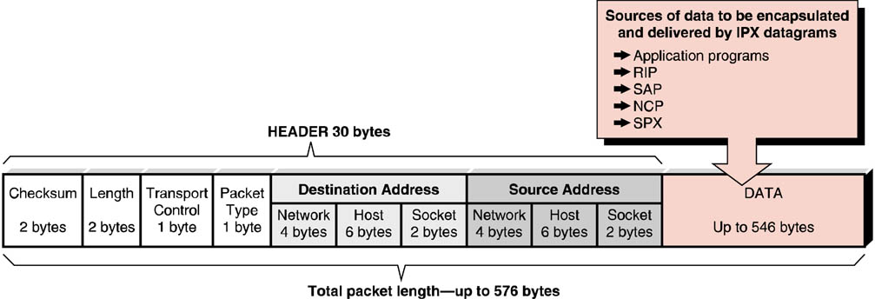
IPX Packet Layout
IPX packets can carry a payload of up to 546 bytes of encapsulated data.
Packet delivery is controlled with a 30-byte packet header consisting of multiple fields.

Slide 33
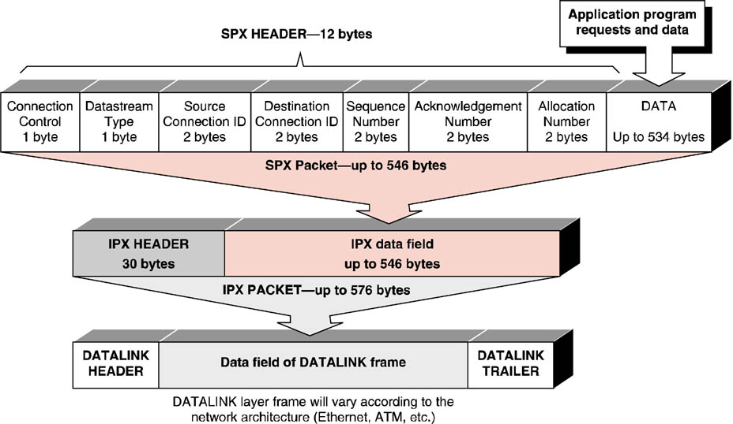
SPX Layout and Encapsulation
Sequenced Packet Exchange (SPX) is a Transport/Session layer protocol that can be used with IPX to provide reliable communication.

Slide 34
SPX – Connection-Oriented
Specific paths known as virtual circuits are explored and determined prior to the first packet being sent.
Once the virtual circuit is established, all packets bound for that address follow each other in sequence down the same physical path.
Virtual circuits are important when the source host and destination host reside on different networks.

Slide 35
SPX - Reliable
SPX requires error checking and acknowledgment in order to assure reliable receipt of transmitted packets.
SPX adds sequence numbers to assure that all pieces are received and that they are reconstructed in the proper order.
SPX also has mechanisms to institute flow control.

Slide 36
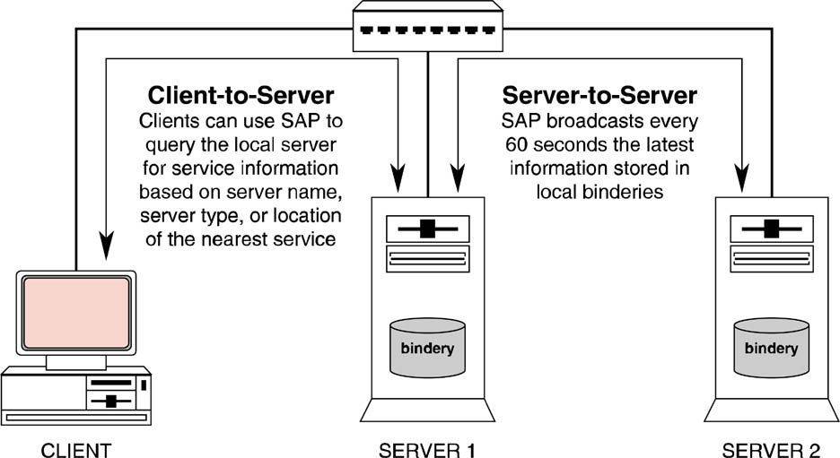
Service Advertising Protocol
SAP is used by network servers to advertise the services they provide.
Servers broadcast this information every 60 seconds.

Slide 37
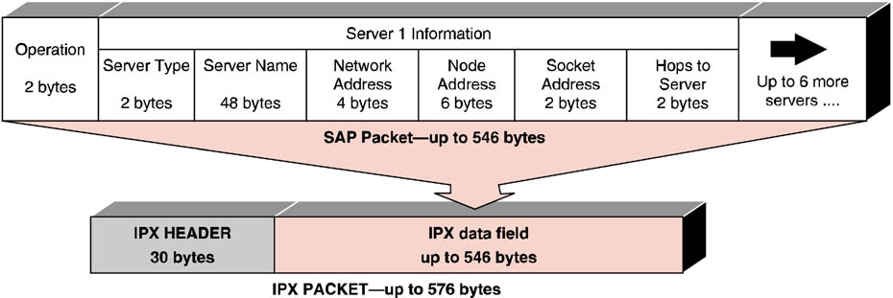
SAP Layout and Encapsulation

Slide 38
The Internet Suite (TCP/IP)
TCP/IP was developed during the 1970s and widely deployed during the 1980s under the auspices of DARPA, to meet DOD’s need to have a wide variety of different computers be able to inter-operate and communicate.
TCP/IP has become the de-facto standard for communication between heterogeneous networked computers – thanks to the popularity of the Internet

Slide 39
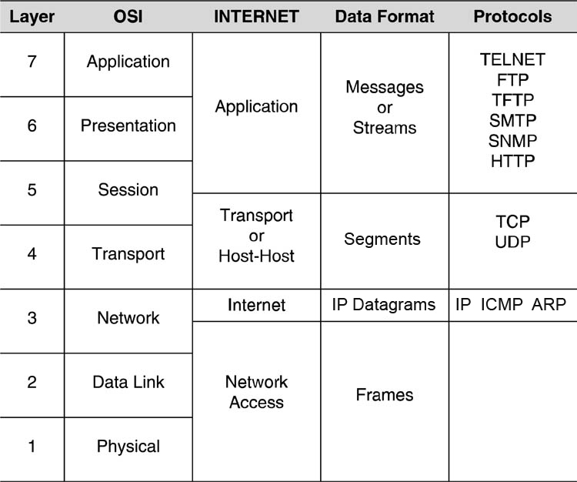
The TCP/IP Model
Also known as the DOD or Internet Model.
Although not identical to the OSI Model, the TCP/IP Model is no less effective at organizing protocols required to establish and maintain communications between different computers.

Slide 40
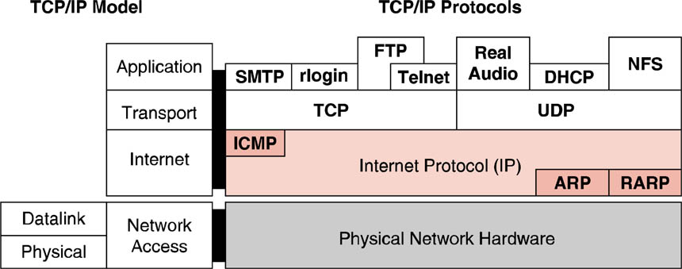
TCP/IP Suite of Protocols
This illustrates the placement of many of the TCP/IP family of protocols into their respective layers of the TCP/IP model

Slide 41
The IP Address
IPv4 addresses are 32 bits long and are represented as a sequence of four octets
Each octet is a decimal representation of an 8-bit section of the overall IP address

Slide 42
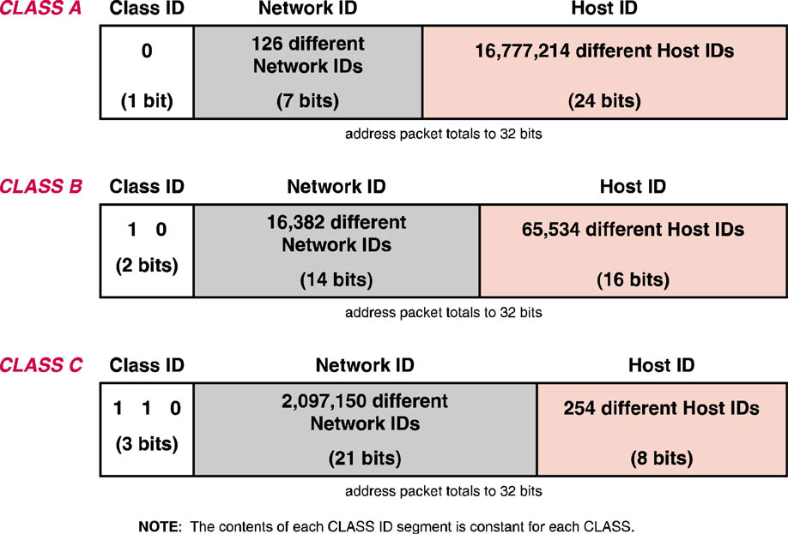
IPv4 Class Addressing
IP addresses contain both the network segment and host addresses.
The original IPv4 specification provided the ability to differentiate segment and host addresses through the use of address classes.

Slide 43
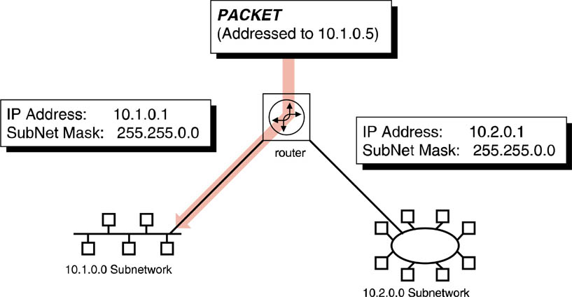
Routing with Subnetting
Subnet mask on gateway interface: 255.0.0.0
The gateway router accepts all packets destined for the 10.x.x.x network and routes them based on class B subnet­working where the second octet has been made part of the network address rather than part of the host address.

Slide 44
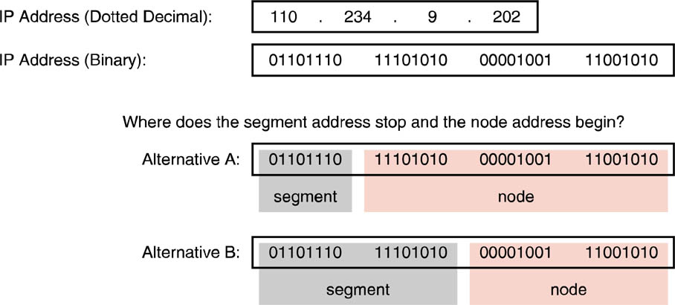
IP Segment Address vs. Host Address
There must be a way of identifying which bits are used for each portion of the overall address.
This is accomplished via a subnet mask.

Slide 45
Subnet Masks
Subnet Masks have two functions:
Separate (mask) the Segment (Network) portion of a host IP address from its Node (Host) address.
Determine if the destination IP address of a packet is local (same segment as sender) or remote (different segment from sender)

Slide 46
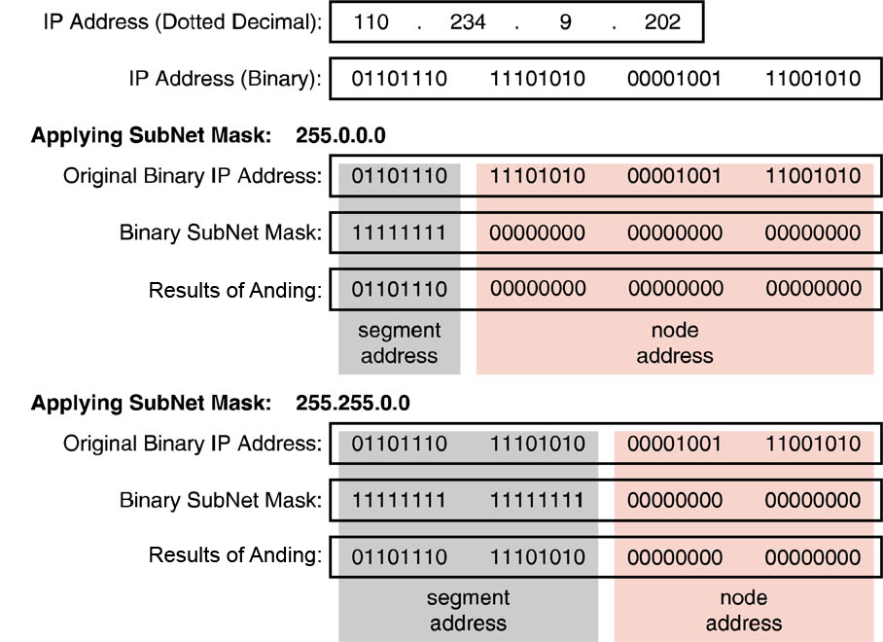
Use of Subnet Masks
A subnet mask is a 32-bit binary sequence that divides the IP address by using a 1 to indicate that the corresponding position is part of the segment address and by using a 0 to indicate that the corresponding portion is part of the host address

Slide 47
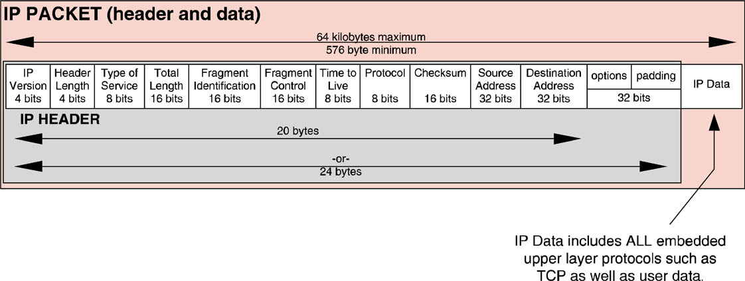
IPv4 Packet Header

Slide 48
Private Addressing & Network Address Translation (NAT)
One way to cope with the depletion of IP addresses is through the use of private addressing.
The Internet Corporation for Assigned Names & Numbers (ICANN) has set aside three ranges of private IP addresses.
10.0.0.0/8
172.16.0.0/12
192.168.0.0/16
Traffic using these address ranges must remain on the organization’s private network.
Computers on a network using a private IP address space send and receive traffic to/from the Internet by using NAT.
NAT is provided by a router.

Slide 49
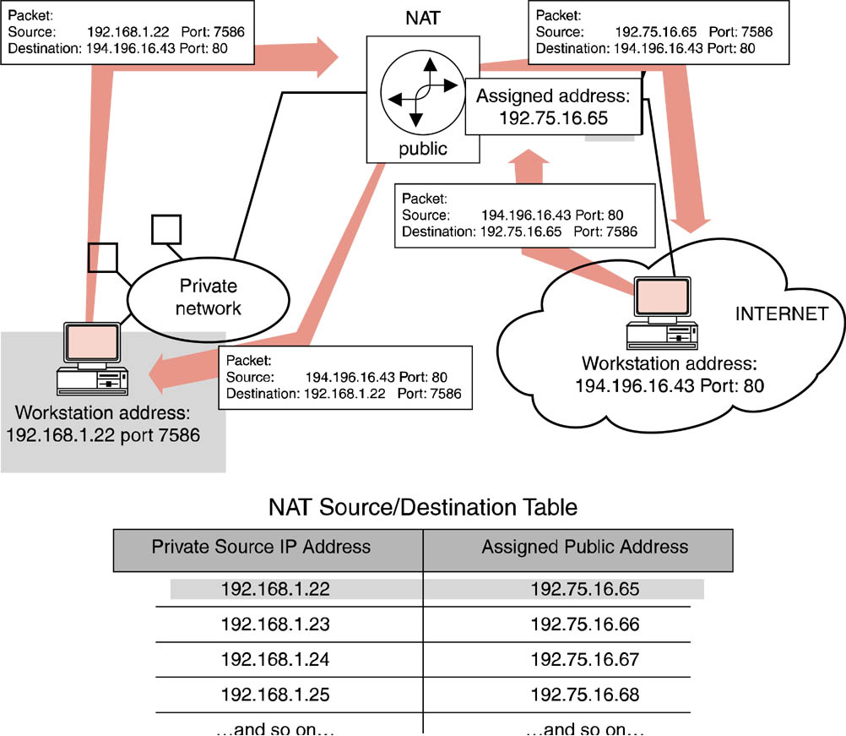
Static Network Address Translation

Slide 50
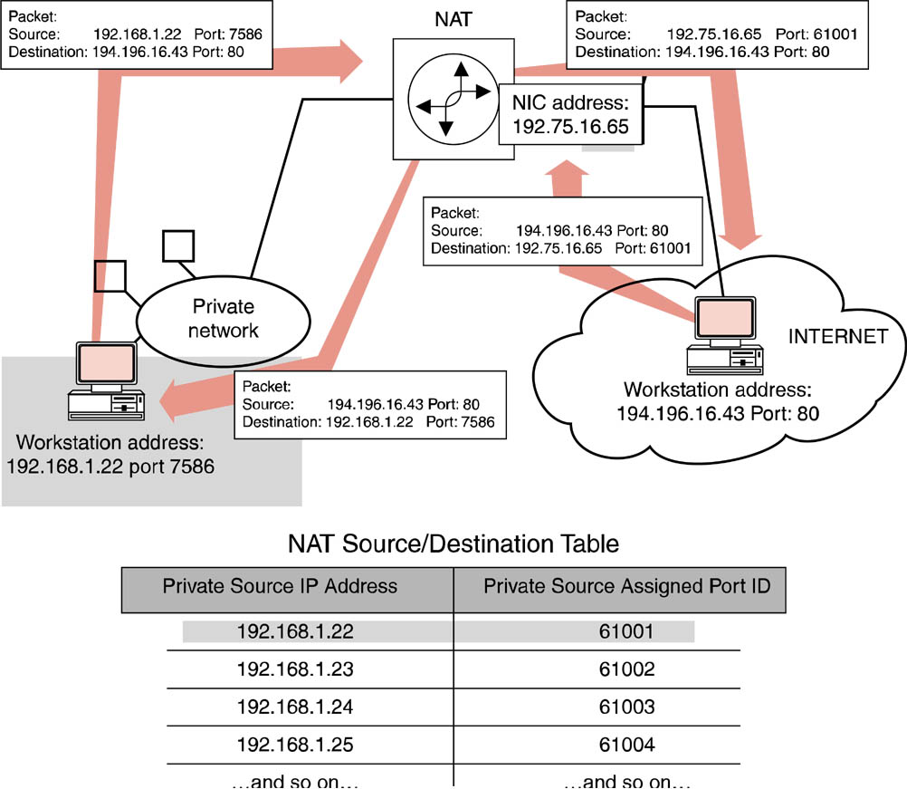
Dynamic Network Address Translation

Slide 51
ICMP Protocol Layout
The Internet Control Messaging Protocol (ICMP) delivers a variety of error status and control messages related to the ability of IP to deliver its encapsulated payloads.
The most common use of ICMP from the user’s perspective is checking for network connectivity between two hosts using PING.

Slide 52
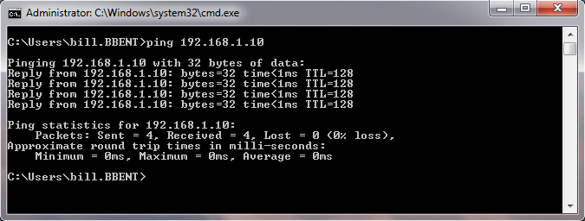
PING
PING uses ICMP packets to test network connectivity

Slide 53
UDP Header Layout
User Datagram Protocol (UDP) is used to provide unreliable, connectionless messaging services for applications.
RIP and streaming video/audio use UDP at the Transport layer.

Slide 54
Transmission Control Protocol (TCP)
Connection-oriented.
Reliable data transmission.
Guarantees delivery through of acknowledgements (ACKs/NAKs).
Transport/Session layer protocol.

Slide 55
TCP Header Layout
Reliability is assured through the additional fields contained within the TCP header that offer flow control, acknowledgments of successful receipt of packets after error checking, retransmission of packets as required, and proper sequencing of packets.

Slide 56
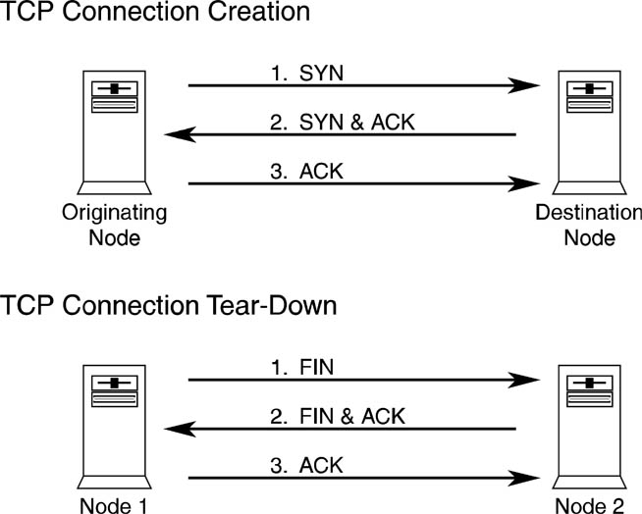
Connection Creation & Tear Down
A point-to-point connection between source and destination computers is established before transmission begins.
The connection is torn down after transmission has concluded.

Slide 57
Dynamic Host Configuration Protocol
The Dynamic Host Configuration Protocol (DHCP) is used to dynamically assign IP addressing and configuration information to TCP/IP hosts
Servers and printers don’t make good DHCP clients (moving targets).

Slide 58
NetBEUI, DLC & LPR
Do NOT implement a Network layer protocol.
Can NOT be routed in a multi-segmented network.
Can be encapsulated in other protocols like PPP or PPTP to add routing capabilities.

Slide 59
Line Printer Requestor (LPR)
Used on TCP/IP based networks to access printers
Application layer protocol
Most network printers support the LPR protocol

