Slide 1
Chapter 6
Wide Area Networking Concepts, Architectures, & Services
https://cis.BBent.com/Courses/CSIS202/Lessons/6

Slide 2
This Chapter Focuses On:
WAN Business Principles/Specifications
WAN Transmission Technologies (Phy)
T1 and SONET
WAN Switching Technologies (DataLink)
Circuit Switched/Packet Switched
WAN Architectures
X.25, Frame Relay, ATM, and MPLS
WAN Evolution

Slide 3
Network Design Principles
Performance
Cost Reduction
Security/Auditing
Availability/Reliability
Manageability & Monitoring
Quality of Service/Class of Service
Support for Business Recovery Planning

Slide 4
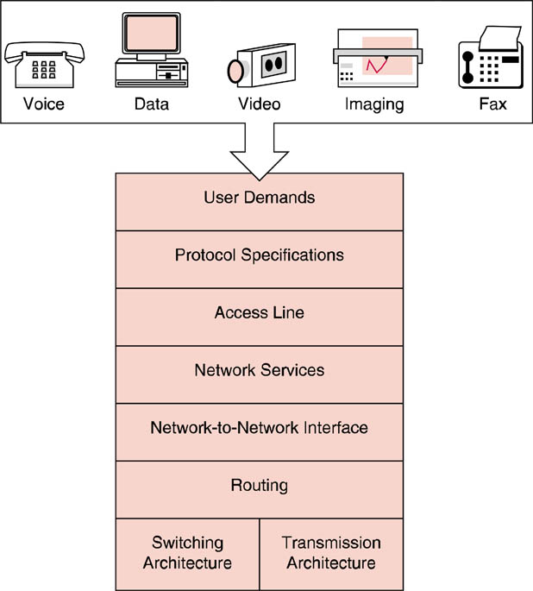
WAN Components/Convergence
A convergence of data, voice, and video
Driving force behind evolution of WAN network services
Interface Specifications
Interoperability among equipment
Customer bandwidth
Telco to customers
AT&T to Verizon
Packet forwarding through switches
Circuit or Packet Switching
Copper, Fiber, Microwave, Satellite

Slide 5
WAN Specifications

Slide 6
WAN Transmission
The standard for digital transmission circuits in North America is known as a T-1 with a bandwidth of 1.544Mbps.
The E-1 standard for digital transmission utilized in other parts of the world provides a bandwidth of 2.048Mbps.

Slide 7
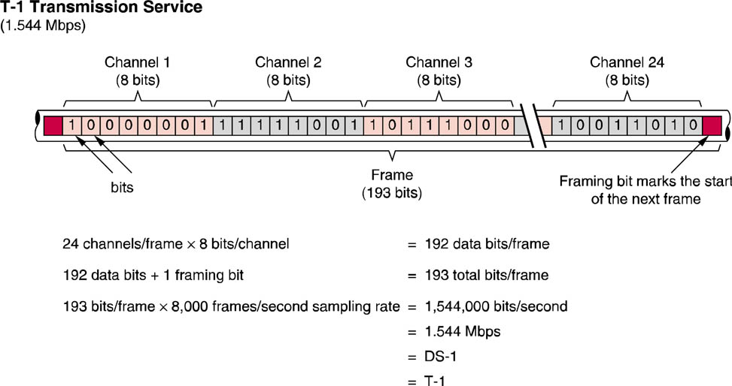
WAN Transmission
T-1 Frame Layout
A T-1 frame consists of a framing bit and twenty-four DS-0 channels, each containing eight bits, for a total of 193 bits per frame

Slide 8
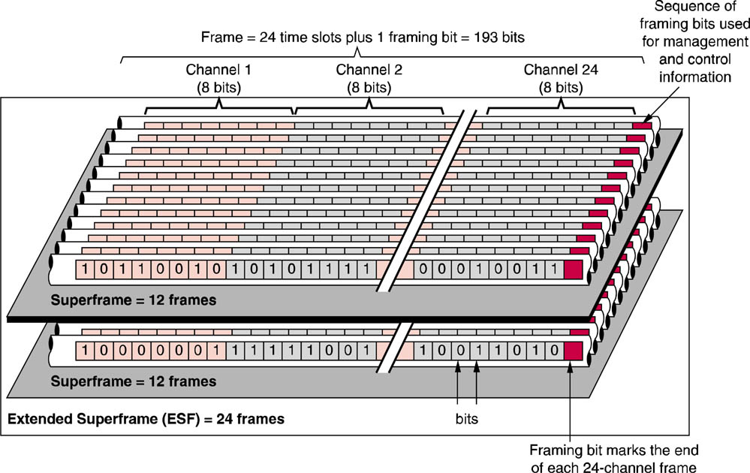
WAN Transmission
Superframes and Extended Superframes

Slide 9
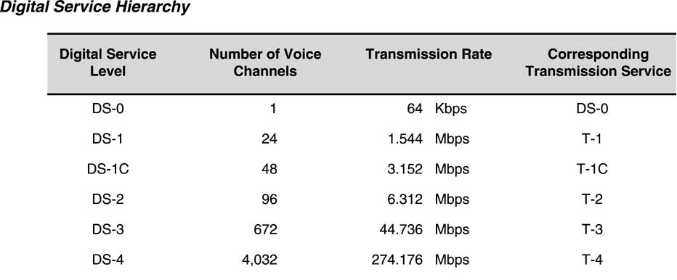
WAN Transmission
U.S. Digital Service Hierarchy
T-1 and T-3 are by far the most common service levels delivered
T-1 service is most often delivered via 4 copper wires (2 twisted pair)
T-3 service is most commonly delivered via optical fiber

Slide 10
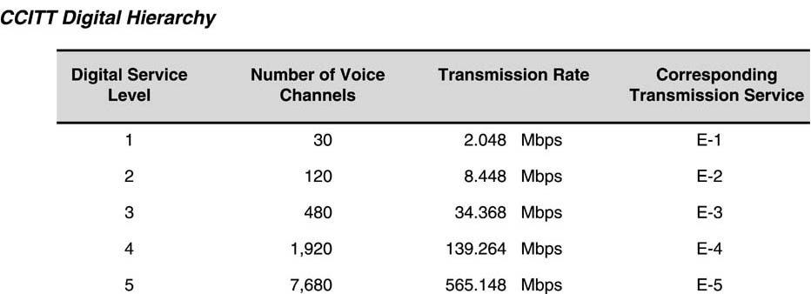
WAN Transmission
International Telecommunications Union (ITU) Digital Hierarchy

Slide 11
T-1 Technology
The fundamental piece of T-1 hardware is the T-1 CSU/DSU (Channel Service Unit/Data Service Unit).
This device interfaces directly to the carrier’s termination of the T-1 service at the customer premises.
A T-1 is commonly delivered as a 4-wire circuit (2 wires for transmit and 2 for receive) physically terminated with a male RJ-48c connector.
Most T-1 CSU/DSUs provide the corresponding RJ-48c female connector to interface with the male counterpart provided by the carrier.

Slide 12
T-1 Technology
The T-1 CSU/DSU will transfer the 1.544 Mbps of bandwidth to local devices over high speed connections such as V.35, RS-530, RS-449 or Ethernet that are provided on the customer side of the CSU/DSU.
A CSU/DSU are often able to communicate status and alarm information to network management systems via the Simple Network Management Protocol (SNMP).

Slide 13
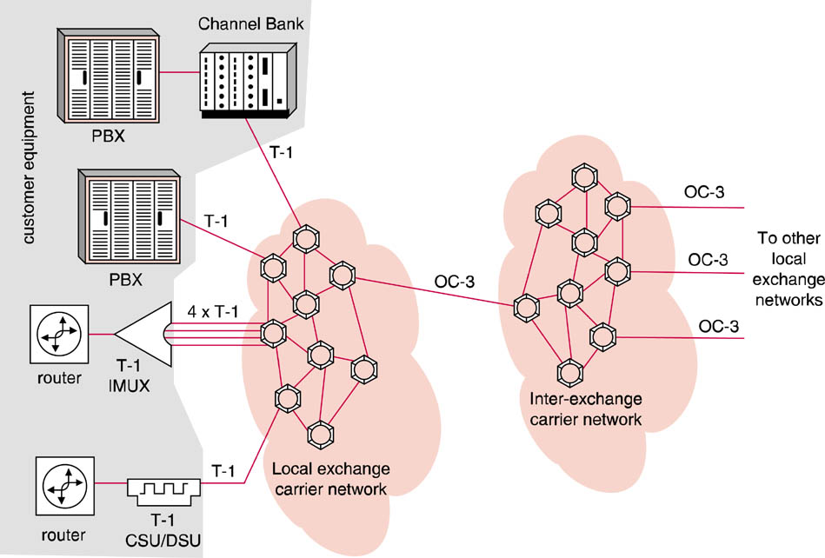
T-1 Technology Implementation

Slide 14
SONET and SDH
SONET (Synchronous Optical Network) is an optical transmission service in the U.S. that makes use of TDM techniques to deliver high bandwidth
The difference between T-1 and SONET is the higher transmission capacity of SONET due to its fiber optic media and the slightly different framing techniques
ANSI T1.105 and T1.106 standards.
SDH - Synchronous Digital Hierarchy
Used in the rest of the world

Slide 15
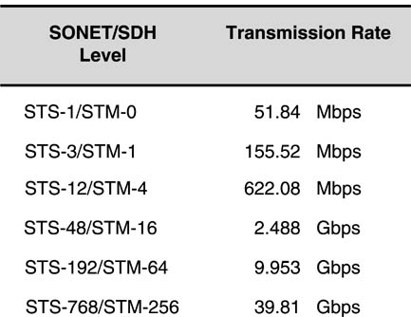
SONET and SDH Transmission Rates
Framing Methods
Synchronous Transports Service (STS)
Used in SONET
Synchronous Transport Model (STM)
Used in SDH
STS-3073/STM-1024 159.25 Gbps

Slide 16
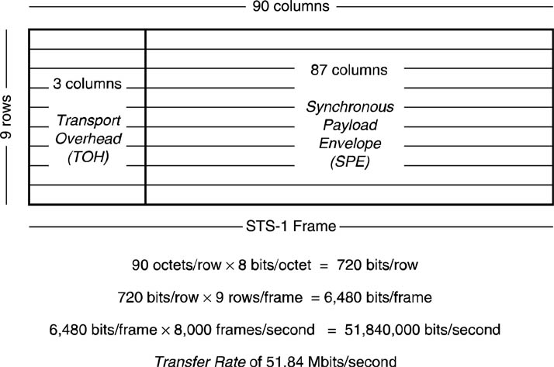
SONET Framing - STS
Column = 1 byte

Slide 17
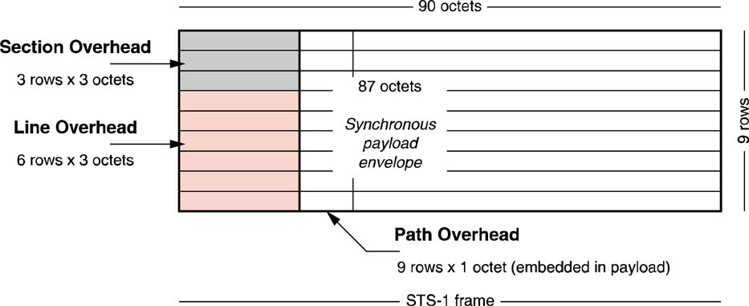
SONET Framing - STS
Section Line and Path Overhead in a SONET Frame

Slide 18
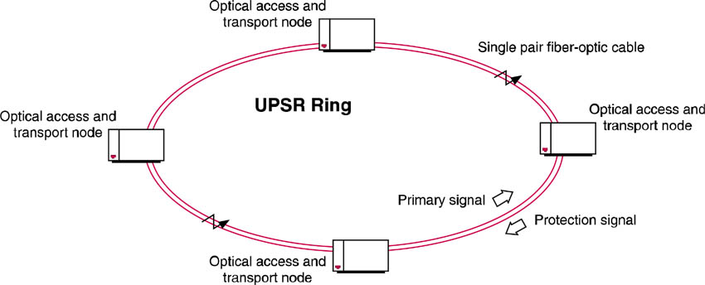
SONET UPSR Topology
UPSR = unidirectional path-switched ring

Slide 19
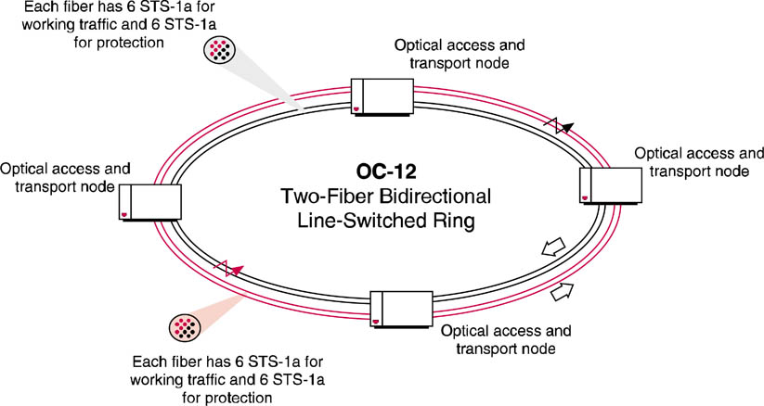
SONET BLSR Topology
BLSR = bidirectional line-switched ring

Slide 20
Wavelength Division Multiplexing (WDM)
Increases SONET network capacity by transmitting more than one wavelength (color) of light simultaneously on a given single-mode fiber
Wavelengths are 50 and 100 GHz apart
Dense Wavelength Division Multiplexing (DWDM)
1 Tbps on a single fiber (theoretically)
Individual wavelengths are called “lambdas”

Slide 21
WAN Network Switching
Switching allows temporary connections to be established, maintained and terminated between message sources and message destinations.
There are two primary switching techniques employed: circuit switching and packet switching.

Slide 22
WAN Network Switching
Circuit Switched
Leased-Lines (always on)
Point-to-Point
Dial-Up
Telephone (land lines)
Integrated Digital Services Network (ISDN)
Demand-Dial Routing (DDR)

Slide 23
WAN Network Switching
Packet Switched
X.25 (original packet switching)
Frame Relay (fast packet switching)
Cell Relay (fast packet switching)
Asynchronous Transfer Mode (ATM)
Multiprotocol Label Switching (MPLS)

Slide 24
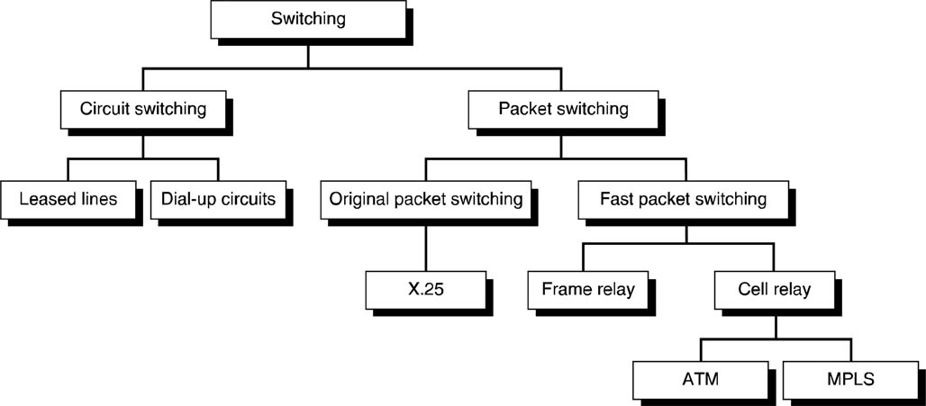
Switching Technologies
ISDN

Slide 25
Circuit Switched WAN
In a circuit switched network, a switched dedicated circuit is created to connect two or more parties, eliminating the need for source and destination address information.
Two types of circuit switched WANS
Leased-lines (dedicated, always on)
Dial-up (like a phone call)

Slide 26
Leased-Lines
Lines are usually leased from a carrier and thus are often called leased-lines
A.k.a. Point-to-Point links
A single, pre-established WAN communications path from the customer premises through a carrier network, such as a telephone company, to a remote network

Slide 27
Leased-Lines
Carrier allocates pairs of wire and facility hardware to your line only
Circuits are generally priced based on bandwidth required and distance between the two connected points
Point-to-point links are generally more expensive than shared services such as Frame Relay

Slide 28
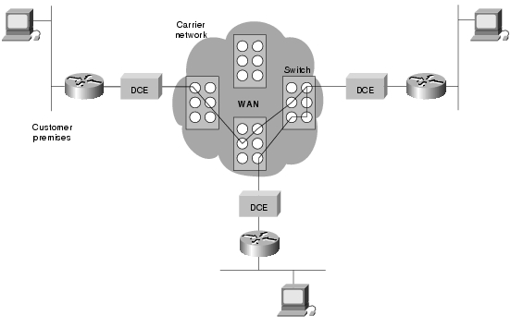
Leased-Lines
Example of a leased-line (always-on) circuit switched WAN.

Slide 29
Leased-Lines
Link between LANs in a leased (always-on) circuit
Multiple messages are multiplexed between source & destination sites

Slide 30
Dial-Up
Data connections that can be initiated when needed and terminated when communication is complete (like a telephone used for voice communication)
ISDN is a good example of dial-up circuit switching
When a router has data for a remote site, the switched circuit is initiated with the circuit number of the remote network
In the case of ISDN circuits, the device actually places a call to the telephone number of the remote ISDN circuit.
When the two networks are connected and authenticated, they can transfer data. When the data transmission is complete, the call can be terminated.

Slide 31
Dial-Up
Phone or Modem (asynchronous or ISDN) initiates “call” to destination
Dedicated circuit exists only while connection is required

Slide 32
Packet Switched WAN
In a packet switched network, packets of data travel one at a time from the message source to the message destination.
The packet of data goes in one side of the Public Data Network (PDN) and comes out the other.
The physical path which any packet takes may be different than other packets and in any case, is unknown to the end users.
Packet switches pass packets among themselves as the packets are routed from source to destination.

Slide 33
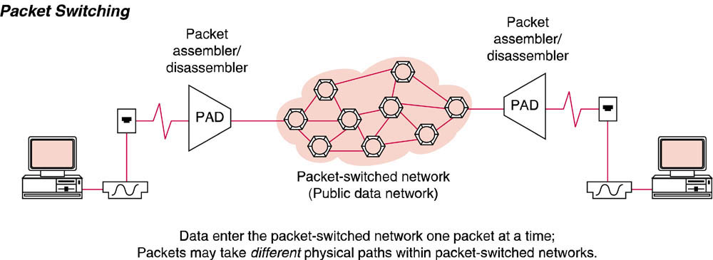
Packet Switched WAN

Slide 34
Packet Switched WAN
Users share common carrier resources
Cost is generally much better than with leased or dial-up point-to-point lines
In a Packet Switched WAN virtual circuits are created using one of two methods:
Connectionless
Connection Oriented

Slide 35
Connectionless Packet Switched Services
In order for a switch to process any packet of data, packet address information must be included on each packet
Each switch reads and processes the packet by making routing decisions based upon the destination address and network conditions
The full destination address uniquely identifying the ultimate destination of each packet is known as the global address.

Slide 36
Connectionless Packet Switched Services
Message pieces may arrive out of order at the destination due to the speed and condition of the alternate paths within the packet-switched network.
The data message must be pieced back together in proper order by the destination Packet Assembler Disassembler (PAD) before final transmission to the destination address.
These self-sufficient packets containing full address information plus a message segment are known as datagrams.
No error-detection or flow control techniques are applied by a connectionless packet-switched network
End-user devices (PCs, modems, communication software) must provide error and flow control

Slide 37
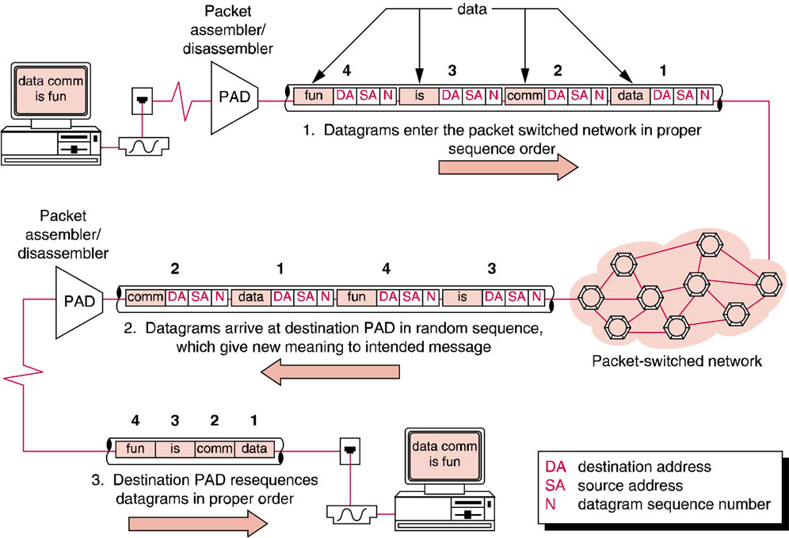
Connectionless Packet Switched Services
Datagram delivery in a connectionless network
Notice that datagrams arrive out of order

Slide 38
Connection-Oriented Packet Switched Services
Establish Virtual Circuits enabling packets to follow one another, in sequence, over the same connection or physical path (logical channel)
Call set-up packets determine best path
Offers checksum error-detection with ACK/NAK retransmission and flow control
Packets do not require global addressing, instead use abbreviated Logical Channel Number (LCN)
Virtual Circuit Table contains details relating LCN to a physical circuit consisting of the actual series or specific packet switches

Slide 39
Connection-Oriented Packet Switched Services
Reduced Overhead
LCNs as opposed to full global addresses reduces overhead
Increased overhead
Connection set-up
Network-based, point-to-point error detection and flow control
Business application will determine best choice

Slide 40
Virtual Circuits
Connection-oriented packet switched connections between customer sites are referred to as a virtual circuit
There are two types of virtual circuits:
Switched Virtual Circuits (SVCs)
Permanent Virtual Circuits (PVCs)

Slide 41
Switched Virtual Circuit (SVC)
Connection is terminated when the complete message has been sent
Clear request packet causes all SVC table entries related to connection to be erased

Slide 42
Permanent Virtual Circuit (PVC)
Virtual circuit table is not erased when message is complete
PVC is the equivalent of a “virtual” circuit-switched leased line

Slide 43
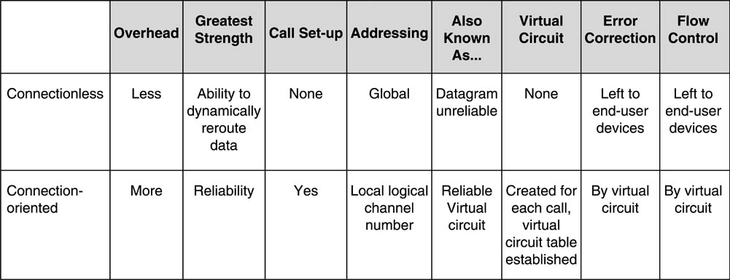
Packet Switching Comparison
Connection-oriented vs.Connectionless Packet Switched Networks

Slide 44
WAN Architectures
X.25
Frame Relay
Asynchronous Transfer Mode (ATM)
Multiprotocol Label Switching (MPLS)

Slide 45
X.25
X.25 is an international ITU-T standard which defines the interface between Terminal Equipment (DTE) and any Packet Switched Network
X.25 does not define standards for what goes on inside the network.
One of the most common misconceptions is that the X.25 standard defines the specifications for a packet switching network

Slide 46
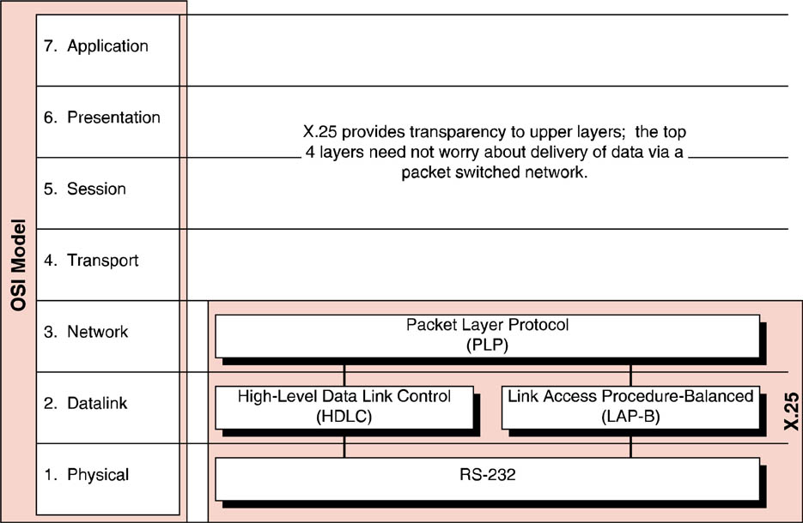
X.25
X.25 and the OSI Model

Slide 47
X.25
X.25 Datalink layer

Slide 48
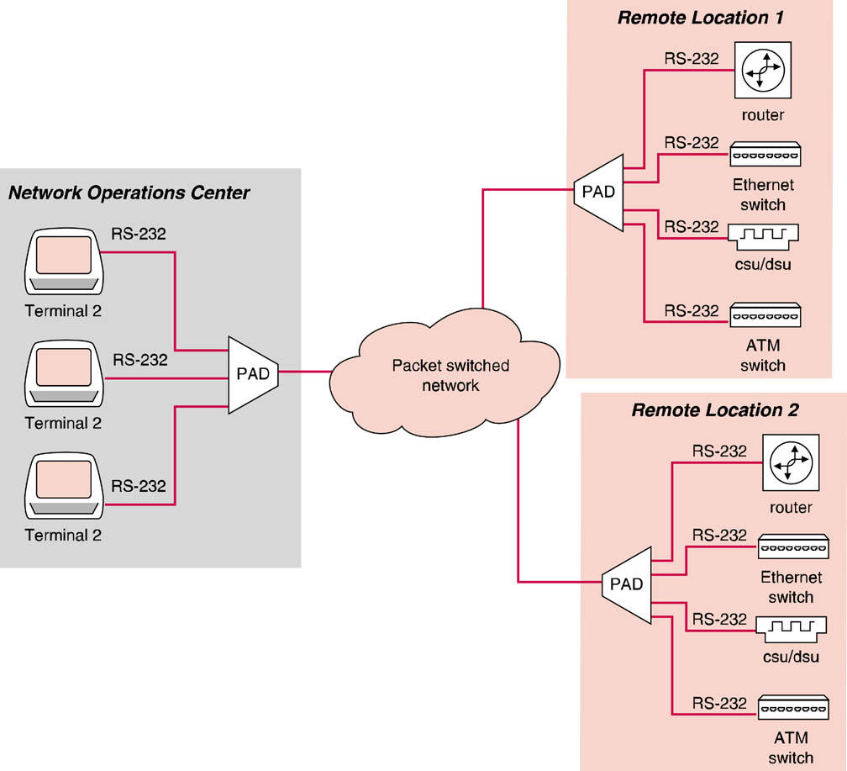
X.25
X.25 implementation

Slide 49
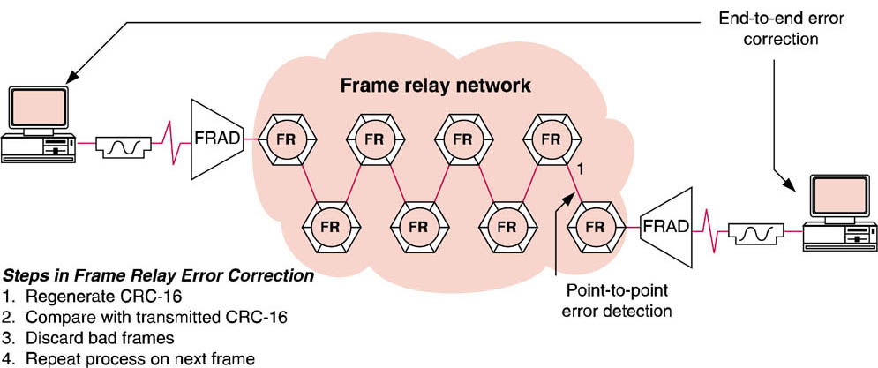
Frame Relay Error Correction

Slide 50
Frame Relay Framing
DLCI = Data Link Connection Identifier

Slide 51
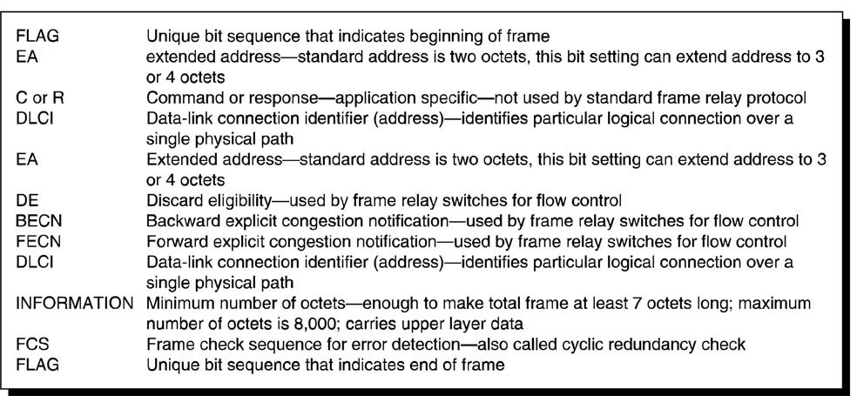
Frame Relay
Frame Layout key

Slide 52
Frame Relay
Before….

Slide 53
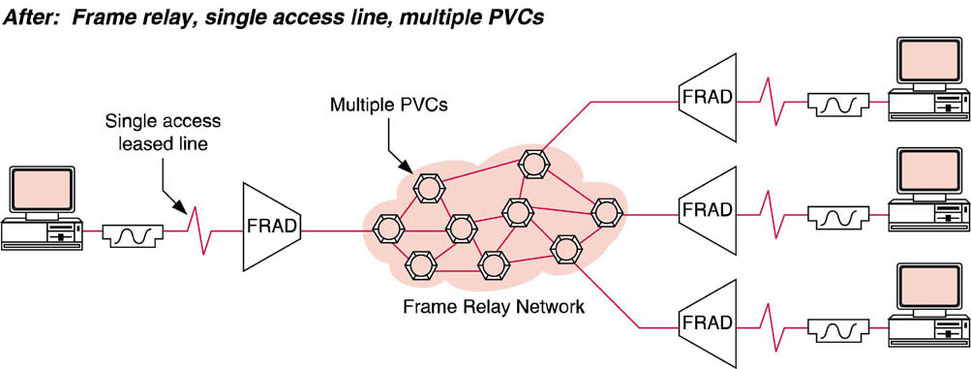
Frame Relay
After…

Slide 54
ATM
As ATM switches utilize very short, fixed-length cells, they process information much faster than frame relay switches.
Fixed-length cells allow for Virtual Circuits (VCs) to be forwarded in hardware as opposed to utilizing processor cycles for this purpose.
The fixed-length cells are enhanced with connection-oriented services.

Slide 55
ATM
The predictability and consistency of transmission of ATM are the features that make this technology a good choice for transporting real-time services
The lack of a predictable and consistent delivery of information was a key limitation of frame relay, which prevented the widespread use of this technology for converged applications.
Access to the ATM core is typically provided by T-carrier services (T-1 or T-3)

Slide 56
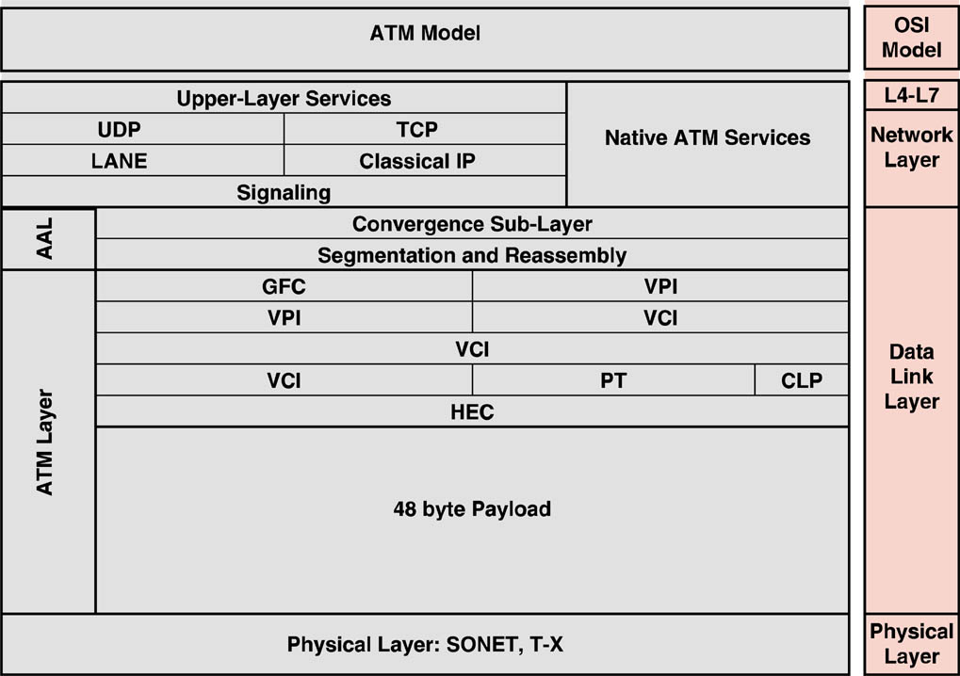
ATM
ATM vs. OSI

Slide 57
ATM
ATM UNI Cell Header

Slide 58
ATM
ATM NNI Cell Header

Slide 59
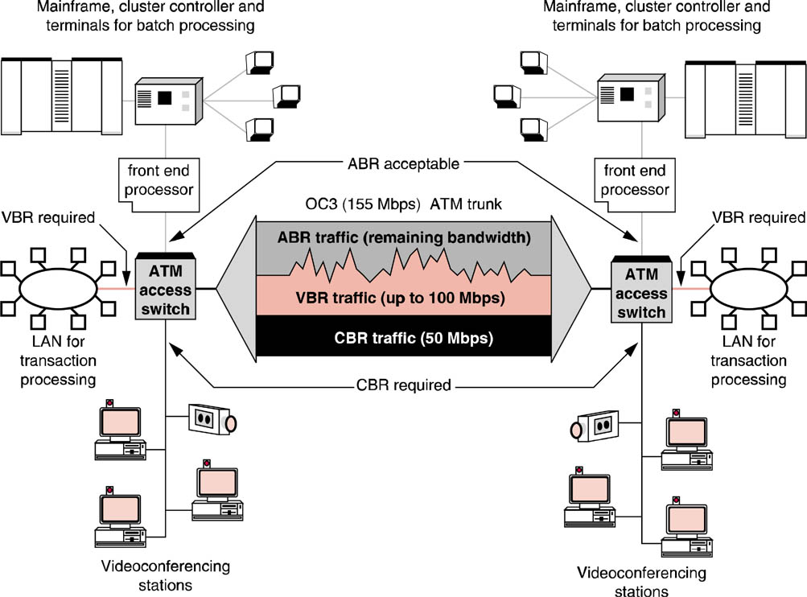
ATM
Bandwidth management

Slide 60
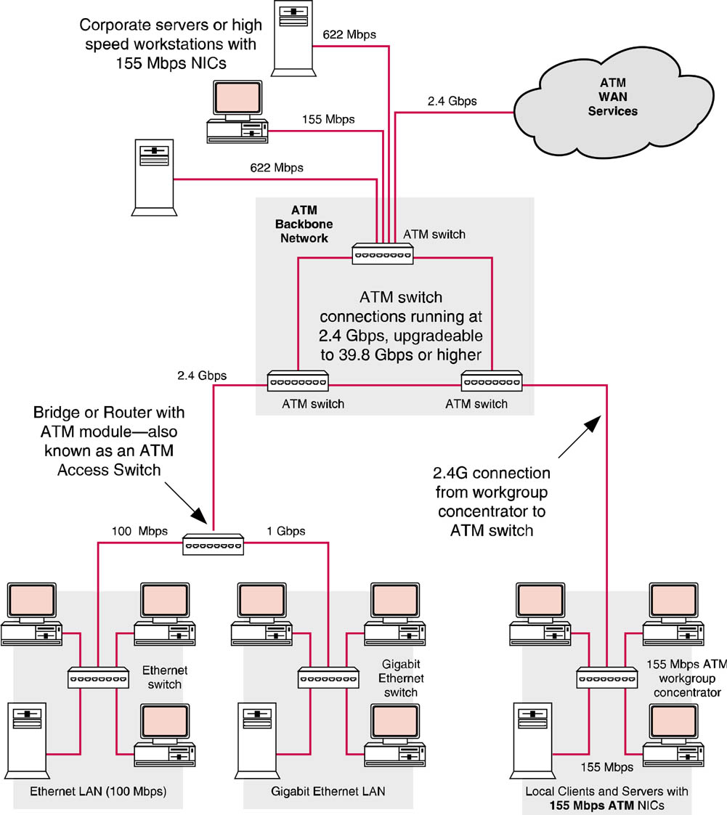
ATM Implementation

Slide 61
Multiprotocol Label Switching (MPLS)
Cell relay protocol
Uses Label Switched Paths (LSP)
Equivalent of ATM switched virtual circuit

Slide 62
MPLS 3-Level Architecture
Edge Layer
Typically non-MPLS devices
Ethernet switches, IP routers, etc.
Access Layer
LER responsible for encapsulating edge traffic in MPLS frames

Slide 63
MPLS 3-Level Architecture
Access Layer
Label Edge Router (LER) responsible for encapsulating edge traffic into MPLS frames
LER establishes, Maintains, and terminates label-switched paths through network core for non-MPLS devices

Slide 64
MPLS 3-Level Architecture
Core Layer
Formed by a mesh of Label Switch Routers (LSR)

Slide 65
WAN Evolution
Four layer model
Most advancements in Photonic Switching layer
Capacity of fiber is being increased using Dense Wavelength Division Multiplexing (DWDM)
Terabits/sec (Tbps) per fiber

Slide 66
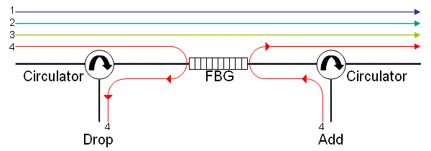
WAN Evolution
Optical Cross-Connects (OXC) reduce need for fiber to electrical conversion for routing
Optical Add/Drop Multiplexor (OADM)

