Slide 1
Chapter 4
Local Area Networks
https://cis.BBent.com/Courses/CSIS202/Lessons/1
Notes:
After mastering the material in this chapter you should:
1. Understand the value of the OSI Model in the analysis of network architecture
alternatives.
2. Understand how access methodologies, logical topologies, and physical
topologies combine to form alternative network architectures.
3. Understand the interaction between the various hardware and software
components of the local area network technology architecture.
4. Understand the major local area network technologies and their applications.
5. Understand basic wireless local area network technology architectures.
6. Understand how to implement, secure, and manage wireless local area networks.
7. Understand the differences between switched LAN architectures and
shared-media LAN architectures.
8. Understand the comparative differences between and proper application of
available network interface cards.
9. Understand the comparative differences between and the proper application
of hubs, concentrators, bridges, and switches.
10. Understand how proper LAN analysis can help determine which network
architecture is most appropriate in any given situation.
Access methodologies
Physical topologies
IEEE 802 standards
Ethernet
LAN hubs
Logical topologies
LAN architectures
LAN technology architectures
Wireless LANs (WiFi)
LAN switches
OSI Model
Hardware/software compatibility
Local area networks
Top-down model
Protocols and standards

Slide 2
Layer 2: The Datalink Layer
The datalink layer provides point-to-point connectivity between devices over the physical connections provided by the underlying physical layer
The datalink layer breaks a data stream into chunks called frames, or cells.

Slide 3
Layer 2: The Datalink Layer
The datalink layer provides a reliable communications link between devices.
Three key functions:
error detection
error correction
flow control
In LANs the datalink layer can be broken down into two sublayers: media access control (MAC) and logical link control (LLC).

Slide 4
Datalink Layer Addressing
MAC address is 48 bits long
Equal to 12 hexadecimal digits
1st 2 bits indentify the type of address
Next 22 bits identify the manufacturer
Last 24 bits are the unique serial number of the card
MAC example: 00-EO-15-9A-57-E6 (in hex)
000000001110000000010101100110100101011111100110 (in binary)
MAC addresses must be unique within each network segment

Slide 5
Datalink Layer Addressing
Broadcast
Send to all devices on a network segment
Destination MAC address is all 1’s
Unicast
Send to specific device
Destination MAC address of receiving device
Multicast
Send to a group of devices

Slide 6
Datalink Layer Addressing
Promiscuous Mode
Generally devices will ignore all messages NOT addressed specifically to their MAC address
In order for device to receive all messages being transmitted on a network segment it must be set to “Promiscuous Mode”

Slide 7
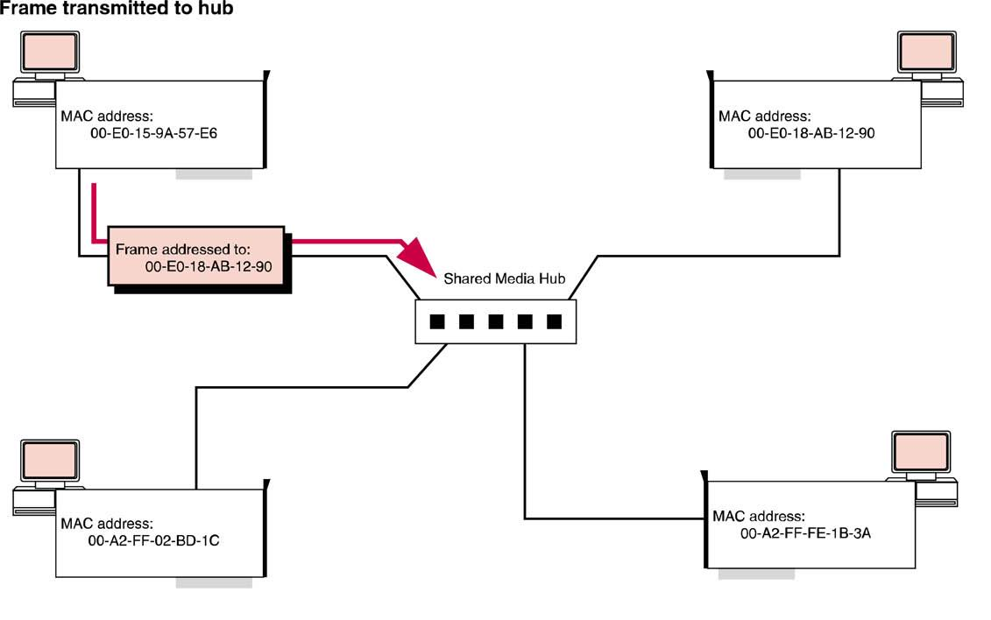
Datalink Layer Addressing
Frame transmitted to hub

Slide 8
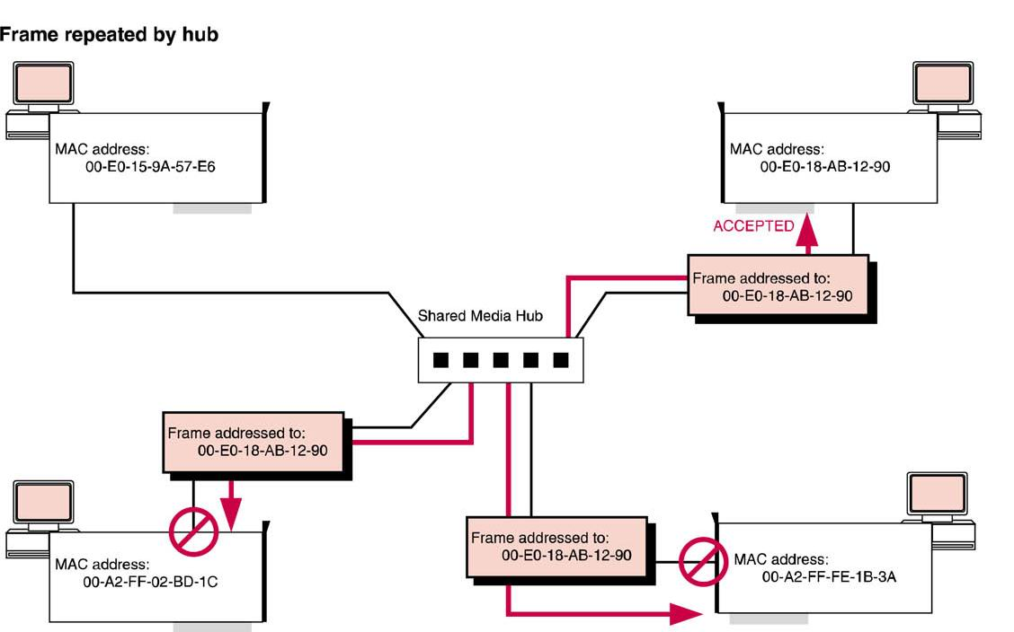
Datalink Layer Addressing
Frame repeated by hub
Note MAC addresses

Slide 9
Network Segments
Least precise term
All of the devices on a local area network that can be addressed directly w/o the use of a router or other layer 3 device

Slide 10
IP Subnet
Also referred to as just a “subnet”
A subdivision of an IP address space
May or may not map directly to a network segment in modern day switched networks

Slide 11
Collision & Broadcast Domains
Collision Domains
A collection of devices that share media directly
Only one device can transmit at a time
Broadcast Domains
The collection of devices that will hear a broadcast message sent at the DataLink layer regardless of network structure
The use of bridges and LAN switches allow a single network segment to be broken into multiple collision domains although they remain a part of the same broadcast domain

Slide 12
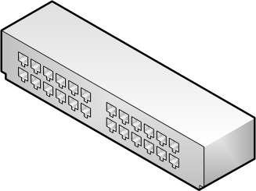
Collision & Broadcast Domains
All Computers are part of the same Collision and Broadcast domain
Hub or
Multi-Port Repeater

Slide 13
Collision & Broadcast Domains
All computers are still part of the same broadcast domain, but now each computer is in a separate collision domain
Switch
Collision Domain
Broadcast Domain

Slide 14
History of LAN Architectures
ALOHAnet (Univ. of Hawaii 1970)
Ethernet (Xerox 1973)
DECNet (Digital Equipment Corp. 1975)
ARCNet (Datapoint corp. 1976)
Token Ring (IBM 1985)
Local Talk (Apple 1985)
Wireless LAN/WLAN (IEEE 1991, Apple 1999)

Slide 15
LAN Architecture Model
A network’s architecture consists of a:
Access methodology
CSMA/CD, CSMA/CA, Token Passing, etc.
Logical topology
Sequential Access or Broadcast Access
Physical topology
Bus, Ring, Star, Mesh
No single architecture is best in all circumstances.
Network Configuration = Architecture + Media

Slide 16
Access Methodology
CSMA/CD
Carrier sense multiple access w/collision detection
Propagation Delay
Time it takes signal from source to reach destination
CSMA/CA
Carrier sense multiple access w/collision avoidance
Token Passing
Device makes request to transmit and must posses the “token” before it can transmit
Ensures transmitting device has 100% of channel

Slide 17
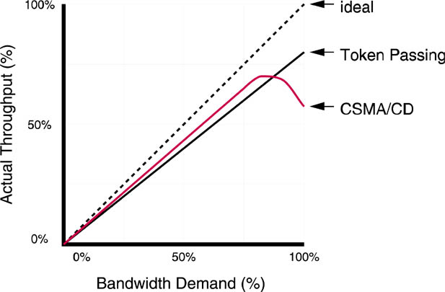
CSMA/CD vs. Token Passing
CSMA/CD becomes less efficient at high bandwidth demand.

Slide 18
Logical Topology
Method of Delivering Data
Sequential
Data is passed from one node to the next until it reaches its destination
Also known as a ring logical topology
Broadcast
Data is sent to all nodes simultaneously
Each node decides if data is addressed to it specifically

Slide 19
Physical Topology
Ring
Packets passed sequentially
Bus
Linear arrangement of devices
Terminators at both ends
Any loose connection downs entire LAN
Star
Used in most modern networks
Single point of failure
Mesh
Multiple paths between source & destination

Slide 20
LAN Technology Model
A LAN, regardless of network architecture, requires the following components:
A Central Wiring Concentrator
Hub, MAU, Concentrator, or LAN Switch
Media
Network Interface Cards (NICs)
Physical link between PC & media
Network Interface Card Drivers
Interface between NIC & Operating System (OS)
Network OS & Applications

Slide 21
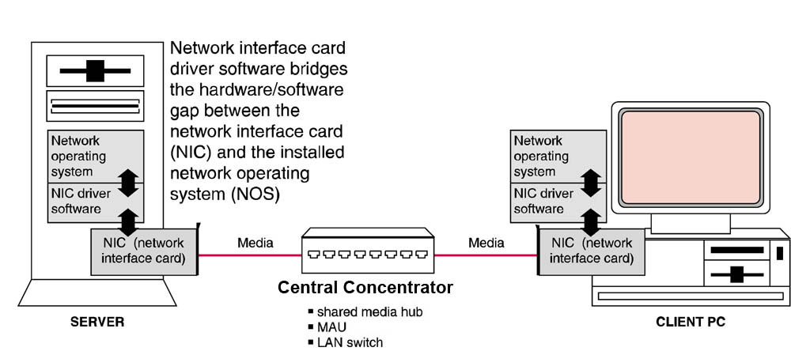
LAN Technology Architecture

Slide 22
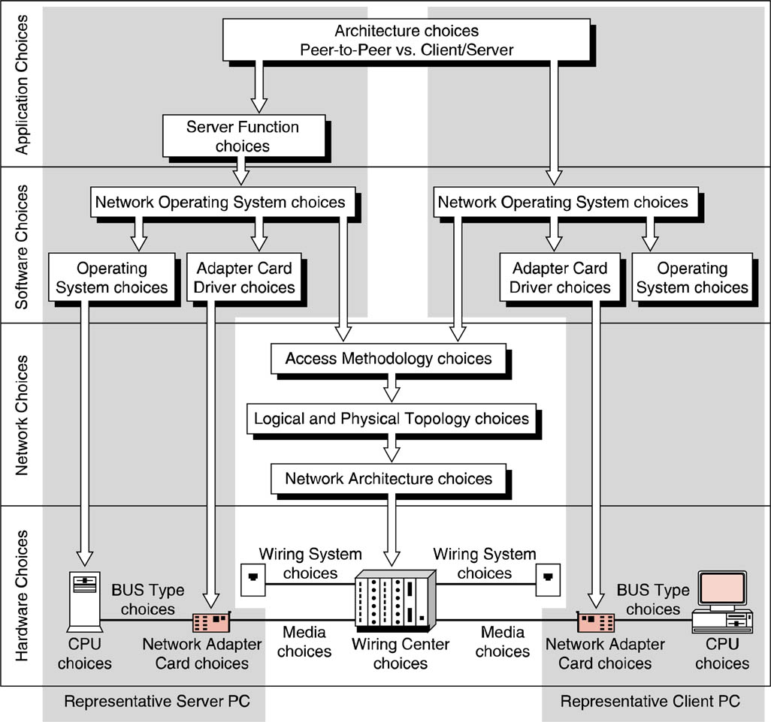
LAN Technology Choices

Slide 23
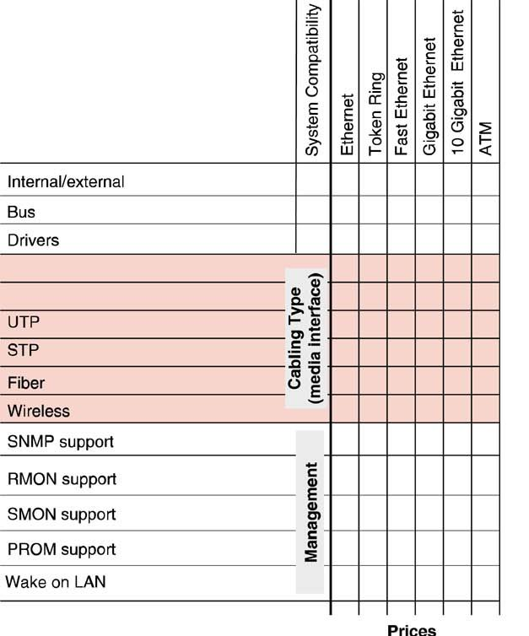
NIC Technology Analysis Grid
Servers should contain faster NICs than clients to prevent bottlenecks
NICs need to be compatible with CPU bus, chosen media, & network architecture

Slide 24
Ethernet
“Born” May 22, 1973
Based on Aloha Net (Univ. of Hawaii)
Invented by Robert Metcalfe
MIT graduate
Developed Ethernet with Robert Boggs at Xerox’s Palo Alto Research Center (PARC)
Founder of the 3COM company
Robert Metcalfe receiving the U.S. National Medal of Technology (2003)

Slide 25
Ethernet
Frame-based computer networking architecture for LANs
Traditional Ethernet can be defined as follows:
Access methodology: CSMA/CD
Logical topology: Broadcast
Physical topology: Historically—bus, currently—star

Slide 26
Ethernet Standards
3 Standards:
DIX 1.0 (Digital, Intel, Xerox)
Ethernet II (DIX 2.0)
IEEE 802.3/802.2

Slide 27
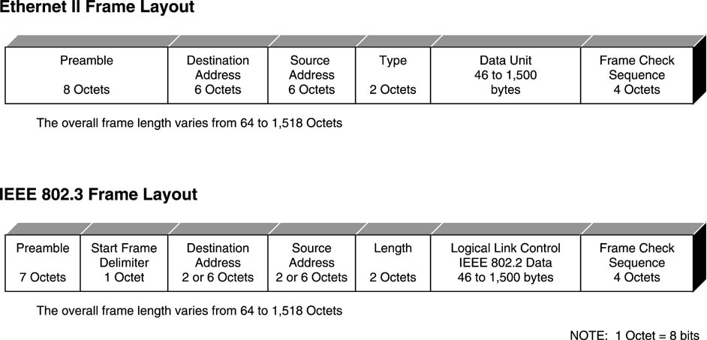
Ethernet Frame Layout
802.3 length field indicates length of the variable-length 802.2 LLC data field containing all upper-layer embedded protocol headers. 802.2 info includes DSAP & SSAP.

Slide 28
Ethernet Nomenclature
XbaseY
X=speed
Base=Baseband transmission
One frequency, both directions
Y=media
10baseT

Slide 29
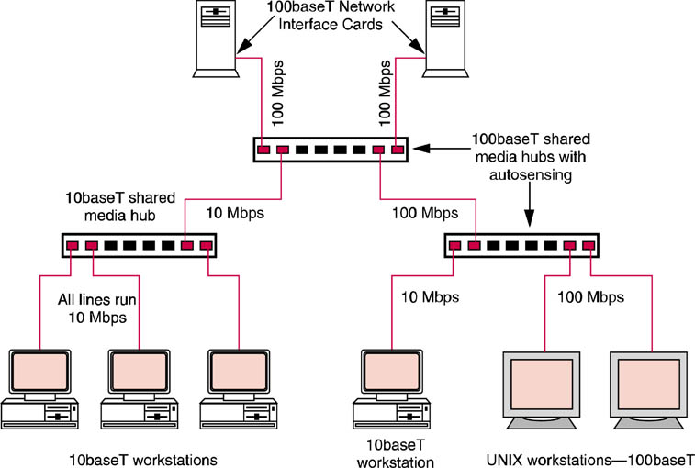
Typical FastEthernet Architecture
Dual Speed Hub or Switch
Autosensing Ports
Extended Star Topology

Slide 30
Gigabit Ethernet
Also known as 1000BaseX, is an upgrade to fast Ethernet that was standardized as IEEE 802.3z :
1000BaseSX: uses short wavelength laser multimode fiber optic media, primarily for horizontal building cabling.
1000BaseLX: uses long wavelength laser single mode fiber optic media, primarily for high-speed campus backbone applications.
1000BaseTX: uses four pair of CAT 5e UTP with a maximum distance of 100 m.

Slide 31
Token Ring
Access methodology: Token passing
Logical Topology: Sequential
Physical Topology: Star
IEEE 802.5
Once contended with 802.3
New installations are uncommon

Slide 32
ATM on the LAN
Asynchromnous Transfer Mode
Switched technology originally developed for WANs
ATM LAN Emulation (LANE)
LANE required for mixed environments
MAC addresses must be translated into ATM addresses

Slide 33
Wireless LANs
IEEE 802.11 standard
CSMA/CD at MAC layer
802.11 frames are similar to 802.3 Ethernet frames

Slide 34
Wireless LANs – 802.11b
11 Mbps theoretical, 4 Mbps practical
2.4 Ghz band – subject to interference from common electronic equipment
Shared access – sensitive to number of simultaneous users
Commonly available, inexpensive
Range is measured in 100’s of feet, lower indoors.

Slide 35
Wireless LANs – 802.11g
Interoperates with, similar to 802.11b
54 Mbps theoretical
Same band
Similar range
Also very common, inexpensive
802.11n – 600 Mbps theoretical (in draft stage)

Slide 36
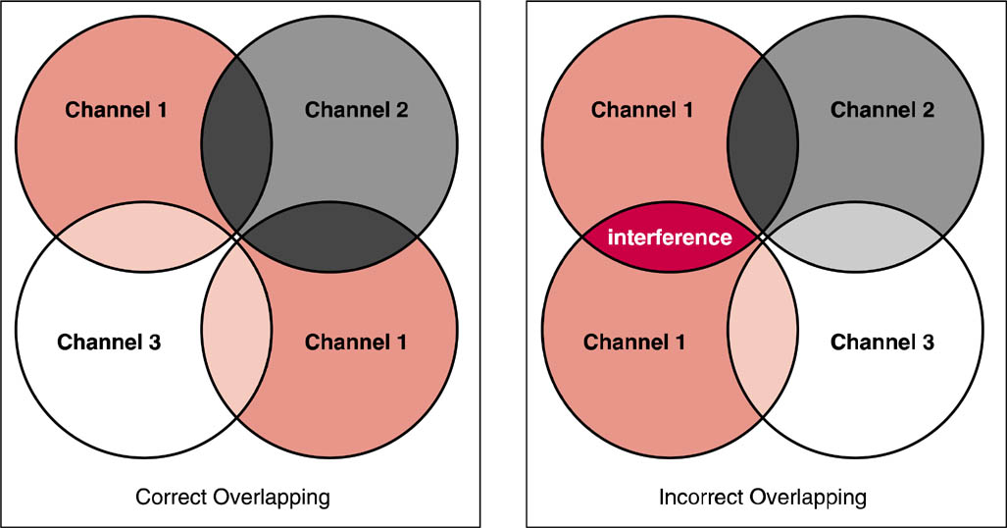
Wireless LANs
Care must be taken in wireless LAN designs

Slide 37
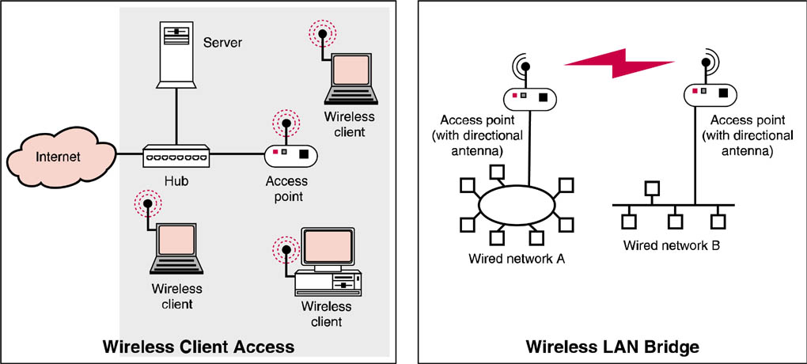
Wireless LANs
Wireless access points can provide for client access or provide a bridge

Slide 38
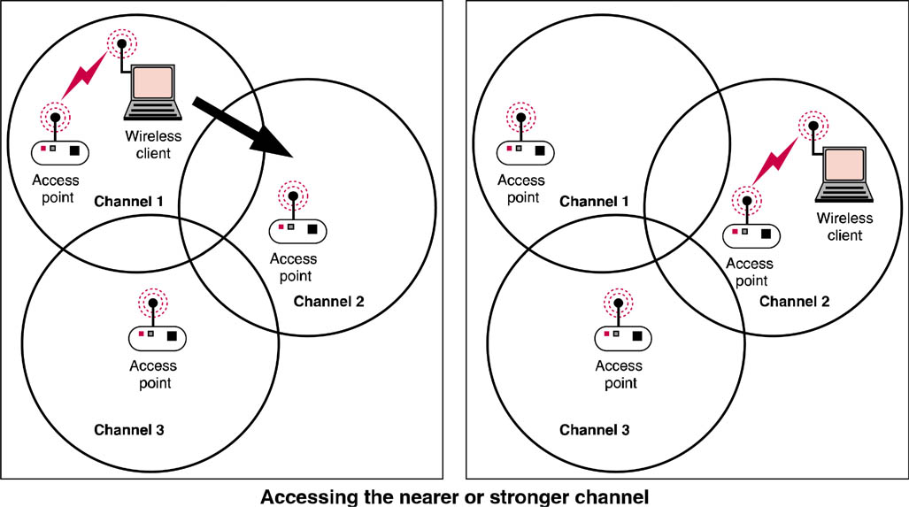
Wireless LANs
A wireless client will access the stronger channel

Slide 39
OSI Layers 1 and 2

Slide 40
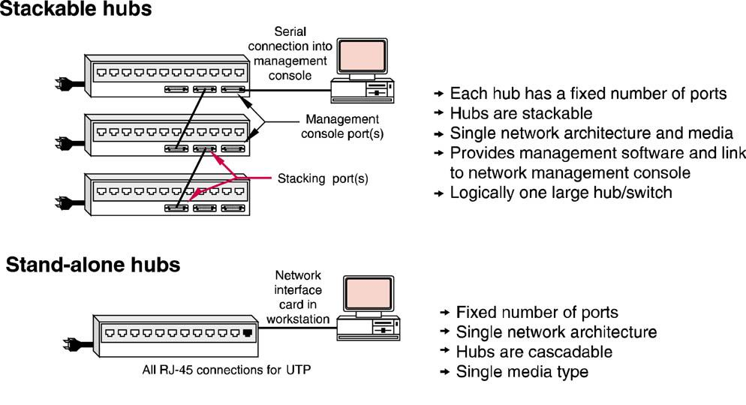
LAN Interconnection Hardware
Many stand-alone hubs may be cascaded
5-4-3 Rule
Stackable Hubs
Stand-alone Hubs

Slide 41
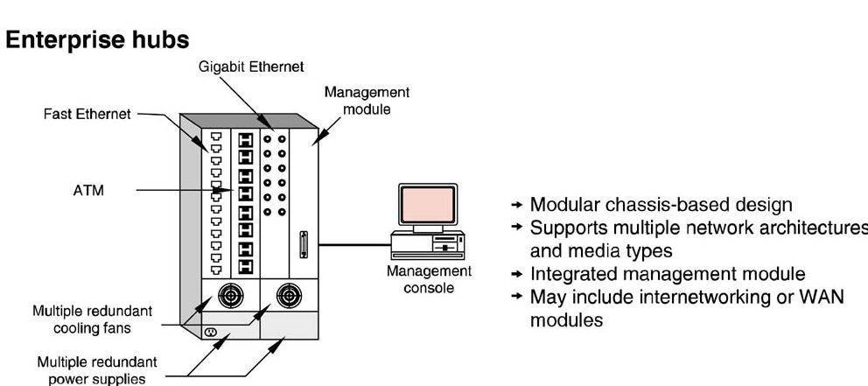
LAN Interconnection Hardware
Enterprise hubs have modular design

Slide 42
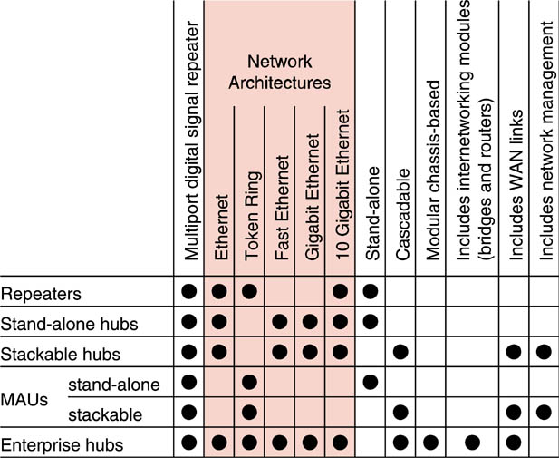
Hub Functional Comparison

Slide 43
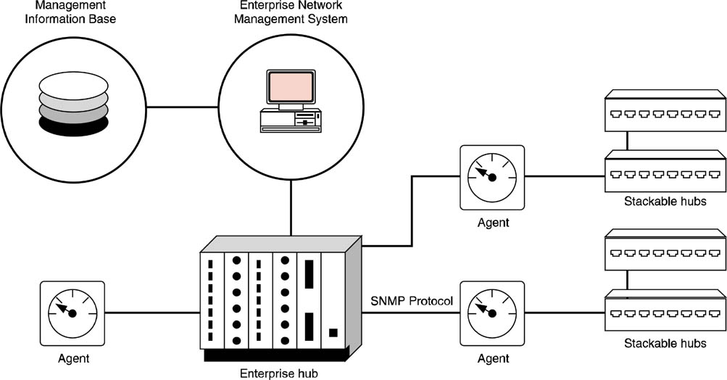
Network Management
SNMP is used to manage network devices

Slide 44
LAN Interconnection Hardware
A LAN Switch

Slide 45
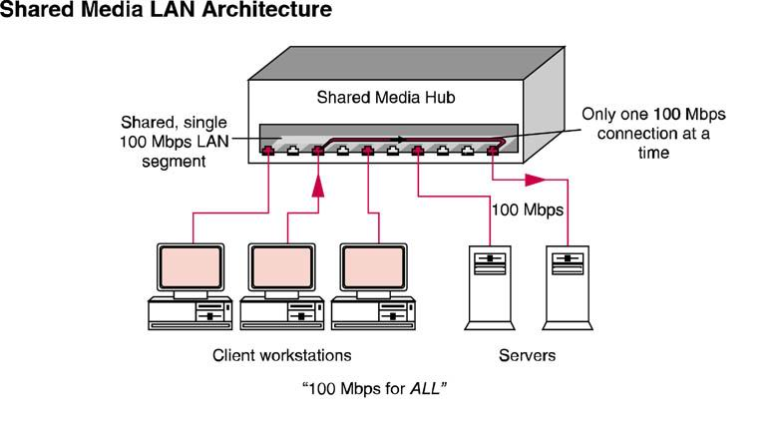
LAN Interconnection Hardware
Shared media – a “party line”
Fixed bandwidth shared by all stations

Slide 46
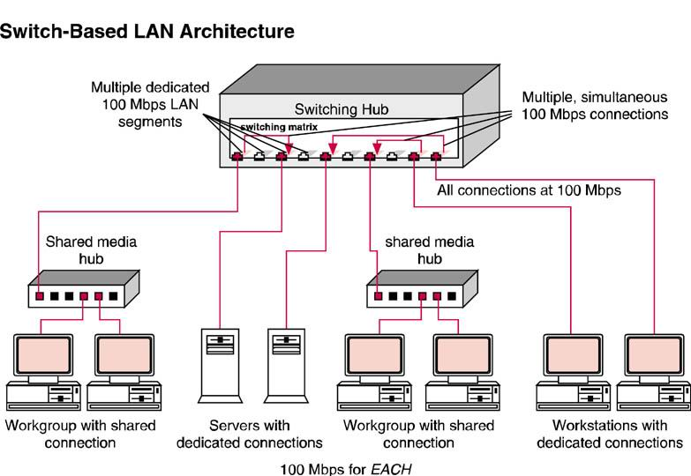
LAN Interconnection Hardware
Multiple, simultaneous connections at the same rate

Slide 47
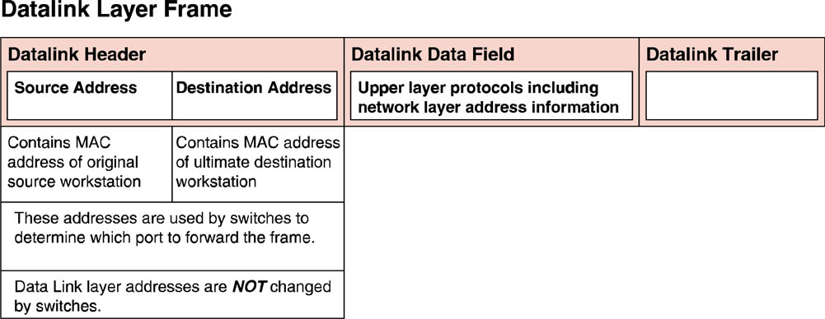
LAN Interconnection Hardware
LAN switches use Datalink (MAC) addresses

Slide 48
Switching
Switching is a datalink layer process, making forwarding decisions based on the contents of layer two frame addresses
Switches are transparent devices, receiving every frame broadcast on a port

Slide 49
Switching
A switch checks the source address of each frame it receives and adds that source address to the local address table (LAT) for the port.
The switch is learning, without having to be manually reconfigured, about new workstations that might have been added to the network.

Slide 50
Store and Forward Switching
The entire frame is read into switch memory.
Bad frames are not forwarded.

Slide 51
Cut-through Switching
Only the address information in the header is read before beginning processing.
Very fast
Bad frames are forwarded.

Slide 52
Error-free Cut-through Switching
Aka “Adaptive Switching”
Automatically selects best switching method for each port

Slide 53
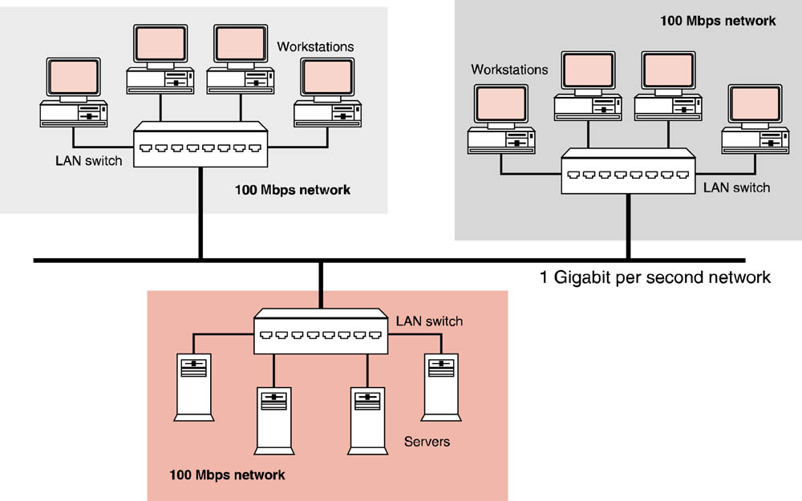
Advantages of Using Switches
Switches can be used to segment networks to improve performance

