Slide 1
Chapter 10
The Network Development Life Cycle
https://cis.BBent.com/Courses/CSIS202/Lessons/10

Slide 2
Network Development Life Cycle
The NDLC depends on previously completed development processes such as strategic business planning, applications development life cycle, and data distribution analysis.
If an implemented network is to effectively deliver the information systems that will fulfill strategic business goals, then a top-down approach must be taken.

Slide 3
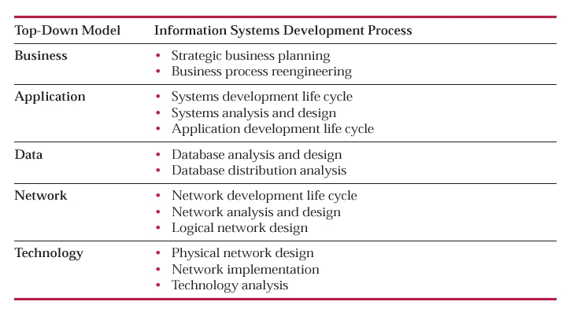
Top-Down Model and NDLC

Slide 4
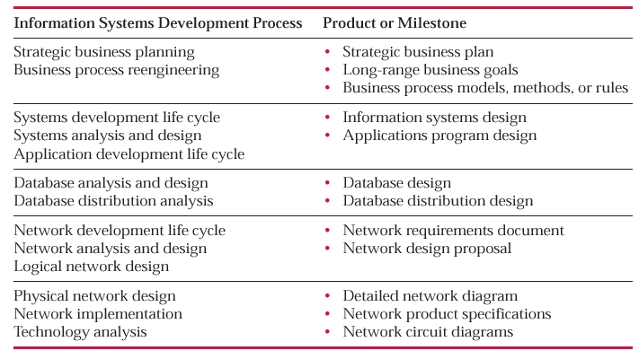
Systems Development

Slide 5
Systems Development and Network Analysis
Network analysis and design cannot be successfully performed in a vacuum.
Network analysis and design is one step in an overall comprehensive information systems development process.

Slide 6
Network Designs
Physical network designs involve the arrangement and inter­connection of the physical network circuits and devices, whereas
Logical network designs involve configuration and definition of services that will run over that physical network such as addressing schemes, routing schemes, traffic prioritization, security, and management.

Slide 7
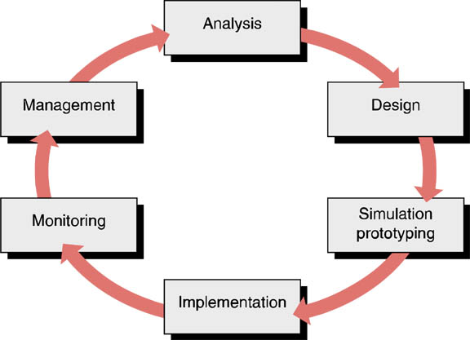
Network Development Life Cycle
The word “cycle” is a key descriptive term of the network development life cycle as it clearly illustrates the continuous nature of network development.

Slide 8
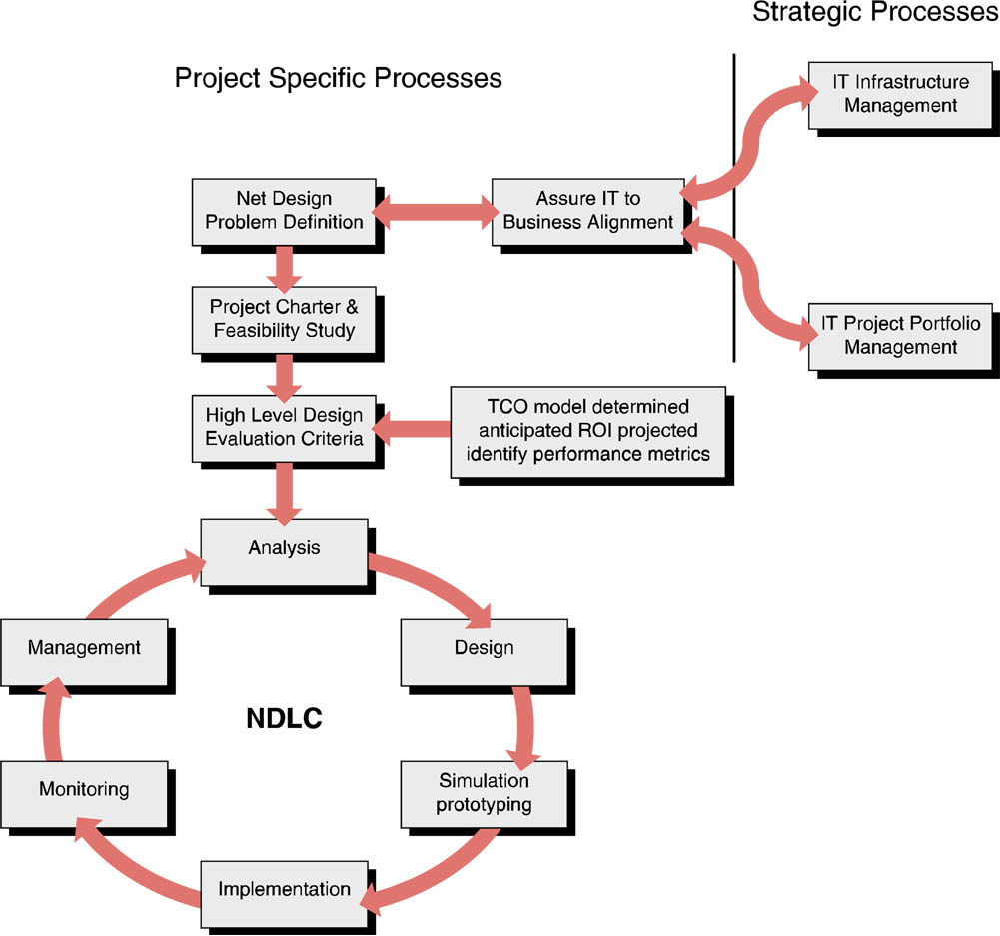
Alignment of Projects with IT and Business Initiatives
From a strategic process standpoint, a given network design project must be aligned with the overall strategic plan of the IT infrastructure as a whole, as well as with the strategic business initiatives of the firm.

Slide 9
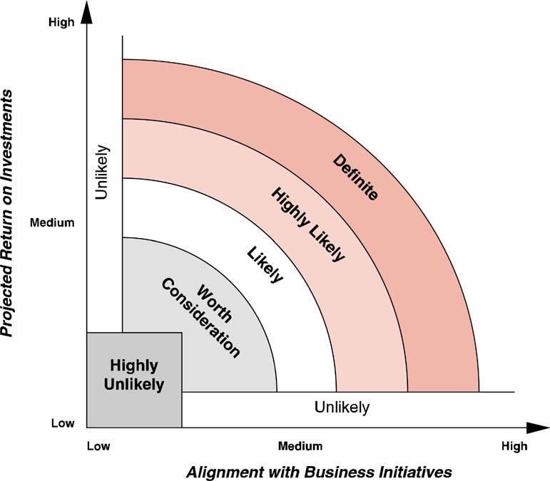
IT Project Portfolio Management
IT project portfolio management often manages the overall strategic development direction of the IT infrastructure.

Slide 10
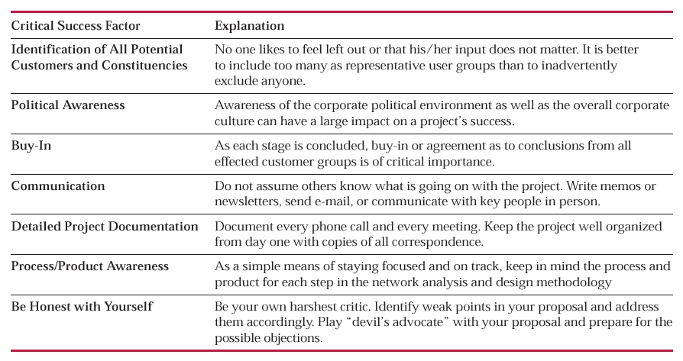
Critical Success Factors for NDLC

Slide 11
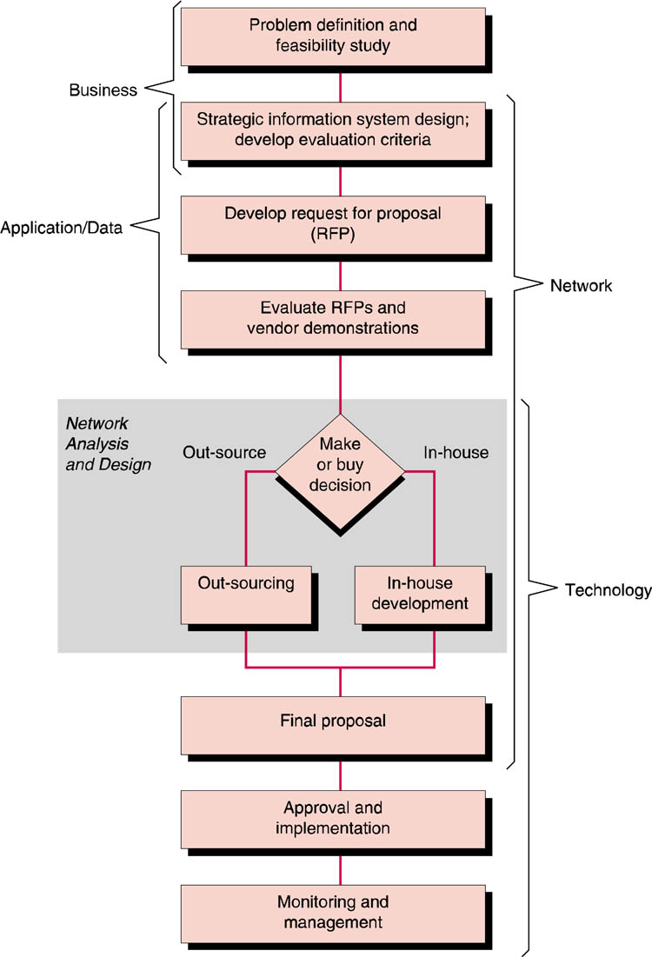
Network Analysis and Design Method
The network analysis and design methodology should be looked upon as an overall guideline to the network development process rather than a step-by-step cookbook-style set of instructions.

Slide 12
Network Analysis and Design Method
is consistent with previous information systems development models.
business, application, and data requirements definition are prerequisites to network design.
treats both in-house personnel as well as outside consultants as potential service providers by clearly documenting requirements in a formalized RFP.
activities from various stages of the method often take place simultaneously.

Slide 13
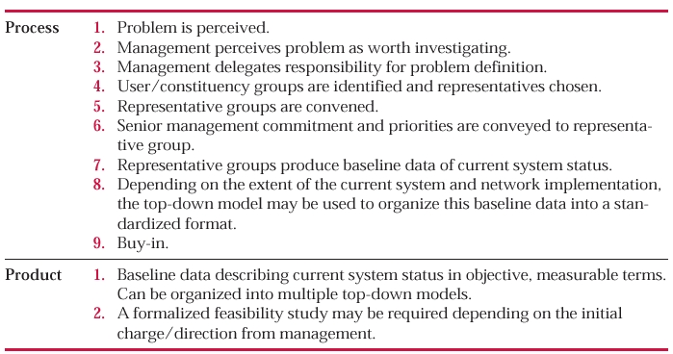
Problem Definition and Feasibility Study

Slide 14
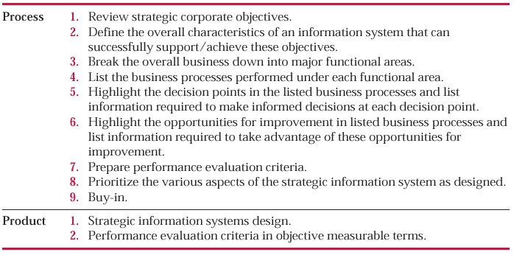
Strategic IS Design

Slide 15
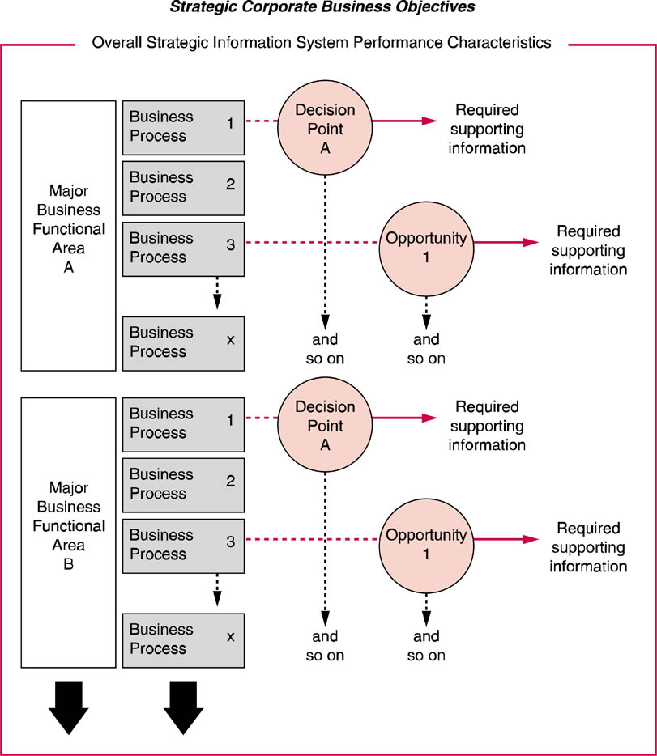
Process Relationship of Strategic IS Design
If opportunities for improvement support the strategic goals of the firm then they should be identified along with the information required to turn these opportunities into reality.

Slide 16
Prioritization
Identify those systems that exhibit the most important elements of the strategic IS design.
A simple approach to systems design prioritization is known as the three-pile approach:

Slide 17
Prioritization
Priority 1 items are so important that the system is simply not worth implementing without them.
Priority 2 items can be lived without or “worked around” but really need to be implemented as soon as possible.
Priority 3 items would be nice to have but can be lived without.

Slide 18
Strategic Network Design
Network design projects are not undertaken at random or on the whim of any network manager.
Network design projects must be aligned with strategic business initiatives and/or the strategic development of the overall corporate IT infrastructure.

Slide 19
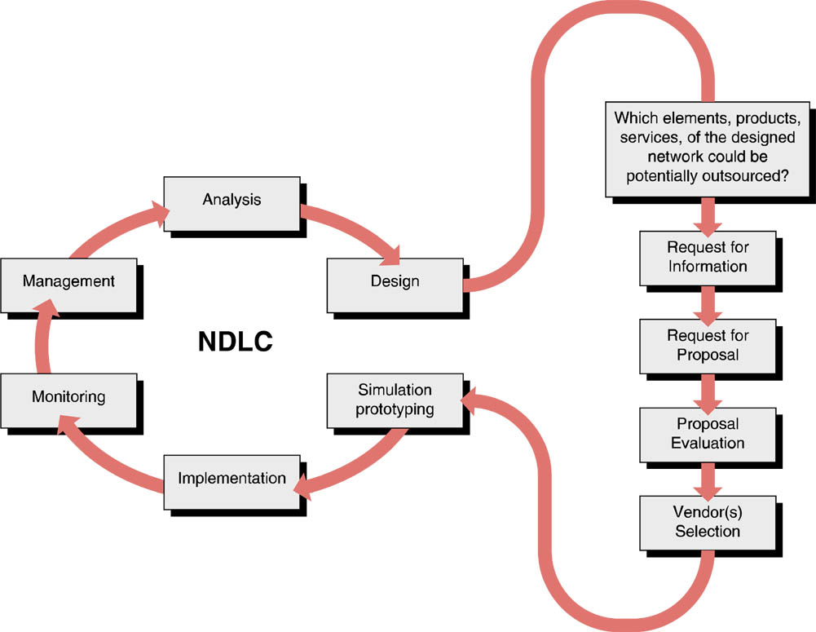
NDLC and Proposal Process
It is often prudent to narrow the field of potential respondents by issuing a request for information (RFI).

Slide 20
RFP - Request for Proposal
Vendor proposals are measured against the users’ predefined requirements.
If a vendor’s proposal does not meet minimum standards for meeting the requirements of the RFP, it is dropped from further consideration
The RFP ensures that the delivered system, will be flexible enough to change as business needs and requirements change.

Slide 21
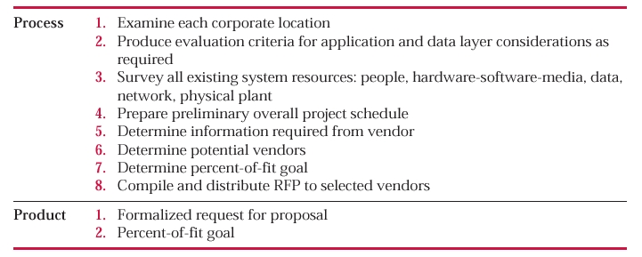
Preparing a RFP

Slide 22
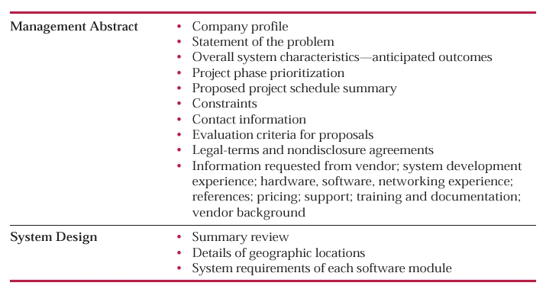
RFP Table of Contents

Slide 23
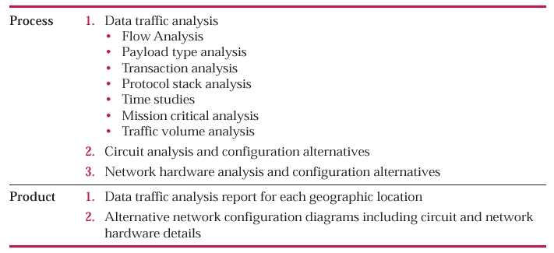
In-House Network Analysis

Slide 24
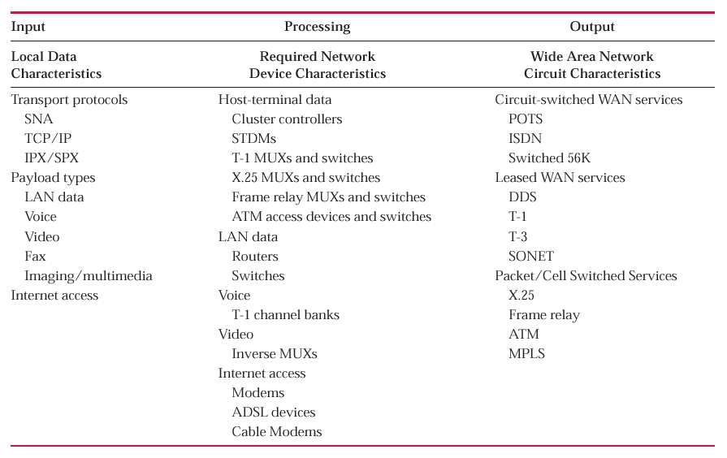
Network Device Analysis

Slide 25
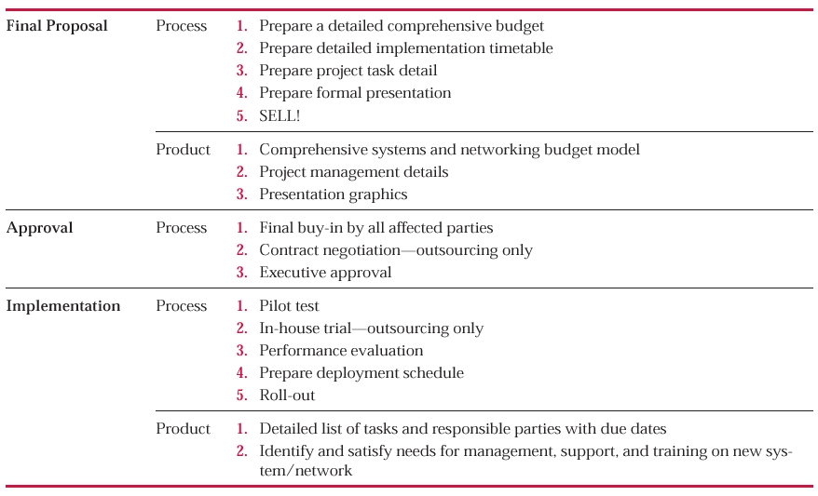
Final Proposal

Slide 26
Computer-Assisted Network Engineering – CANE
The entire network development life cycle is sometimes referred to as network engineering.
The use of software tools of one type or another to assist in this process is known as computer-assisted network engineering (CANE).
Prices for the software generally range from $10,000 to $30,000 per copy.

Slide 27
Computer-Assisted Network Engineering
By using analysis and design software to model their current network, companies are able to run optimization routines to reconfigure circuits and/or network hardware.
Network optimization software can redesign networks that can save from thousands of dollars per month to millions of dollars per year depending on the size of the network.

Slide 28
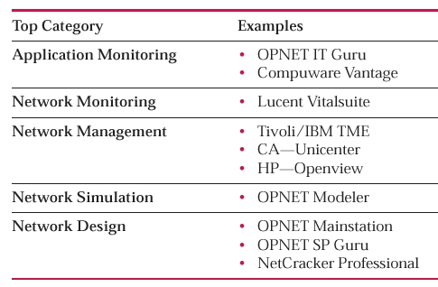
Computer-Assisted Network Engineering Software

Slide 29
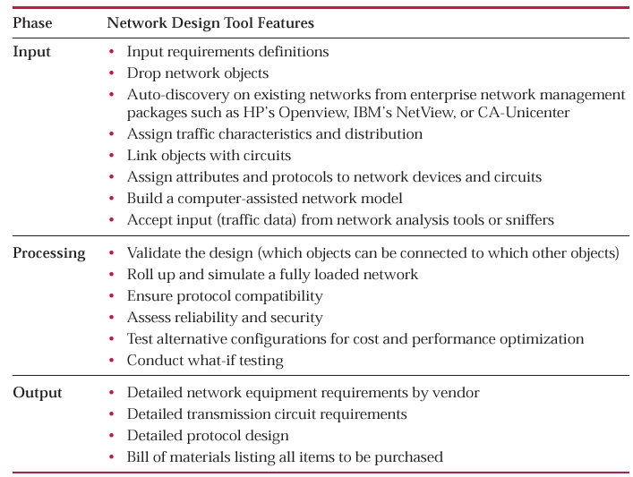
IPO Model for Network Design Tools

Slide 30
The Future of CANE / NDLC
Computer­assisted network engineering software tools continue to evolve and mature.
The key word in terms of the future of these various tools that make up the automated NDLC is integration.
The real potential of network engineering software integration has just barely scratched the surface and only in a few vendor­specific cases.

Slide 31
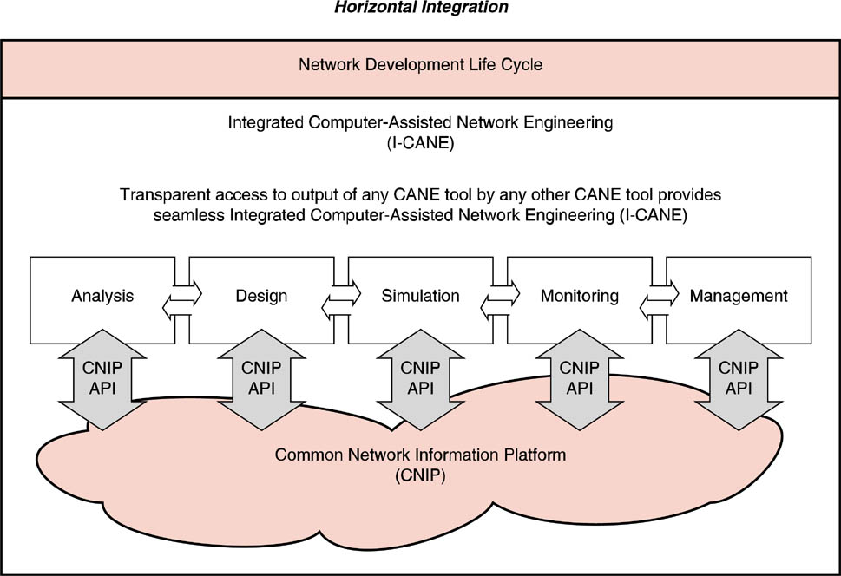
Future Automated NDLC – Horizontal

Slide 32
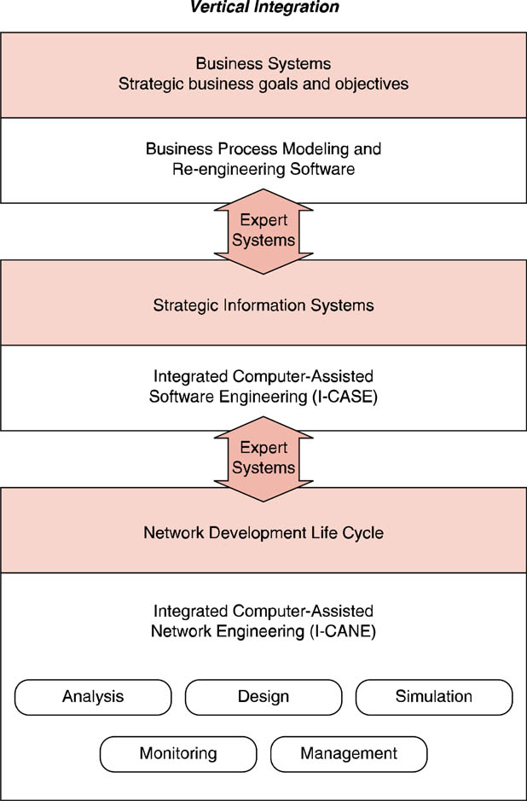
Future Automated NDLC -Vertical
The business information system of the future may interface to the strategic business planning person who amends strategic business goals and objects via a graphical user inter­face and point-and-click manipulation of business process objects.

Slide 33
Copyright 2004
Copyright 2004 John Wiley & Sons, Inc. All rights reserved. Reproduction or translation of this work beyond that permitted in section 117 of the 1976 United States Copyright Act without express permission of the copyright owner is unlawful. Request for further information should be addressed to the Permissions Department, John Wiley & Sons, Inc. The purchaser may make back-up copies for his/her own use only and not for distribution or resale. The Publisher assumes no responsibility for errors, omissions, or damages caused by the use of these programs or from the use of the information herein.

