Slide 1
Chapter 1
The Data Communications Industry
https://cis.BBent.com/Courses/CSIS202/Lessons/1

Slide 2
Objectives
Upon successful completion of this chapter, you should:
Understand today’s data communications industry as a system of interacting components.
Understand the current state of the data communications industry, as well as the major issues facing each of the industry’s constituent components.
Understand the challenges and solution to business-oriented data communications analysis.
Understand the importance of structured models such as the top-down model, the OSI model, and the I-P-O model to successful business-oriented data communications analysis.
Understand the relationship of network analysis and design to information systems analysis and design.
Understand career opportunities in data communications and the job skills required to succeed in this field.

Slide 3
Approach to Data Communications
You will never know all there is to know about data communications.
Be honest with yourself concerning what you don’t know.

Slide 4
What is Data Communications
“The encoded transmission of data via electrical, optical, or wireless means between computers or network processors.”
Learning data communications is a lot like learning a foreign language.
Notes:
What is data communications? It can be viewed as a foreign language. Just as the mastery of any foreign language requires practice in speaking and writing that language, so it is with data communications.
Practice is a key factor for success
Form study groups
Classic definition of Data Communications: the encoded transmission of data via electrical, optical, or wireless means between computing devices or network processors.

Slide 5
The Data Communications Industry
Judicial
Political / Legislative
Internet Service
Providers
Standards Making
Organizations
Vendors /
Consultants
Technology /
Research
Data
Communications
Carriers
Regulatory
Agencies
Manufacturers
Business
Customers
Residential
Customers
Figure 1-1 The Data Communications Industry: A Series of Interacting Components
The Data Communications industry has many stakeholders with complex relationships.
Notes:
Traditionally, Data Communications is viewed as a subset of Telecommunications, which encompasses the transmission of voice, data, and video.
The lines of distinction between Data Communications and Telecommunications are becoming blurred.
Figure 1-1 shows one way of breaking down the complexities of the Data Communications Industry.
As you can see from the figure, Data Communications is the sum total of interacting components. There is no distinct beginning or end and no single component is more important than another.

Slide 6
The Regulatory Process
Two tightly dependent components in a constant and ongoing state of change are the regulatory and carrier components.
The regulatory component represents local, state, and federal agencies charged with regulating telecommunications.
The carrier component represents companies such as telephone and cable TV companies that sell transmission services.

Slide 7
The Regulatory Process
This interaction is a rather formal process of a series of proposals, also known as tariffs.
Tariffs are submitted to state and federal regulatory agencies by carriers, and rulings and approvals are issued in by the agencies in return.

Slide 8
The Regulatory Process
Carriers and agencies interact in the formation of tariffs.
Notes:
The Regulatory Process
Regulatory component represents local, state, and federal agencies charged with regulating telecommunications.
Carrier component represents companies such as: telephone, cable TV, and satellite TV companies that sell transmission services.
We need to understand their interaction which is a formal process
Carriers submit proposals, known as tariffs, to state and federal regulatory agencies
Regulatory agencies issue rulings and approvals in return

Slide 9
Deregulation & Divestiture
Judge Harold Greene
Notes:
Deregulation and Divestiture: early 1980s - The Justice Department
Before Deregulation and Divestiture, not synonymous, America’s telecommunications needs (data and voice), (hardware and services) were supplied, with few exceptions, by a single vendor: AT&T (American Telephone and Telegraph).
Homeowners were not allowed to purchase and install their own phones. AT&T owned all equipment connected to the PSTN. Customers rented their phones from AT&T.
Local Bell operating companies provided local service but were still part of AT&T. All telephone service was coordinated through one telecommunications organization. Most indoor wiring was also the responsibility of AT&T. The top to bottom integration allowed for excellent coordination and interoperability, but, severely limited customer choice.
The single company telecommunications industry was viewed as a monopoly and came to an end in the late 70s and early 80s. The initial divestiture and deregulation of the telecommunications industry was not the result of a purely regulatory process. This enormously important event was primarily a judicial process, fought out in the courtrooms and largely fostered by one man, Bill McGowan, former president of MCI.
Although the FCC (Federal Communications Commission) initially ruled in 1971 that MCI could compete with AT&T for long distance service, it was McGowan’s 1974 lawsuit that got the justice department involved and led to the actual breakup of AT&T.
AT&T was declared a monopoly and broken into several smaller companies in a process know as divestiture as set forth by Federal Judge Harold Greene in the 1982 MFJ (Modified Final Judgment), which Judge Greene used to effectively control the U.S. telecommunications industry until 1996 when the Telecommunications act expressly ended his control.

Slide 10
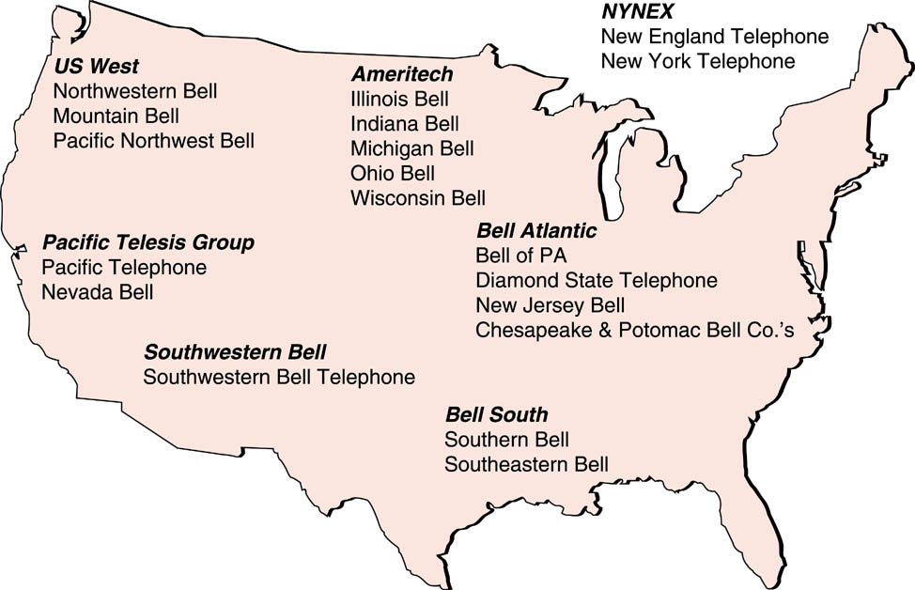
RBOC’s at the time of the AT&T breakup (pre-1996)
How does this differ from the ownership and control structure that exists today?
Notes:
Divestiture broke up the telephone network services of AT&T into separate long-distance and local service companies. AT&T retained the right to offer long-distance services, while the former local BOCs (Bell Operating Companies) were grouped into new RBOCs (Regional Bell Operating Companies) to offer local telecommunications service.
The graphic illustrates the RBOCs and their constituent former BOCs after divestiture and up through 1996.
Deregulation introduced an entirely different aspect of the telecommunications industry in the United States: the ability of “phone companies” in America to compete in an unrestricted manner in other industries such as computer and information systems fields. Prior to deregulation, phone companies were either banned from doing business in other industries or were subject to having their profits and/or rates monitored or “regulated” in a fashion similar to the way in which their rates for phone service were regulated.
Network services offered by phone companies are still regulated. Local service rate proposal are filed as tariffs on the state level with a particular state’s Public Utilities Commission and on a federal level with the FCC for interstate service proposals and rate change requests.
These commisions must balance objectives that are sometime contradictory:
Basic phone service must remain affordable enough that all residents of a state can afford it. This guarantee is sometimes known as universal service or universal access.
Phone companies must remain progitable to be able to afford to constantly reinvest in upgrading their physical resources (hardware, cables, buildings) as well as in educating and training their human resources.
The divestiture and deregulation activities of the 1980s allowed competing long-distance carriers such as MCI and US Sprint to sell long-distance services on a level playing field with AT&T thanks to a ruling known as Equal Access. This means that all long-distance carriers must be treated equally by the local RBOCs in terms of access to the local carrier switching equipment, and ultimately to their customers.

Slide 11
Telecommunications Act of 1996
Sought to encourage competition in all aspects and markets of telecommunications services including switched and dedicated local and inter-LATA traffic, cable TV, and wireless services such as paging, cellular, and satellite services.
The legislation directs the FCC to produce the rules that will allow Local Exchange Carriers (LECs) and Inter-Exchange Carrier (IXCs) to compete in each other’s markets.

Slide 12
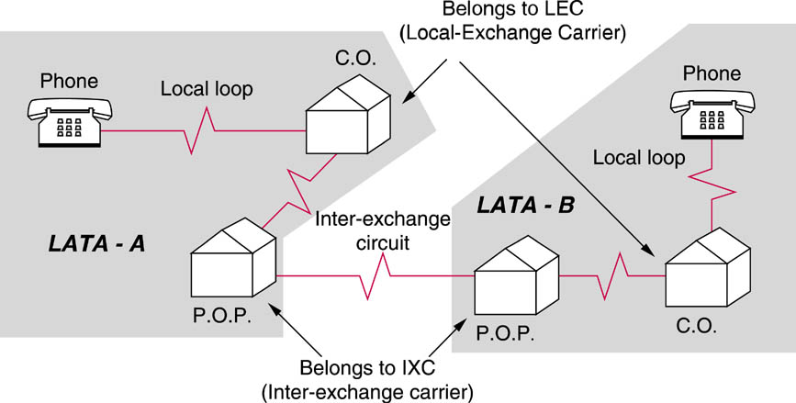
LATA’s and Basic Infrastructure
Local access transport areas (LATA) were established as a result of the breakup of AT&T to segment long-distance traffic.
Notes:
Basic Telecommunications Infrastructure (Phone Companies)
All components make-up the PSTN (Public Switched Telephone Network)
LATAs (Local Access Transport Areas) were established as a result of the AT&T breakup. Originally reserved for the local phone company or LEC (Local Exchange Carrier).
Recent rulings and legislation have made the distinction between the intra-LATA and inter-LATA calls less significant, but, the LATA structure is still important to the overall telecommunications architecture.
Their can be several LATAs per Area Code and LATAs can cross state boundaries, Area Codes cannot.
Residences and businesses are connected to the PSTN by circuits known as the “local loop” . Local loops run between the residence or business location and the local CO (central office), a facility belonging to the local phone company in which calls are switched to their proper destination.
Any phone traffic destined for locations outside of the local LATA must be handed off to the long-distance or IXC (Inter-Exchange Carrier) of the customer’s choice.
Competing long-distance carriers wishing to do business in a given LATA maintain a switching office in that LATA known as a POP (point of presence).
POPs handle billing and routing between LATAs. The circuit may be via satellite microwave, fiber optic cable, traditional wiring, or some combination.

Slide 13
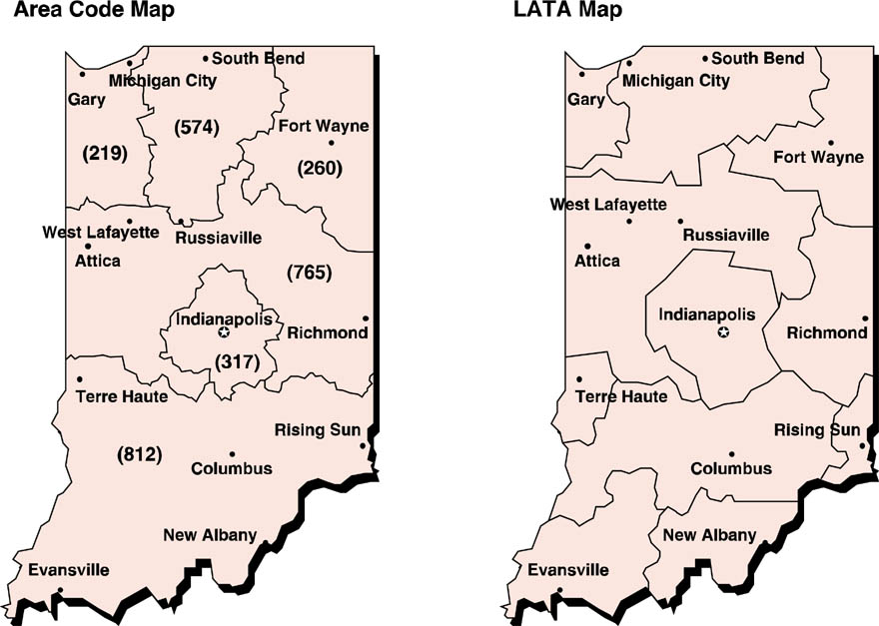
LATA v. Area Codes
LATA’s do not correspond to area codes.
Notes:
The graphic of the state of Indiana demonstrates that although LATAs and Area Codes can represent the same geographic area, that is not always the case. There can be many LATAs in a single Area Code and LATA’s can cross state boundries.

Slide 14
California LATAs
5
GTE

Slide 15
U.S. Area Codes & Time Zones

Slide 16
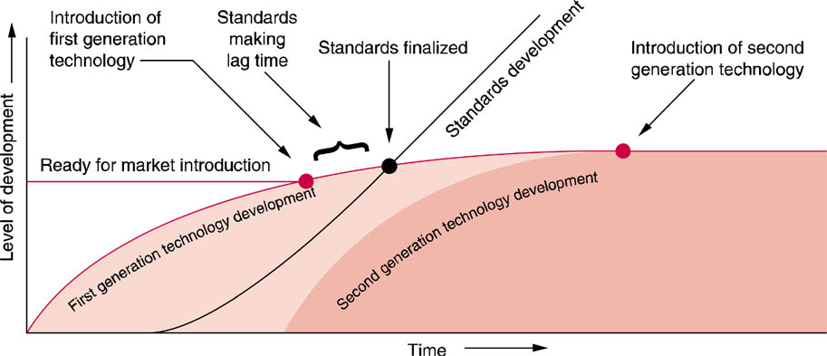
Technology and Standards Development
The development of a standard generally lags the development of the technology.

Slide 17
The Importance of Standards
Without standards, data communications would be nearly impossible.
Standards allow multiple vendors to manufacture competing products that work together effectively.
End-users can be confident that devices will operate as specified and will interoperate successfully.
Standards can have a tremendous potential economic impact on vendors.

Slide 18
The Standards Process
Recognition of the need for a standard
Formation of some type of committee or task force
Information/recommendation gathering phase
Tentative/alternative standards issued
Feedback on tentative/alternative standards
Final standards issued
Compliance with final standards
Notes:
1. Recognition of the need for a standard
2. Formation of some type of committee or task force
3. Information/recommendation gathering phase
4. Tentative/alternative standards issued
5. Feedback on tentative/alternative standards
6. Final standards issued
7. Compliance with final standards

Slide 19
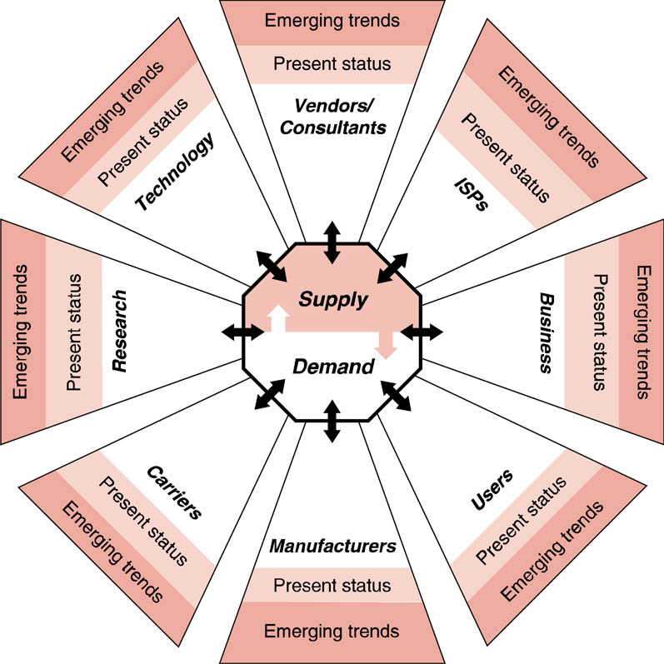
Driving Forces in the Datacomm Industry

Slide 20
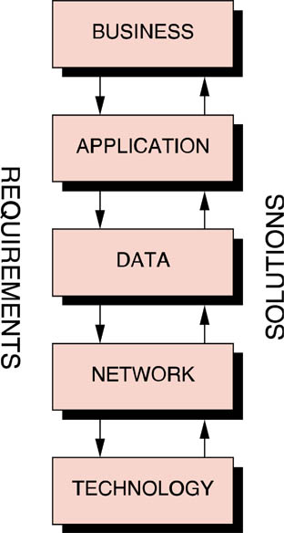
The Top-Down Approach
Business needs drive solutions.

Slide 21
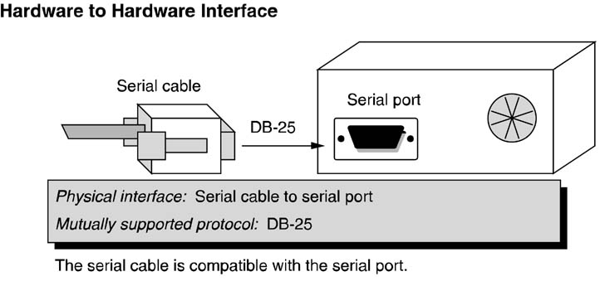
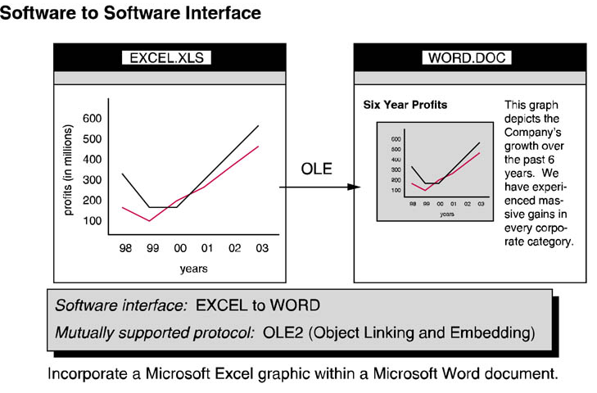
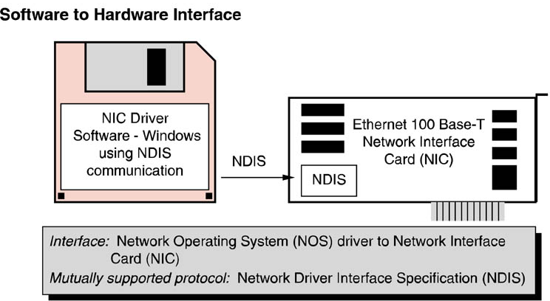
Interfaces
Implementing mutually supported protocols allows interfacing hardware and/or software technology to communicate, thereby ensuring compatibility.

Slide 22
The OSI Model
Open systems interconnection (OSI) network reference model, a framework for organizing networking technology and protocol solutions developed by The International Standards Organization (ISO).
The OSI Model consists of a hierarchy of 7 layers that loosely group the functional requirements for communication between two computing devices.

Slide 23
The OSI Model
The power of the OSI Model, officially known as ISO Standard 7489, lies in its openness and flexibility.
It can be used to organize and define protocols involved in communicating between two computing devices located in the same room as effectively as two devices located on opposite sides of the world.
It is THE reference model in the world of telecommunications

Slide 24
Protocols
A protocol is a set of rules that govern communication between hardware and/or software components.
There are many well known as well as a few obscure protocols used in telecommunications.

Slide 25
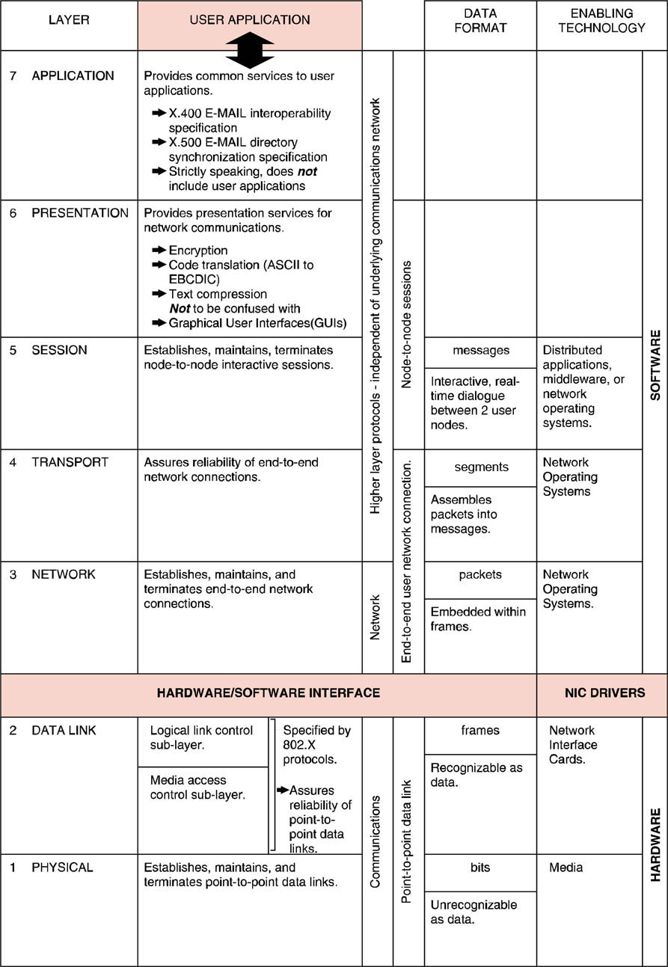
OSI Model Overview
Away
All
People
Pizza
Operating
Systems
Sausage
Seem
Throw
To
Need
Not
Network
Interface
Card
LLC
Data
Do
MAC
Please
Processing

Slide 26
Mapping the OSI Model

Slide 27
The OSI Model
Network analysts literally talk in terms of the OSI model.
When troubleshooting network problems, the network analyst starts with the physical layer and ensures that protocols and interfaces are operational at each layer.
Another benefit of the OSI model is that it allows discussion about the interconnection of two networks or computers in common terms without dealing in proprietary vendor jargon

Slide 28
Physical Layer
Responsible for the establishment, maintenance and termination of physical connections between communicating devices.
Transmits and receives a stream of bits.
No data recognition at the physical layer.

Slide 29
Data Link Layer
Responsible for providing protocols that deliver reliable point-to-point connections.
Organizes the bit stream into structured frames which add addressing and error checking information.
Additional information added to the front of data is called a header.
Information added to the back of data is called a trailer.
Data link layer protocols provide error detection, notification, and recovery

Slide 30
Data Link Layer (NIC’s)
Data-link layer frames are built within the network interface card installed in a computer according to the pre-determined frame layout particular to the network architecture of the installed network interface card.
Network interface cards are given a unique address in a format determined by their network architecture.
These addresses are usually assigned and pre-programmed by the NIC manufacturer.

Slide 31
Data Link Layer – Sub Layers
The IEEE 802 committee split the data-link layer into two sub-layers:
Logical Link Control or LLC sub-layer and is represented by a single IEEE 802 protocol (IEEE 802.2).
Media Access Control or MAC sub-layer interfaces with the physical layer and is represented by protocols which define how the shared local area network media is to be accessed by the many connected computers.

Slide 32
LLC Sub-Layer
Splitting the data-link layer into two sub-layers offers transparency to the upper layers (network and above) while allowing the MAC sub-layer protocol to vary independently.
This allows a given network operating system to run equally well over a variety of different network architectures as embodied in network interface cards.

Slide 33
Network Layer
Network layer protocols are responsible for the establishment, maintenance, and termination of end-to-end network links.
Network layer protocols are required when computers that are not physically connected to the same LAN must communicate.
Network layer protocols are responsible for providing network layer (end-to-end) addressing schemes and for enabling inter-network routing of network layer data packets.

Slide 34
Network Layer (Packets v. Frames)
The term packets is usually associated with network layer protocols while the term frames is usually associated with data link layer protocols.

Slide 35
Transport Layer
Transport layer protocols are responsible for providing reliability for the end-to-end network layer connections.
Transport layer protocols provide end-to-end error recovery and flow control.
Transport layer protocols also provide mechanisms for sequentially organizing multiple network layer packets into a coherent message.

Slide 36
Session Layer
Session layer protocols are responsible for establishing, maintaining, and terminating sessions between user application programs.
Sessions are interactive dialogues between networked computers and are of particular importance to distributed computing applications in a client/server environment.

Slide 37
Presentation Layer
Presentation layer protocols provide an interface between user applications and various presentation-related services required by those applications.
Data encryption/decryption protocols are considered presentation layer protocols.
Also protocols that translate between encoding schemes such as ASCII to EBCDIC

Slide 38
Application Layer
Includes utilities and network-based services that support end-user application programs.
The best examples of application layer protocols are the OSI protocols X.400 and X.500.
The Domain Name Service (DNS), which is an Internet protocol that resolves a computer's common or domain name to a specific IP address, is also considered an application layer protocol

Slide 39
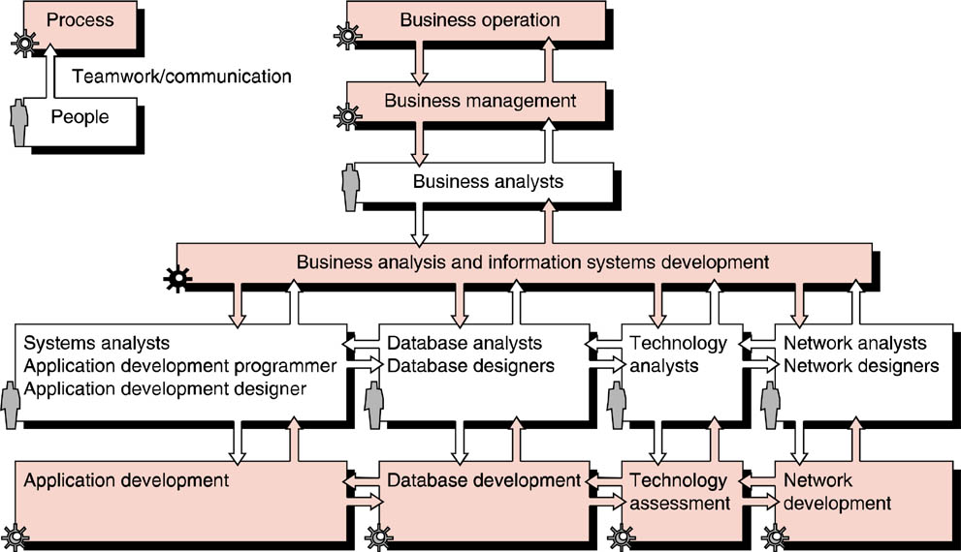
The Top-Down Approach to Information Systems Development
Networking and Telecomm in the ISD context.

