Slide 1
Networks & Data Communications
Voice Communication
Concepts and Technology
https://cis.BBent.com/Courses/CSIS202/Lessons/5
Notes:
Upon successful completion of this chapter, you should be able to:
Understand the underlying technical concepts for voice transmission, voice digitization, voice compression, and data/voice integration.
Understand currently available voice-related technology including PBXs, Voice Digitizers, and Voice/Data Multiplexers and Modems.
Understand the functionality, standards, business impact, and technology involved with computer telephony integration.
Understand the functionality, concepts, standards, business impact, and technology involved with voice networks services, voice transmission alternatives, and voice/data integration.
Network Analysts must be qualified to design networks that are capable of carrying voice as well as data.
Before assigning such networks, it is essential for the network analyst to understand the nature of voice signals, as well as how voice signals can be processed and integrated into a cohesive network with data transmissions.
Voice communication used to be exclusively analog transmissions but is becoming more digital.
Once a voice signal has been digitized, a wide variety of transmission services can potentially be employed to complete the transmission of the voice signal to its designated destination.
In some cases voice transmissions can be integrated with data transmission.
Standards play an essential role in ensuring end-to-end interoperability.
This chapter covers these concepts:
Voice Digitization and Compression (Voice Transmission Basic Concepts)
PBX – Private Branch Exchange – now seen as a Voice Server, a server like any other.
Voice and Data Convergence technologies

Slide 2
Voice Network Concepts
Telephone switchboard
- Circa 1898

Slide 3
Voice Network Concepts
Telephone calls are connected from source via circuit switching.
Circuit switching originally meant that a physical electrical circuit was created from the source to the destination.
The modern telephone system is commonly known as the Public Switched Telephone Network or PSTN

Slide 4
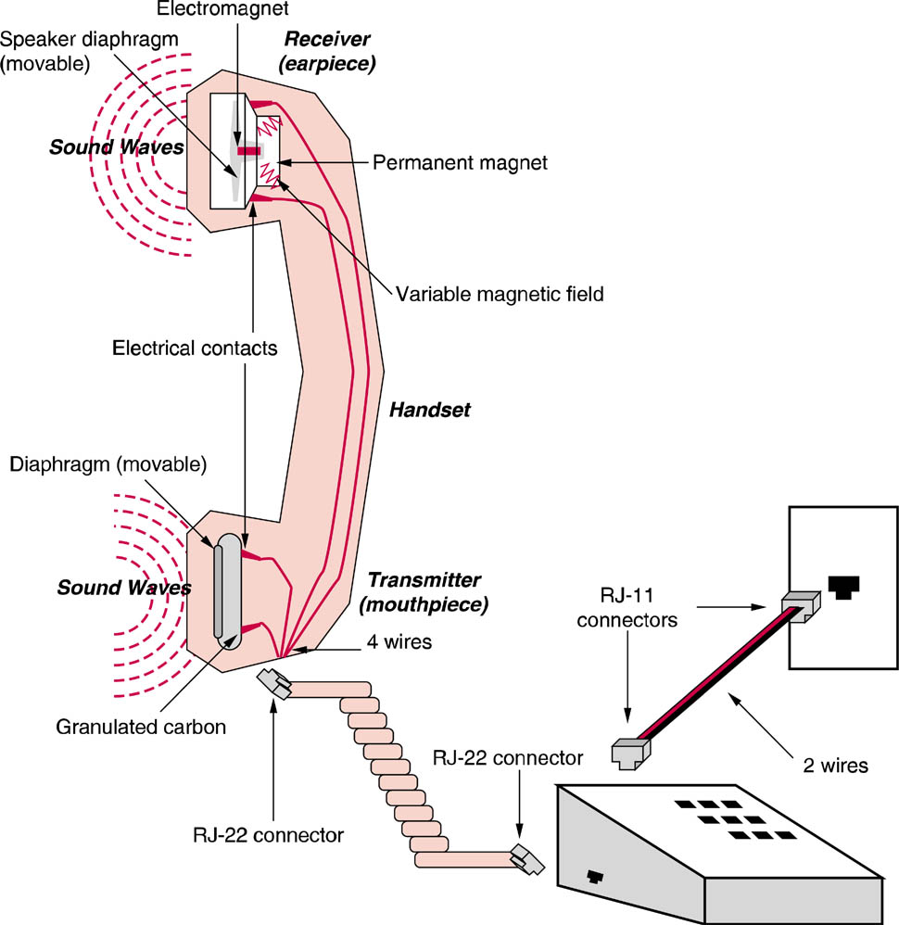
Voice Concepts
Getting voice onto and off of the network
Notes:
VOICE TRANSMISSION BASIC CONCEPTS
Voice conversation consists of sound waves that vary in Frequency (soprano, baritone) and Amplitude (loudness). Represented as a continuously varying analog waveform.
POTS (Plain Old Telephone Service) network employed analog transmission methodologies to transmit voice signals from source to destination.
The human transmitter (your voice) generates sound waves that strike the Diaphragm in the telephone’s transmitter (mouthpiece). The diaphragm is sensitive to frequency and amplitude and contains carbon granules that have the ability to conduct electricity.
As you speak varying amounts of the carbon granules strike the electrical contacts sending a varying analog electrical signal out onto the voice network.
The receiver (earpiece) at both ends of the connection receive the electrical waves. The receiver contains an electromagnet (a device that converts electricity into magnetic fields). The electromagnetic fields are varied by the electrical waves it receives which in turn causes the diaphragm in the receiver to move in direct proportion to the magnetic variance.

Slide 5
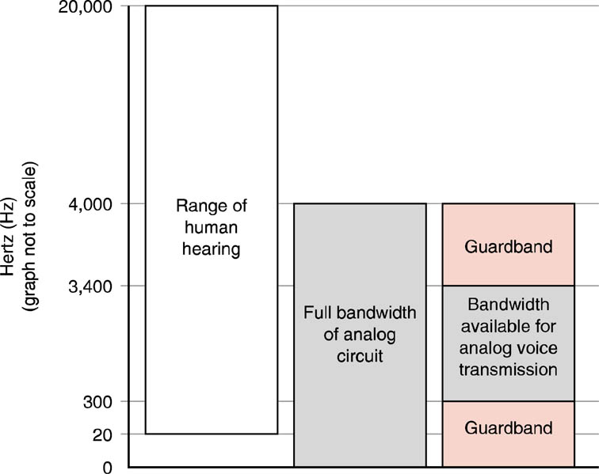
Voice Bandwidth
Telephone voice bandwidth is more narrow than can actually be heard by most people.
Notes:
The range of human hearing is between 20Hz and 20KHz
POTS produces a bandwidth of 4KHz including the two guard bands – useable is 3KHZ (3000Hz) between 300Hz to 3300Hz (33KHz).

Slide 6
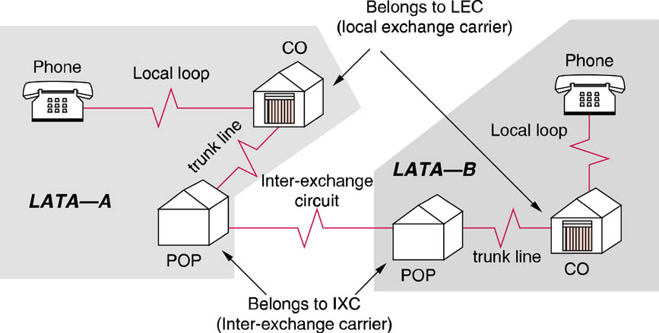
Basic Infrastructure
The circuit between the central office and customer is called the local loop
The local loop is the only remaining analog component in the system.
Notes:
Voice Networks
Telephone networks were originally Circuit Switched end-to-end manually by telephone operators at a switchboard. Later, rotary telephone & automatic switching was introduced.
On a switched circuit the same amount of bandwidth is dedicated to the call when both parties are quiet as well as when both parties are talking.
Basic Telecommunications Infrastructure
PSTN (Public Switched Telephone Network)
CO (Central Office)
LATA (Local Access and Transport Area)
Customer’s telephone line is connected to the CO’s Telephone Switch via the Local Loop (the Last Mile – designated so because it’s still analog)
Intra-LATA: circuit established is not in the same CO but within same LATA
Inter-LATA – circuit established between LATAs – requires an IXC
POP (Point Of Presence) Where IXC accesses local loops via a trunk line
IXC (Inter-Exchange Carrier – Long Distance Company). Chosen by Cust.
Most local loops (the LAST MILE) are still analog, once the signal hits the switch it’s digitized.

Slide 7
Basic Infrastructure
Telephone calls are established by a device located at the local telephone companies Central Office (CO) known as a telephone switch
All voice traffic destined for locations outside of the local LATA must be handed off to the Long Distance or Inter-Exchange carrier (IXC) of the customer's choice

Slide 8
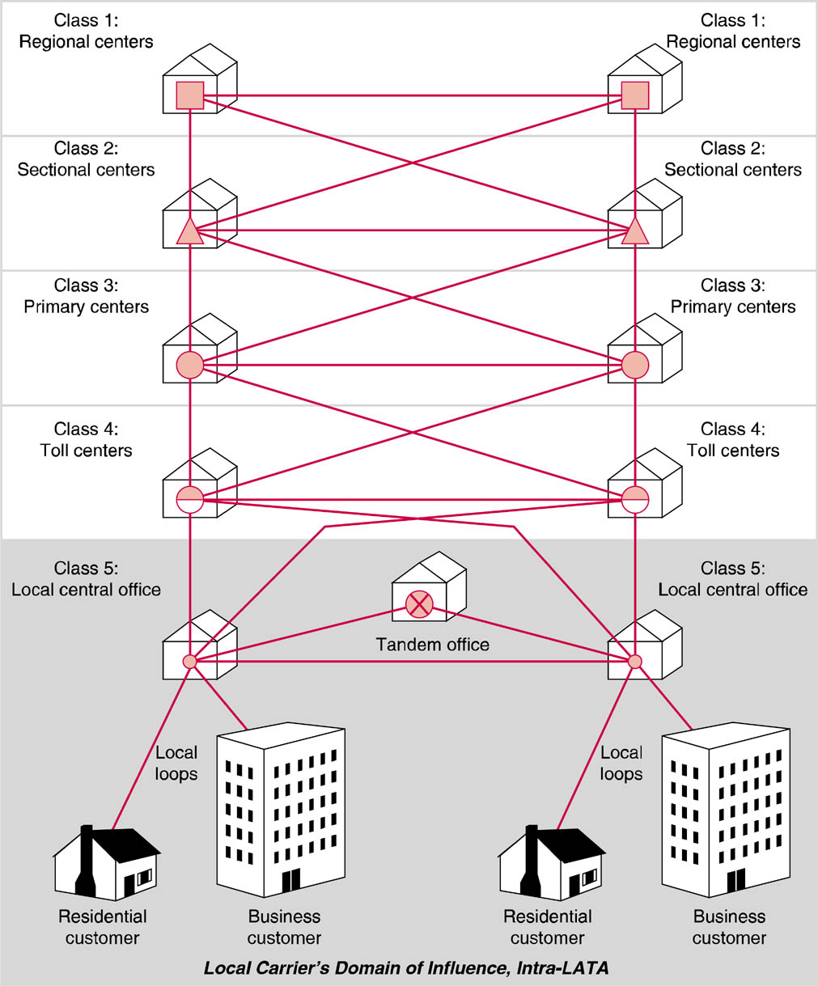
PSTN Network Hierarchy
Notes:
PSTN Network Hierarchy
Class 5 Office – Local CO (Central Office) that contains switch which processes incoming calls, determines best path to the call destination, and establishes the circuit connection.
Tandem Office – switches between Intra-LATA COs when a CO does not have a direct line to the destination CO, also handles billing procedures
When call is destined for another LATA, it is turned over to the customer’s primary IXC’s POP.
IXC POPs are know as Class 4 toll centers.
A given CO may have trunks to more than one toll center. Circuit redundancy offering multiple alternative paths for call routing is a central premise of the voice network hierarchy. If the local toll center can find adequate space on a trunk headed to the destination CO, then the connection between source and destination COs is completed. If no paths to the destination are directly available to the local toll center, then the call is escalated up the network hierarchy to the next level of switching office. The overall desire is to keep the call as low on the hierarchy as possible. This provides both quicker call completion and cost-effective use of the lowest and least expensive switching offices as possible.
Higher levels of network hierarchy = greater switching & transmission capacity and greater expense.
Telephone Numbering Plans
Telephone numbers are built using a hierarchical address method. Telephone numbers in the United States can be broken down into three basic parts: a three-digit area code, a three-digit exchange, and a four-digit subscriber number.
Originally you didn’t have to dial a 1 for long distance because all area codes used the N1/0x format and all prefixes were NNX, which meant that no prefix could contain a 1 or 0 as its middle number. The format has been changed to NXX+NXX+XXXX, where N is 2-9 and X is 0-9.
International Numbers: 011 + country code + city code + phone number
Telephone Number Shortages and New Area Codes
10,000 per exchange X 1,000 exchanges per area code = 10 million phone numbers per area code
Two choices: split area code in two or overlay a new area code into the same area.

Slide 9
PSTN Network Hierarchy
Original AT&T system was organized in a 5 class hierarchy – still a standard.
Local CO is lowest level
Regional center is highest level

Slide 10
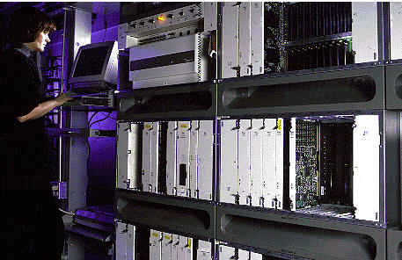
Digital Cross Connect
Notes:
Digital Cross-Connect
A network device used by telecom carriers and large enterprises to switch and multiplex low-speed voice and data signals onto high-speed lines and vice versa. It is typically used to aggregate several T1 lines into a higher-speed electrical or optical line as well as to distributed signals to various destinations; for example, voice and data traffic may arrive at the cross-connect on the same facility, but be destined for different carriers. Voice traffic would be transmitted out one port, while data traffic goes out another.
Digital cross-connect Systems (DCSs) are widely used in conjunction with central office telephone switches and may be installed both before and/or after the switch. Cross-connections are established via an administrative process and are semi-permanent, whereas the telephone switch dynamically picks up dialing instructions and routes calls based on telephone number.
Cross-connects come large and small handling only a few ports up to a couple of thousand. Narrowband, wideband and broadband cross-connects support channels down to DS0, DS1 and DS3 respectively

Slide 11
Telephone Number Plans
Telephone numbers are a hierarchical address method.
United States telephone numbers can be broken into three basic parts: a three digit area code, a three digit exchange, and a four digit subscriber number.
To make a telephone call at a minimum the exchange plus the subscriber number must be dialed.

Slide 12
System Signaling
In addition to carrying the actual voice signals, the telephone system must also carry information about the call itself
This is referred to as system signaling or inter-office signaling
There are two approaches to system signaling: in band and out of band
Most home telephones use in band signaling across analog local loop
Notes:
System Signaling
In addition to voice signals, the telephone system must also carry information about the call itself. This system is referred to as: System Signaling or Interoffice Signaling
At minimum System Signaling, provides Call setup and Call termination.
Adv. Functions: Call Waiting, Caller ID, 3-Way Calling
Two methods to System Signaling: In-Band and Out-of-Band.
In-Band: signals are sent on the same channel as the voice data itself. It’s used to send system signals across the analog local loop for most home telephones.
When you pick up the phone the CO switch acknowledges that the circuit is open and ready for transmission by providing a dial tone. You dial, sending the phone number across the voice bandwidth, and listen for the phone to ring. If the called party answers the phone, the remote telephone switch comes off the hook and the connection is established.
Destination phone number can be communicated to phone switch in 2 ways:
Pulse Dialing pulse of electricity are generated (rotary phone). Modern phone switches no longer use mechanical relays.
Tone Dialing or DTMF (Dual Tone MultiFrequency). These tonescan also enable special servies on PBXs, carriers, banks, information services, and retail establishments.
When you terminate the call, hang up or change status from off-hook to on-hook (flash button), the telephone switch knows you are ready to receive a call. Call waiting, three-way calling, and caller ID all use similar in-band means to communicate between the phone handset and the local phone switch.

Slide 13
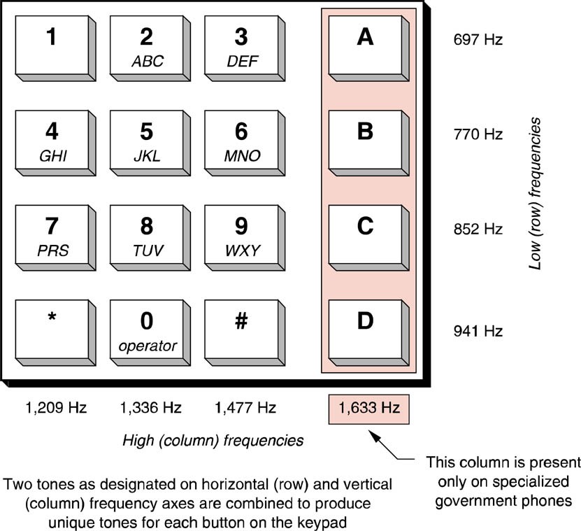
Touch-Tone Dialing
DTMF = Dual Tone Multi-Frequency

Slide 14
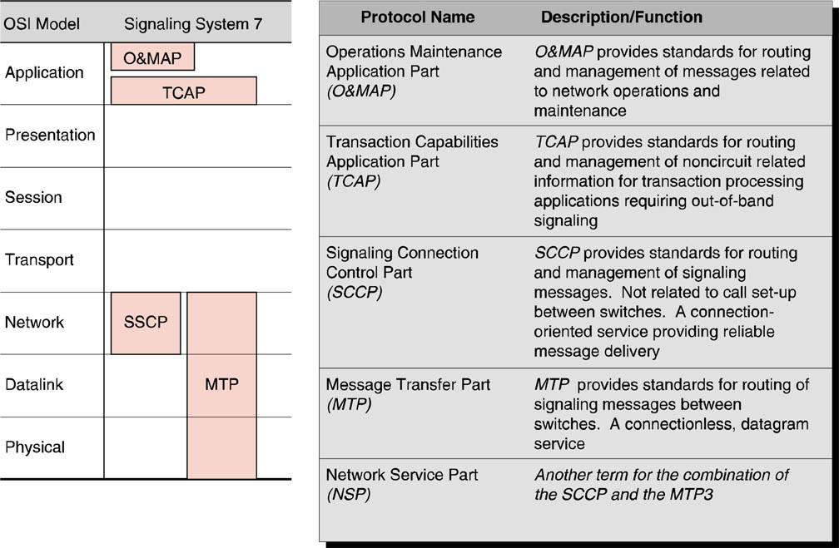
Signaling System 7 Protocols
SS7 mapped to the OSI model
Out-of-band signaling
Notes:
Although in-band signaling works well for communication between the phone handset and the local phone switch across the analog local loop, the inter-switch connections on the digital PSTN make use of a separate channel to carry the system signaling data. Out-of-Band Signaling provides a means to manage the network itself by handling the routing of calls and circuit establishment as well as monitoring circuit status and notification re-routing in the case of alarms or circuit problems. By moving the call setup and management data to a separate network, it becomes easier to support transparent operation between different digital encoding mechanisms. The management data is readily available to each piece of the telephone network equipment regardless of the encoding mechanism used.
Signaling System 7
CCITT-approved standard for out-of-band signaling.
Uses a packet switched network physically separate from the circuit switched network.
Each node on the PSTN must connect to both the voice network and the SS7 network.
Like most protocol suites SS7 can modeled to the 7-layer OSI model.
SS7 and the intelligent services it enables are often described as part of an all-encompassing interface between user and the PSTN know as the AIN (Advanced Intelligent Network) or IN (Intelligent Network).
Services enabled by AIN include:
Alternate billing service (ABS) This service allows a long-distance call to be billed to a calling card, third party, or receiver (collect call).
CLASS (Custom Local Area Signaling Service) A group of services local to the customer's telephone. Examples include call waiting, call forwarding, call blocking, caller ID blocking, busy number redial, and automatic redial of missed calls.
Enhanced 800 service This service allows 800 number portability. Originally 800 numbers were tied to specific area code and long distance provider. This service resolves those limitations.
ICP (Intelligent Call Processing) Using this service customers are able to re-route incoming 800 calls among multiple customer service centers in a matter of seconds. This re-routing is done completely transparent to the calling customer. ICP allows multiple call centers geographically dispersed throughout the country to function as one logical call center, with the overall number of incoming calls distributed in a balanced manner across all centers.
User oriented network services such as AIN are being offered in response to user demands for in-house control over a key element of their business: their telecommunications systems and the links from those systems to the wide area PSTN. Catalog sales organizations for example.

Slide 15
SS7
- controls the structure and transmission of both circuit-related and non-circuit related information via out-of-band signaling between central office switches.
- delivers the out-of-band signaling via a packet switched network physically separate from the circuit switched network that carries the actual voice traffic.

Slide 16
Voice Digitization
The analog POTS system has been supplanted in the modern telephone system by a combination of analog and digital transmission technologies.
Converting a voice conversation to digital format and back to analog form before it reaches its destination is completely transparent to phone network users
There are a limited ways the electrical pulses can be varied to represent an analog signal
Notes:
Voice Digitization
The analog POTS system has largely been supplanted in the modern telephone system by a combination of analog and digital transmission technologies. Although analog is effective, it is limited in terms of quality, distance, and capacity. The longer the signal has to travel, the poorer the quality. Also significant capacity issues are associated with analog transmission. In general the only one voice conversation can be carried on a single set of wires using analog transmission.
Most voice digitization techniques employ a sampling rate of 8000 samples per second.
Pulse Amplitude Modulation (PAM), like AM radio it varies the Amplitude or voltage of the electrical pulses in relation to the varying characteristics of the voice signal. PAM was the voice digitization technique used in some earlier PBXs.
Pulse Duration Modulation (PDM), like FM radio and also known as Pulse Width Modulation (PWM), varies the duration of each electrical pulse in relation to the variances in the analog signal.
Pulse Position Modulation (PPM) varies the duration between pulses in relation to the variances in the analog signal. By varying the spaces in between the discrete electrical pulses on the digital circuit, PPM focuses on the relative position of the pulses to one another as a means of representing the continuously varying analog signal.

Slide 17
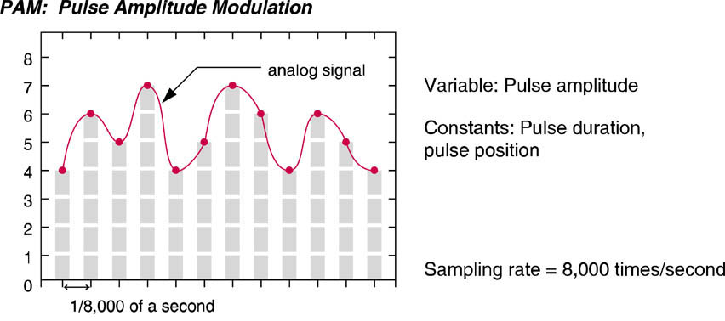
Voice Digitization
Pulse Amplitude Modulation

Slide 18
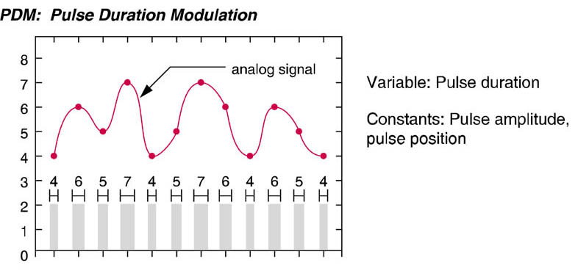
Voice Digitization
Pulse duration modulation

Slide 19
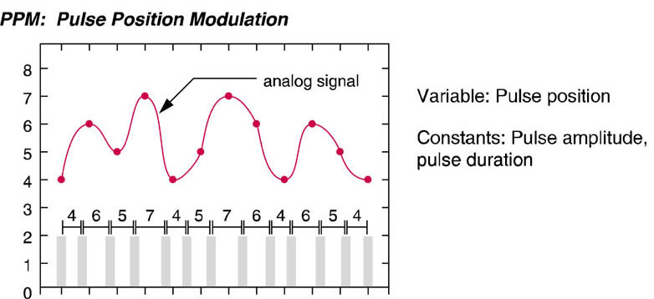
Voice Digitization
Pulse position modulation

Slide 20
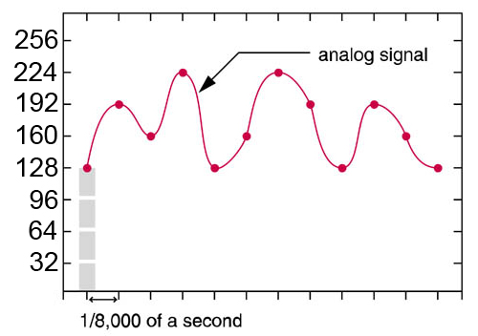
Voice Digitization
Pulse Code Modulation (PCM)
Audio is sampled 8,000 times per second
Each sample contains 8 bits
Digitized signal
10000000 11000000 10100000 11100100 10000000 . . .
Sample 1
Sample 2
Sample 3
Sample 4
Sample 5

Slide 21
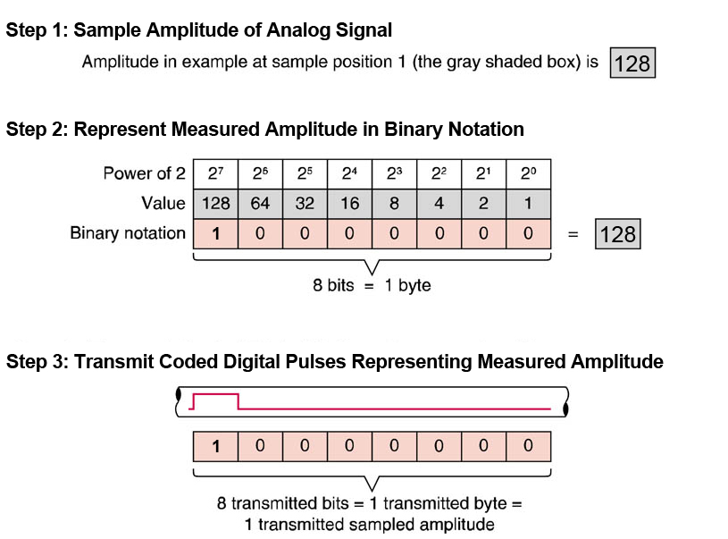
Voice Digitization
Pulse Code Modulation (PCM)
Notes:
Pulse Code Modulation (PCM) – The most common voice digitization technique in use today. Eight bits or one byte is required to transmit the sampled amplitude of an analog signal. Since 8 bit code allows 2⁸ or 256 different possible values, each time the actual analog wave is sampled, it is assigned a value from 0 to 255 depending on its location or amplitude at the instant it is sampled.
The device that samples the analog POTS transmission coming in from the local loop and transforms it into a stream of binary digits using PCM is known as a CODER/DECODER or CODEC. Each codec outputs a digital signal at a data rate of 64 Kbps. This data rate is know as DS-0 or Digital Service 0, and is the basic unit of voice data transmission in a PCM-based telephone system. All higher speed voice connections will operate at some multiple of the DS-0 speed. Codecs are usually deployed as part of a channel bank. A channel bank is a hybrid device consisting of 24 codecs, and the circuitry required to place the digitized PCM voice signals onto a T-1 circuit. Codecs and channel banks may be integrated into telephone switches or purchased separately.
ADPCM – A variation of the PCM technique is Adaptive Differential Pulse Code Modulation. Most commonly used in Europe. ADPCM is an ITU standard that takes a slightly different approach to cding sampled amplitudes in order to use transmission bandwidth more efficiently; ADPCM requires roughly half the bandwidth for each digitized conversation compared with PCM. By transmitting only the approxiamte differenc or change in amplitude of consecutive amplitude samples, rather than the absolute amplitude, only 32 Kbps of bandwidth is required for each conversation digitized with ADPCM.
Using a special circuit known as an adaptive predictor, ADPCM calculates the difference between the predicted and actual incoming signals and specifies the difference as one of 16 different levels using 4 bits (24 = 16). Since each voice channel can be represented by just 4 bits, ADPCM can support 48 simultaneous conversations over a T-1 circuit.
DSP – Digital Signal Processors. Used for Compresing the digital voice signals. Transmission quality degradation varies from one instance to another.

Slide 22
Voice Digitization
Coder/decoder (codec)
Device that samples the analog POTS transmission coming in from the local loop and digitizes it into a stream of bits
Each codec outputs a digital signal at 64 Kbps
DS0 = basic unit of voice transmission 64Kbps
8,000 samples/sec X 8 bits = 64,000 bits/sec
24 DS0s = T1 Line

Slide 23
Voice Transmission Alternatives
Although the PSTN has traditionally been seen as the cheapest and most effective way to transmit voice, alternative methods for voice transmission do exist.
VoIP
Frame Relay
ATM
ISDN

Slide 24
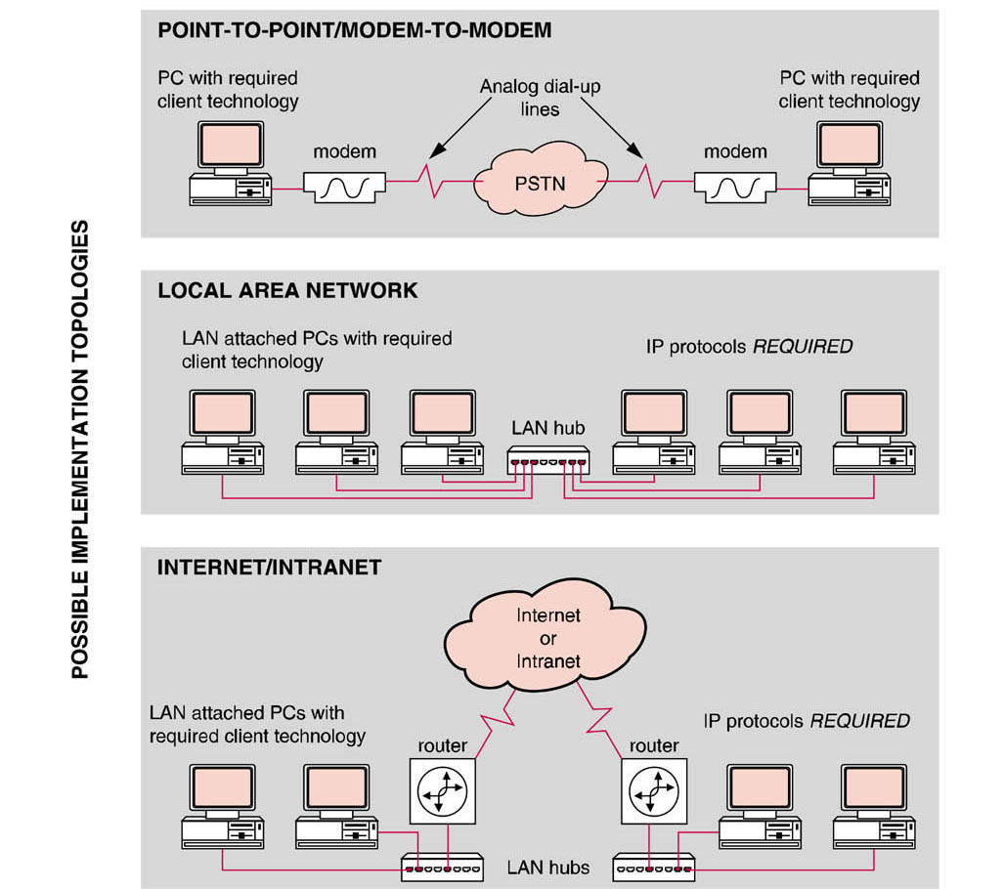
Voice over IP (VoIP)

Slide 25
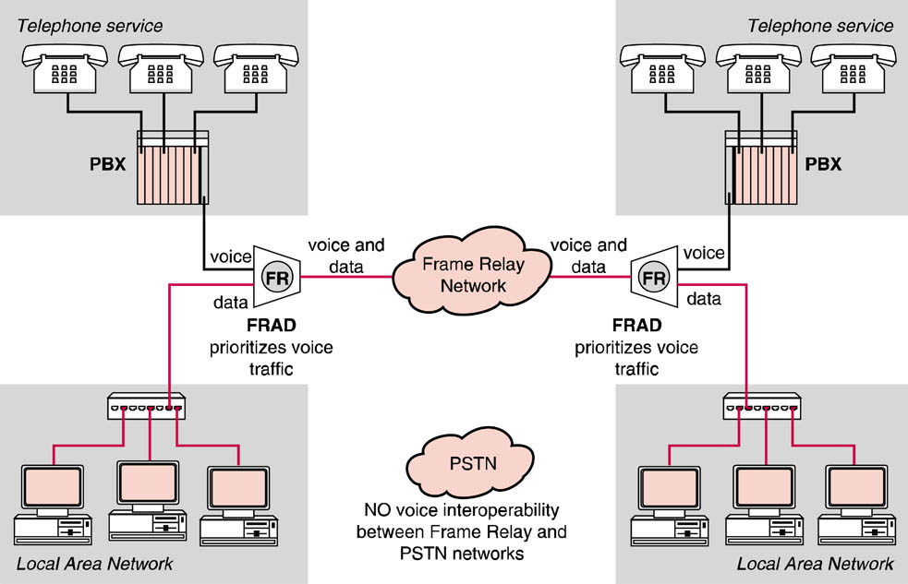
Frame Relay
Voice over Frame Relay

Slide 26
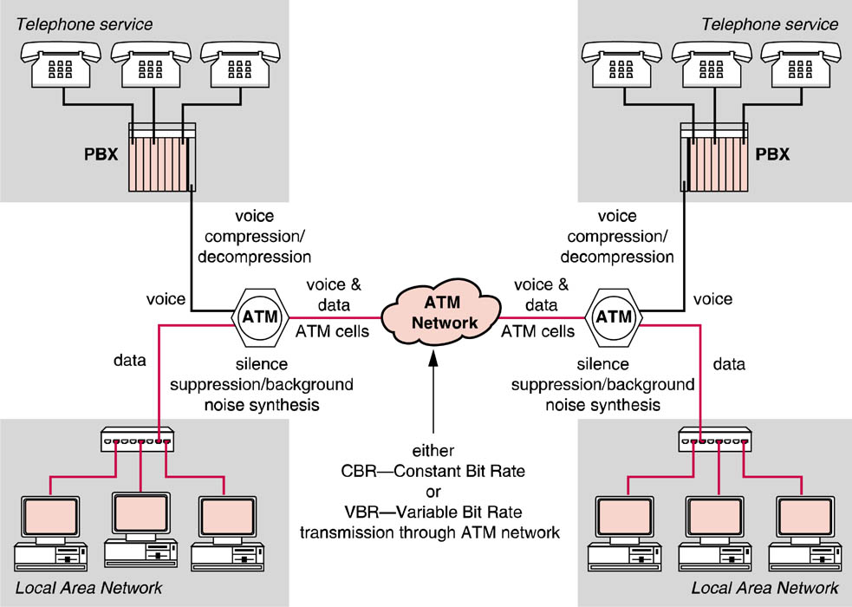
ATM
Voice over ATM

Slide 27
ISDN
ISDN (Integrated Services Digital Network) is a switched digital service that is also capable of transmitting voice and data simultaneously.
ISDN BRI (Basic Rate Interface) service offers two 64 Kbps (Bearer) channels and one 16 Kbps (Delta) channel for a total bandwidth of 144 Kbps.
One of these channels is used for data while the other is used to simultaneously transmit voice.

Slide 28
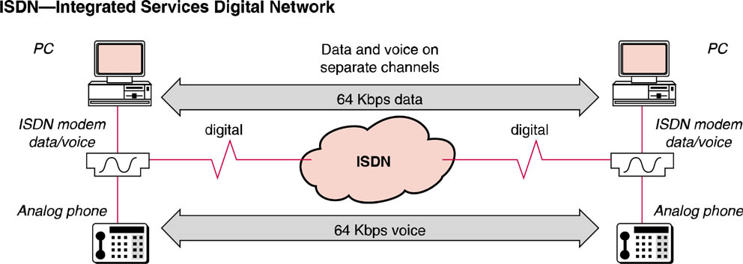
ISDN
Simultaneous voice/data with ISDN

Slide 29
Wireless Voice Transmission
Before cell phones, people who needed mobile-communications installed radio telephones in their cars
The radio-telephone system had one central antenna tower per city, and perhaps 25 channels available on that tower
Using a central antenna meant that the phone in your car needed a powerful transmitter -- big enough to transmit 40 or 50 miles (about 70 km). It also meant that not many people could use radio telephones -- there just were not enough channels.

Slide 30
Wireless Voice Transmission
The genius of the cellular system is the division of a city into small cells. This allows extensive frequency reuse across a city, so that millions of people can use cell phones simultaneously.
A good way to understand the sophistication of a cell phone is to compare it to a CB radio or a walkie-talkie.

Slide 31
Wireless Voice Transmission
Both walkie-talkies and CB radios are half-duplex devices
Two people communicating on a CB radio or on walkie-talkies are using the same frequency, so only one person can talk at a time
Cell phones are full-duplex. That means that you use one frequency for talking and a second, separate frequency for listening. Both people on the call can talk at once.

Slide 32
Wireless Voice Transmission
Channels - A walkie-talkie typically has one channel, and a CB radio has 40 channels. A typical cell phone can communicate on 1,664 channels or more!
Range - A walkie-talkie can transmit about 1 mile (1.6 km) using a 0.25-watt transmitter. A CB radio, because it has much higher power, can transmit about 5 miles (8 km) using a 5-watt transmitter. Cell phones operate within cells, and they can switch cells as they move around. Cells give cell phones incredible range. Someone using a cell phone can drive hundreds of miles and maintain a conversation the entire time because of the cellular approach.

Slide 33
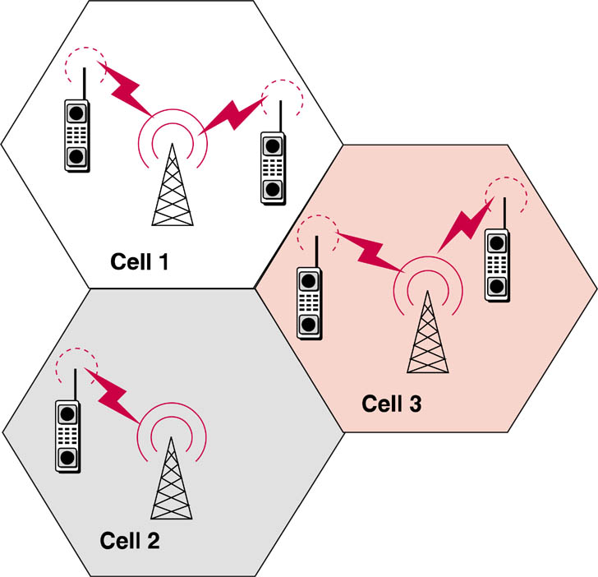
Wireless Voice Transmission
Cells – Service provider chops up service area into 10 sq. mile “cells”
Because cell phones and base stations use low-power transmitters, the same frequencies can be reused in non-adjacent cells, i.e.
Cell 4
cell 1 & 4
Each cell has a base station that consists of a tower and a small building containing the radio equipment.

Slide 34
Wireless Voice Transmission
Cells have 6 sides & each cell is surrounded by 6 other cells
A single cell in an analog cell-phone system uses one-seventh of the available duplex voice channels so it has a unique set of frequencies and there are no collisions
A service provider typically gets 832 radio frequencies to use in a city
Each cell phone uses two frequencies per call -- a duplex channel -- so there are typically 395 voice channels per carrier. (The other 42 frequencies are used for control channels)
Cell 4
Cell 5
Cell 6
Cell 7

Slide 35
Wireless Voice Transmission
Therefore, each cell has about 56 voice channels available. In other words, in any cell, 56 people can be talking on their cell phone at one time.
Each carrier in each city also runs one central office called the Mobile Telephone Switching Office (MTSO).

Slide 36
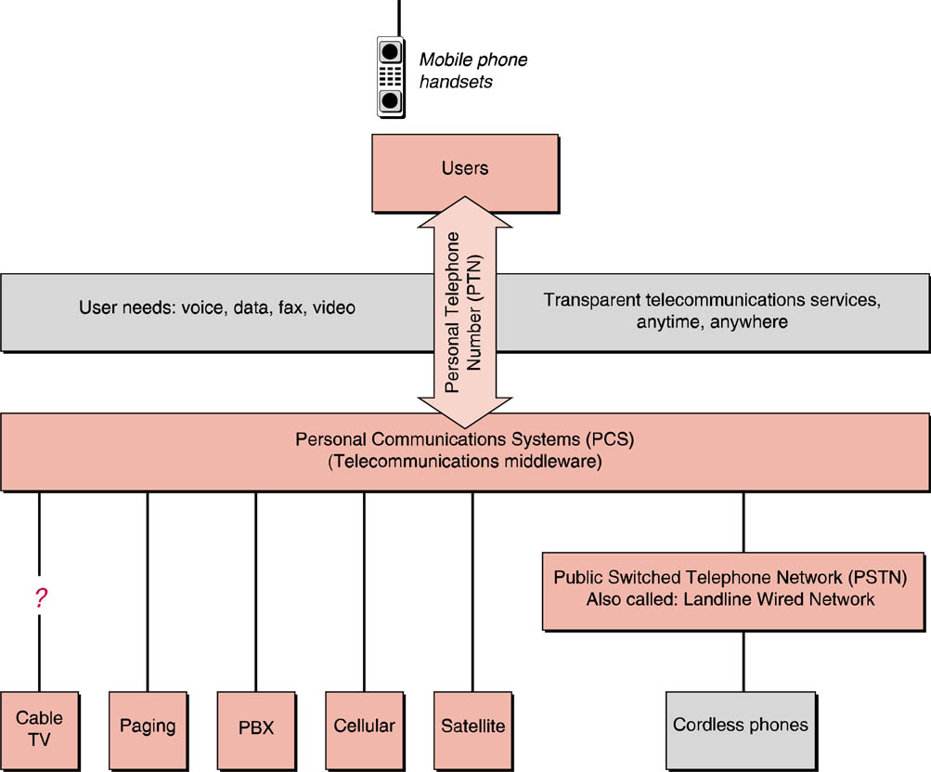
Wireless Voice Transmission

Slide 37
Cellular Standards
Frequency division multiple access (FDMA)
puts each call on a separate frequency
Time division multiple access (TDMA)
assigns each call a certain portion of time on a designated frequency
Code division multiple access (CDMA)
gives a unique code to each call and spreads it over the available frequencies

Slide 38
Cellular Standards - FDMA
FDMA separates the spectrum into distinct voice channels by splitting it into uniform chunks of bandwidth like radio stations
Each station sends its signal at a different frequency within the available band
FDMA is used mainly for analog transmission. While it is certainly capable of carrying digital information, FDMA is not considered to be an efficient method for digital transmission
Used in Advanced Mobile Phone Service (AMPS)

Slide 39
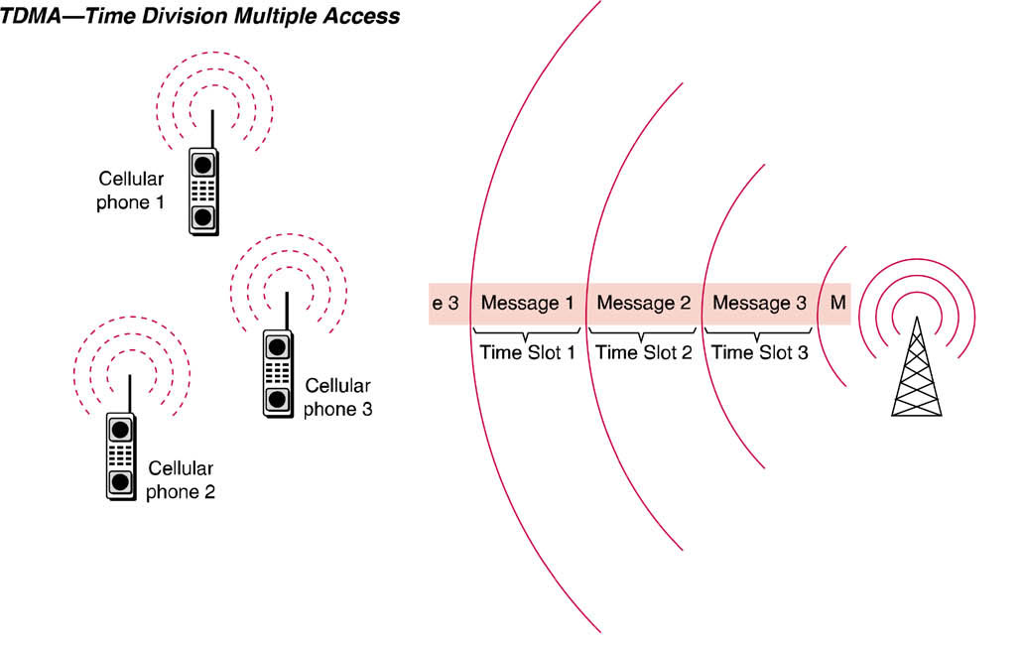
Cellular Standards - TDMA
AT&T
and
T-Mobile
Aka D-AMPS
TDMA achieves more than one conversation per frequency by assigning timeslots to individual conversations
3-times as many calls as AMPS (168 channels/cell)
Data transmission rate = 9.6 Kbps
More technically limited than CDMA

Slide 40
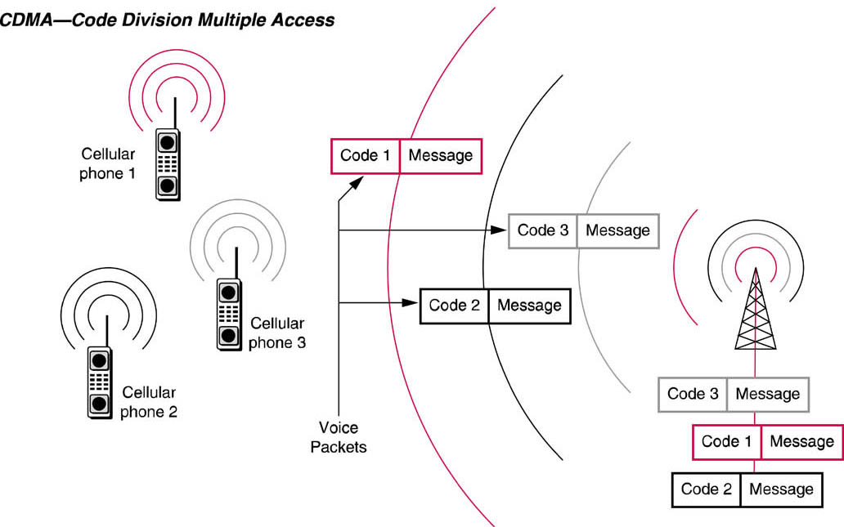
Cellular Standards - CDMA
Verizon
and
Sprint
CDMA attempts to maximize the number of calls transmitted within a limited bandwidth by using a spread spectrum transmission technique
Packets for each call are marked with a code
Patented by Qualcom – requires 8% royalty

Slide 41
Wireless Data Service Generations
Pre-G Technologies (aka 0G)
Enhanced Paging and two-way text messaging (pagers)
Private Packet Radio (proprietary modem)
1G
Circuit-switched analog cellular (AMPS) [Introduced in U.S. in 1983 by AT&T]
Cellular Digital Packet Radio (CDPD) [AT&T - service ended in 2004]
2G
Time Division Multiple Access (TDMA) [AT&T and T-Mobile]
Code Division Multiple Access (CDMA) [Verizon and Sprint]
2.5G
General Packet Radio Service (GPRS) [AT&T and T-Mobile]
Based on TDMA standard
1xRTT [Verizon and Sprint]
Based on CDMA standard
3G
Enhanced Data for GSM Evolution (EDGE) [AT&T and T-Mobile]
Evolution Data Optimized or Evolution Data Only (EvDO) [Verizon and Sprint]
See table on page 193

Slide 42
1G Cellular
Advanced Mobile Phone Service (AMPS)
Analog cellular systems
Operate in the 800MHz frequency range
Uses separate frequencies, or "channels", for each conversation (FDMA)
Have significant limitations …
offer relatively poor signal quality
static and interference are inherent with the system
can handle relatively few concurrent calls per cell
FCC ended service requirement on 2/18/2008

Slide 43
1G Cellular
Cellular Digital Packet Radio (CDPD)
used unused bandwidth normally used by AMPS mobile phones between 800 and 900 MHz.
Speeds up to 19.2 kbit/s were possible.
The service was discontinued in conjunction with the retirement of the parent AMPS service.

Slide 44
2G – Digital Cellular
Digital Cellular offers significant capacity increases compared to AMPS analog cellular systems.
Carriers have steadily moved to digital cellular systems.

Slide 45
2G – Digital Cellular
Call is digitized at the telephone handset and sent in a digital format to the tower
Digital conversations can be compressed which allows between three to 10 digital cell-phone calls to occupy the space of a single analog call.
More calls to share the common bandwidth in a cell concurrently
Quality is greatly improved
Better equipped to support wireless data transmission
2GHz band allocated to digital cellular
Conversations are multiplexed using TDMA or CDMA

Slide 46
2.5G – Cellular
General Packet Radio Services (GPRS) [AT&T and T-Mobile]
Based on TDMA model
Wireless, packet-based communication service
Until recently was the standard 2.5G protocol used in most smartphones
Unlike a circuit-switched voice connection, this is a packet-switched, "always on" connection that remains active as long as the phone is within range of the service. It allows smartphones to do things like run applications remotely over a network, interface with the Internet, participate in instant messenger sessions, act as a wireless modem for a computer and transmit and receive e-mails
Theoretical data transfer rate of >200 Kbps (56Kbps actual)
Some smartphones in the United States still use this protocol, though newer, faster protocols are available

Slide 47
2.5G – Cellular
1vRTT
Based on CDMA model
Data transfer rate of 100Kbps

Slide 48
3G – Digital Cellular
3G technology is intended for the true multimedia cell phone -- typically called “smartphones”
Features increased bandwidth and transfer rates to accommodate Web-based applications and phone-based audio and video files.

Slide 49
3G – Digital Cellular
Enhanced Data GSM Environment (EDGE). EDGE can transmit data at more than three times the rate of GPRS (384 Kbps)
Many smartphones in the United States are now using EDGE protocol
Used by AT&T and T-Mobile

Slide 50
3G – Digital Cellular
EvDO (CDMA 2000)
Data transmission rates:
2.4 Mbit/s with Rev. 0
up to 3.1 Mbit/s with Rev. A (4G)
Used by Verizon and Sprint

Slide 51
Wireless Data Services - GSM
Originally, the acronym GSM stood for Groupe Spécial Mobile, a group formed by the Conference of European Posts and Telegraphs (CEPT) in 1982 to research the merits of a European standard for mobile telecommunications.
Commercial service using the GSM system did not actually start until 1991. Instead of using analog service.
Global System for Mobile communications (GSM) is an international standard. If you travel in Europe and many other parts of the world, GSM is the only type of cellular service available.
Service layer that overlies TDMA (original draft was for CDMA, however vendors & carriers weren’t willing to standardize on a patented technology)

Slide 52
4G - Digital Cellular
Being developed to accommodate the QoS and rate requirements set by forthcoming applications like wireless broadband access, Multimedia Messaging Service (MMS), video chat, mobile TV, HDTV content, Digital Video Broadcasting (DVB), minimal services like voice and data, and other services that utilize bandwidth.
Some 4G protocols are:
Universal Mobile Telecommunication Service (UMTS)
Wideband Code-Division Multiple Access (WCDMA)
High-Speed Downlink Packet Access (HSDPA) [AT&T]
Evolution Data Optimized (EvDO rev. A) [Verizon & Sprint]

Slide 53
Coverage Maps
Verizon
Sprint
AT&T technology
T-Mobile

Slide 54
Private Branch Exchange
A PBX is really just a privately owned, smaller version of the switch in telephone company central offices that control circuit switching for the general public.
Depending on the requested destination, switched circuits are established, maintained and terminated on a per call basis by the PBX switching matrix.

Slide 55
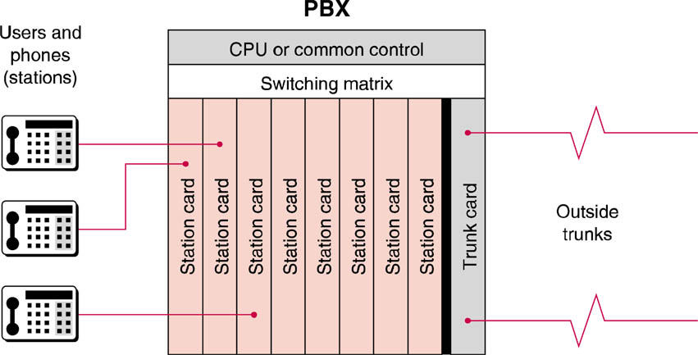
PBX

Slide 56
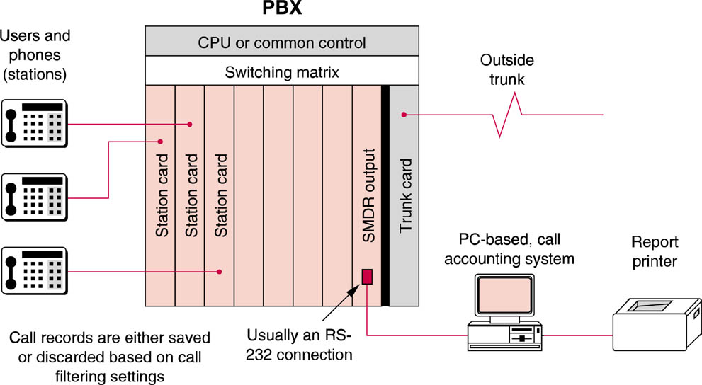
PBX
Call Accounting Systems may be installed with the PBX

Slide 57
Computer Telephony Integration
CTI or seeks to integrate the computer and the telephone to enable increased productivity not otherwise possible by using the two devices in a non-integrated fashion.
CTI is not a single application, but an ever-widening array of possibilities spawned by the integration of telephony and computing.

Slide 58
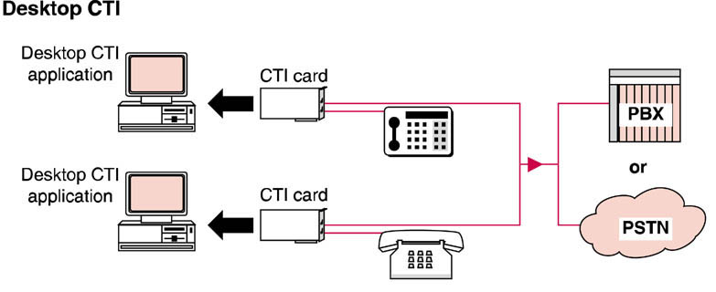
Computer Telephony Integration
Desktop CTI

Slide 59
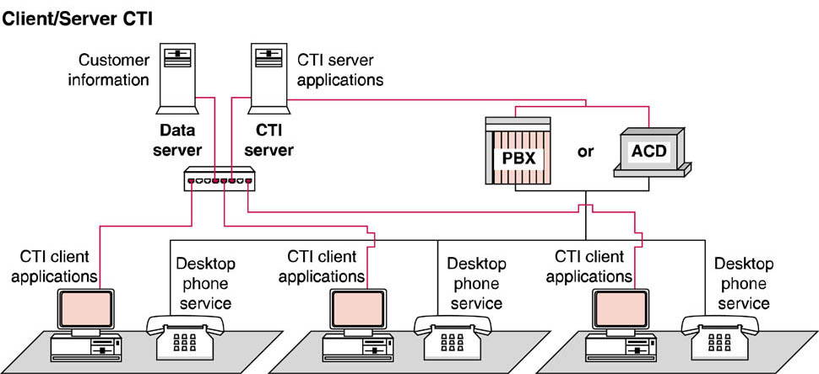
Computer Telephony Integration
Client Server CTI

