Slide 1
Chapter 3
Basic Data Communication Technology
https://cis.BBent.com/Courses/CSIS202/Lessons/3
Notes:
Upon successful completion of this chapter, you should:
Understand modem operation, comparative modem features, the importance of modem standards, and the cost/benefit analysis of various modem purchases.
Understand the comparative features and proper business application of communications software
Understand the implications in terms of technology and cost/benefit of the use of various carrier services
How does one gauge the impact of investment in modem technology?
Potential impacts of modem technology purchases include the ability to transfer data in a manner that is
Faster
More Efficient
More Reliable
More Secure
Standards define methods of:
Modulation
Data Compression
Error Correction
Auto-Dialing
Backward Compatibility
bis = second
ter = third
Before the standardization of the V.90 modem there were two proprietary 56 Kbps modem technologies: X2 from 3COM/US Robotics and 56Kflex from Lucent

Slide 2
Physical Layer
Responsible for the establishment, maintenance and termination of physical connections between communicating devices.
Transmits and receives a stream of bits.
No data recognition at the physical layer.
Operation is controlled by protocols that define the electrical, mechanical, and procedural specifications for data transmission

Slide 3
American Wire Gauge Standard
Think of electrons flowing down a wire like a water flowing through a water pipe
The bigger (thicker) the wire, the more electrons it can carry
AWG is used to measure wire thickness
The higher the gauge number the thinner the wire

Slide 4
Signal Degradation
Attenuation is the decrease in the power of signal over a distance in a particular type of wire or media.
Signal degrades faster on thinner wires
Near-End Crosstalk (NExT) is signal interference caused by a strong signal on one-pair (transmitting) overpowering a weaker signal on an adjacent pair (receiving).
Near End Crosstalk (NExT) and Attenuation to Crosstalk Ratio (ACR) are both measured in dB or decibels.

Slide 5
Communications Media
Non-Twisted Pair
Flat Phone Wire
Unshielded Twisted Pair (UTP)
Shielded Twisted Pair (STP)
Coaxial Cable
Fiber Optic Cable

Slide 6
Unshielded Twisted Pair
Consists of one or more pairs of insulated copper wire twisted around each other at varying lengths ranging from two to twelve twists per foot.
The twisting is used as a mechanism to reduce interference between pairs and from outside sources that can cause data errors and necessitate retransmission.
These individually twisted pairs are then grouped together and covered with a plastic or vinyl jacket, or sheath.

Slide 7
Unshielded Twisted Pair
7 different categories of UTP, 3 are defined in the EIA/TIA 568-B specification
EIA/TIA 568-B also specifies:
Network topology, cable types, and connector types to be used in EIA/TIA 568-B compliant wiring schemes
The minimum performance specifications for cabling, connectors and components such as wall plates, punch down blocks, and patch panels to be used in an EIA/TIA 568-B compliant installations
Beyond CAT 6

Slide 8
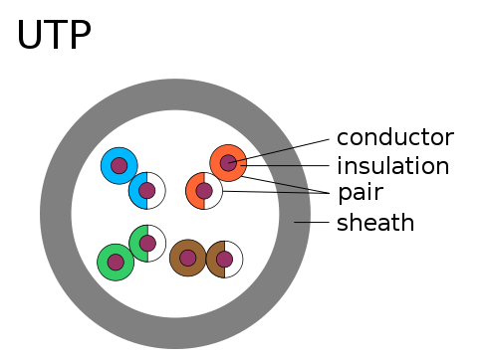
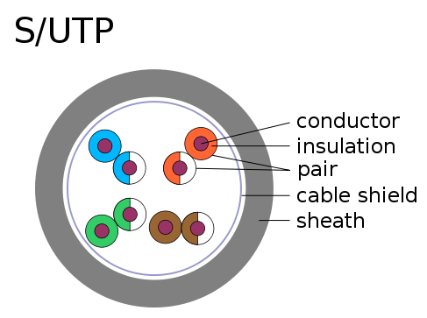
Unshielded Twisted Pair
(Screened UTP)
CAT 5e AWG 24

Slide 9
UTP Specifications
UTP Category
Maximum Data Speed
Attenuation /NEXT limit
Applications
Cat 1
< 1Mbps
Telephone lines
Cat 2
4 Mbps
4 MHz
4 Mbps Token-Ring over UTP
Cat 3
16 Mbps
16 MHz
10baseT Ethernet. Tested for attenuation and near-end crosstalk up to 16MHz.
EIA/TIA
Cat 4
20 Mbps
20 MHz
16 Mbps Token-Ring over UTP. Tested for attenuation and near-end crosstalk up to 20MHz.
Cat 5
100 Mbps (2 pair)
1 Gbps (4 pair)
100 MHz
100baseT (fast) Ethernet, 155 Mbps ATM, Gigabit Ethernet
Cat 5e
100 Mbps (2 pair)
1 Gbps (4 pair)
100 MHz
100baseT (fast) Ethernet, 155 Mbps ATM, Gigabit Ethernet
Category 5e cable has a tighter quality control standard than standard Cat 5 cable
EIA/TIA
Cat 6
2.5 Gbps (2 pair)
potentially up to 10 Gbps (4 pair)
200 MHz
None that require cat 6 at the time of this writing. The IEEE is working on a copper 10 Gbps Ethernet standard that would require cat 6 if released.
EIA/TIA
EIA/TIA = Currently defined in the EIA/TIA 568-B specification.

Slide 10
Common UTP Installation Mistakes
Untwisting the UTP wire more than the maximum 13mm
Bundling the groups of UTP too tightly

Slide 11
Shielded Twisted Pair (STP)
Transmission speed improved by shielding around each pair & the entire group of twisted pairs
Shielding may be metallic foil or copper braid
Commonly used in Token Ring installations
More expensive than UTP cable

Slide 12
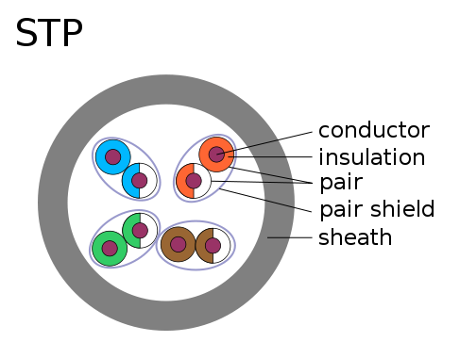
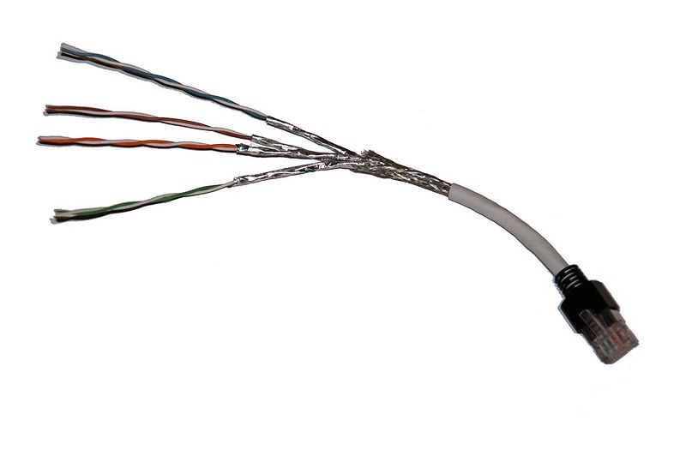
Shielded Twisted Pair (STP)
Screened Shielded STP (S/STP) aka Screened Fully shielded Twisted Pair (S/FTP),

Slide 13
Coaxial Cable
Coaxial cable, more commonly known as coax or cable TV cable, has specialized insulators and shielding separating two conductors allowing reliable, high speed data transmission over relatively long distances.
Coax comes in various thicknesses and has been historically used in Ethernet network architectures (ThickNet and ThinNet).
Modern local area network implementations rarely use coaxial cable today.

Slide 14
Coaxial Cable
With the advent of cable modems and the use of the cable television system as a mechanism to provide high speed Internet connectivity to homes coaxial cable continues to play an important role in data communication

Slide 15
Fiber-Optic Cable
Fiber optic cable is the current reliability and performance champion of the data communication world.
Although the most expensive media choice currently available, fiber optic media delivers data transmission speeds measured in Gigabytes (billions of characters) per second over distances of measured in miles.

Slide 16
Fiber-Optic Cable
Fiber Optic cable is also one of the most secure of all media:
It is relatively untappable, transmitting only pulses of light, unlike all other guided media which transmit varying levels of electrical pulses.
It is immune to electro-magnetic interference contributing to its high bandwidth and data transmission capabilities.

Slide 17
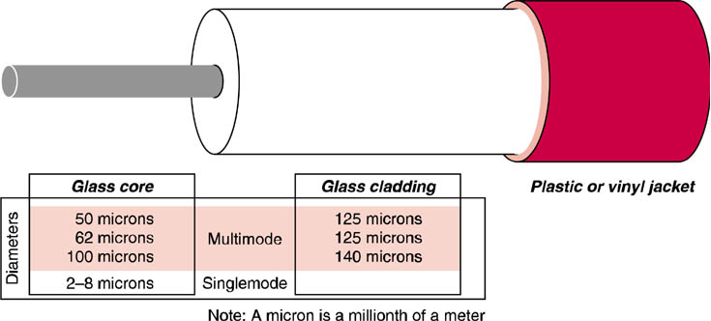
Fiber Optic Cable
Fiber optic cable requires careful handling.

Slide 18
Light Transmission Modes
Once a pulse of light enters the core of the fiber optic cable, it will behave differently depending on the physical characteristics of the core and cladding of the fiber optic cable.
In a Multimode or Multimode Step Index fiber optic cable, the rays of light will bounce off of the cladding at different angles and continue down the core while others will be absorbed in the cladding.
These multiple rays at varying angles cause distortion and limit the overall transmission capabilities of the fiber.
This type of fiber optic cable is capable of high bandwidth transmission but usually over fairly short distances.

Slide 19
Multimode Graded Index Fiber
By gradually decreasing a characteristic of the core known as the refractive index from the center to the outer edge, reflected rays are focused along the core more efficiently yielding higher bandwidth over several kilometers.
This type of fiber optic cable is known as Multimode Graded Index Fiber

Slide 20
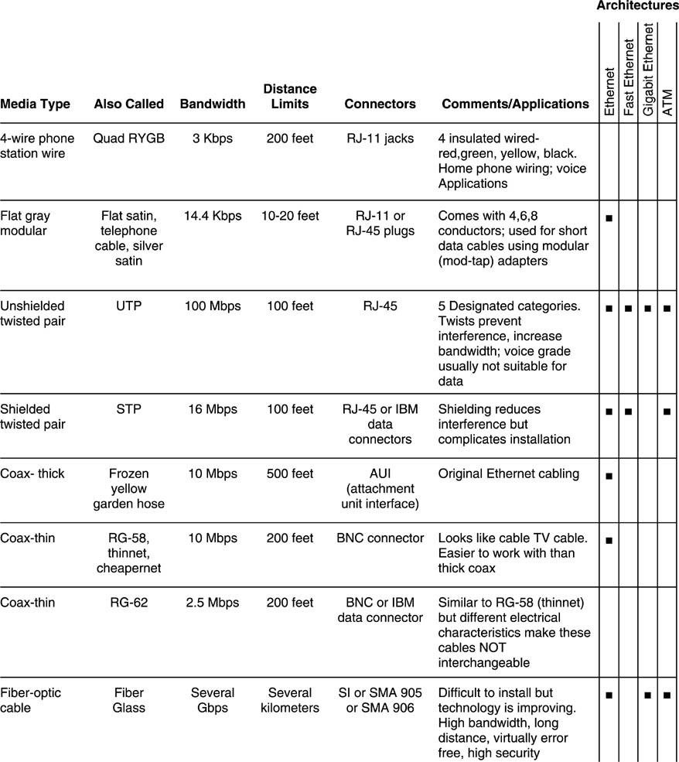
Guided Media Characteristics

Slide 21
Point-to-Point Data Transmission Technologies
The most basic data communication technologies are those used to directly connect two devices.
These connections can be used to connect a computer to peripheral devices.
Operating at layer one of the OSI Network Reference Model, these technologies provide a physical connection that can be used to carry many higher level protocols.

Slide 22
Serial Transmission Standards
Serial transmission is the basis of most data communication between computers.
There are several different serial communication standards available for use in modern computers including RS-232, USB, and IEEE 1394 (Firewire).

Slide 23
RS-232
RS-232 is currently the most commonly used serial standard for modem communication.
Commonly referred to as a serial port.
Limited to 20 Kbps
Maximum distance 50 feet
Most commonly implemented using DB-25 or DB-9 connectors.

Slide 24
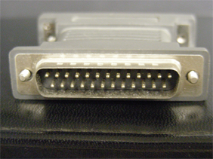
RS-232 DB-25 & Db-9 Connectors
DB-25 Male Connector
DB-9 Female Connector

Slide 25
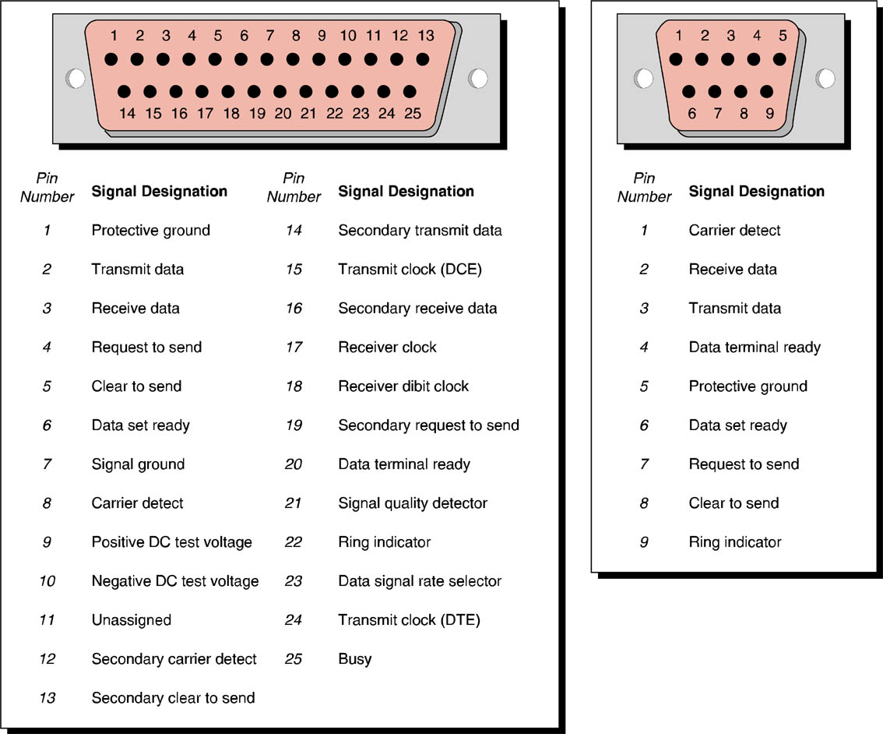
RS-232 Serial Connections

Slide 26
DCE/DTE
Data Communications Equipment (DCE)
Aka Data Circuit Terminating Equipment
Clock end of data circuit
Connects to modem
Data Terminal Equipment (DTE)
Connect to terminal (computer)
Used to identify cable pinouts
In RS-232 Pin 1 connects to Pin 1

Slide 27
UARTs
Universal Asynchronous Receiver Transmitter
Acts as interface between parallel transmission of computer bus and serial transmission of serial port
16550 UART
16 byte on-chip buffer memory

Slide 28
Universal Serial Bus (USB)
Has all put replaced RS-232 in all but the most basic applications.
A high speed, multi-point serial communications technology developed to resolve these shortcomings of RS-232.
There are two versions of USB currently available: the original USB 1.1 specification and a newer higher speed USB 2.0 specification.
USB 2.0 is backwards compatible with USB 1.1.
USB 1.1 = 1.5 Mbps or 12 Mbps
USB 2.0 = 480 Mbps
USB supports up to 127 devices per host controller

Slide 29
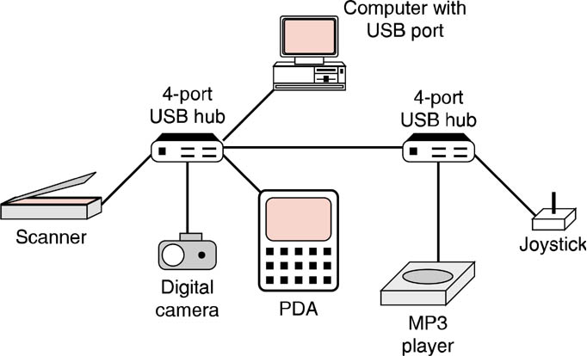
USB Hubs
USB can be used to connect several devices on the same port using hubs.

Slide 30
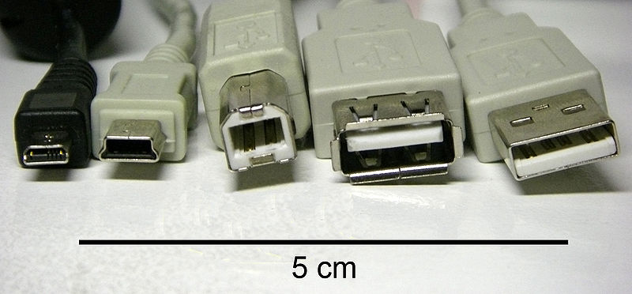
USB Connectors
8-pin Micro
AGOX
Mini
B
A
Receptor
B
A
Original USB specification detailed Standard-A and Standard-B plugs and receptacles
USB 2.0 specification added Mini-B plugs and receptacles.
Also found in male and female forms when used in extension cables.

Slide 31
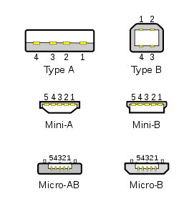
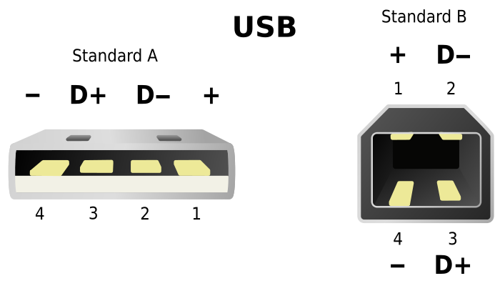
USB Connectors
Many PDAs, mobile phones or digital cameras use the now-deprecated (but standardized) Mini-A and Mini-B and the currently standard Micro-A, and Micro-B connectors
USB icon

Slide 32
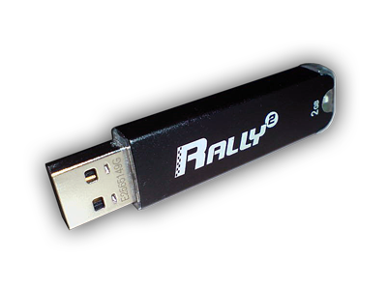
Common USB Implementations
USB thumb drive
USB ports on PC front

Slide 33
USB Soldier

Slide 34
IEEE-1394
IEEE-1394 is a high-speed serial solution ranging in speed from 400 Mbps (original specification) to 800 Mbps at a distance of 100 meters (1394b).
IEEE-1394 includes support for isochronous communication.
Isochronous communication guarantees data delivery at a constant, pre-determined rate.
The constant data delivery rate reduces the need to buffer data thereby greatly reducing the cost of implementing the technology compared to a traditional asynchronous solution.
Full duplex connectors, 4-wire and 6-wire which can supply power to devices

Slide 35
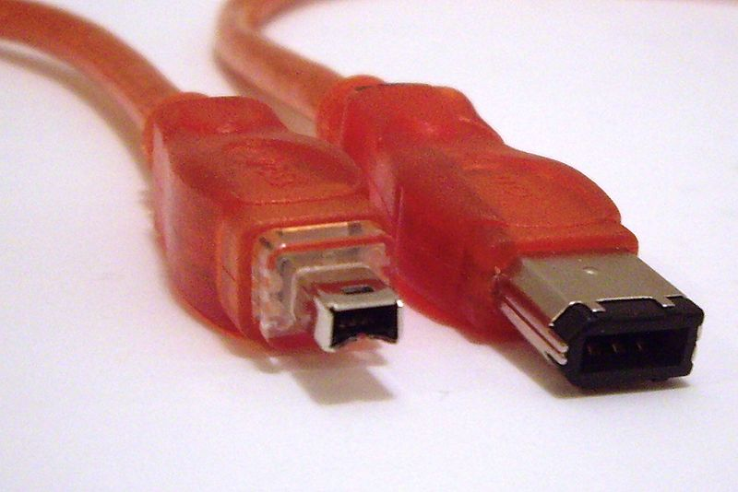
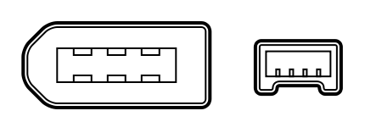
FireWire (IEEE-1394)
Commonly used to connect multimedia devices, including camcorders, to PC’s

Slide 36
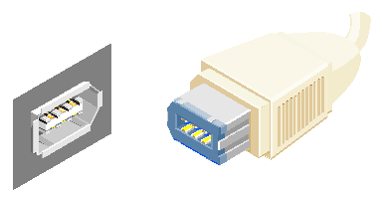
FireWire Connectors
6-wire connector

Slide 37
Parallel Transmission
Uses DB-25 connector on one end and a 36-pin Centronics connector on the other end
Used to be commonly used to connect printers and scanners to a PC
Replaced by USB
Connector no longer offered on new PCs

Slide 38
Centronics Cable
A common means of connecting printers to PC’s

Slide 39
Wireless Technologies
There are two technologies that have been developed as wireless cable replacements: Infrared (IRDA) and radio (Bluetooth).
Personal Area Networks (PAN)
Wireless Mice and Keyboards
Wireless Printers

Slide 40
IrDA
IrDA:
signals are point-to-point nature,
have a narrow angle (30 degree cone),
are limited to around meter, and
have a throughput of 9600 bps to 4 Mbps
IrDA has proven to be a popular technology with compliant ports currently available in an array of devices including:
embedded devices, pagers, phones, modems, cameras, watches, computers (PCs) and laptops, PDAs, printers, and other computer peripherals

Slide 41
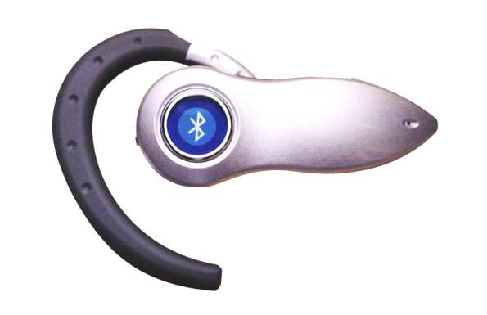
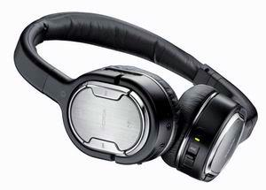
Bluetooth is the name given to an emerging wireless radio frequency (RF) communication standard.
Bluetooth uses radio frequency communication in the unlicensed 2.4-2.4835 GHz band using frequency hop spread spectrum (FHSS).
By constantly changing frequency the transmission tends to be less effected by interference, an especially desirable characteristic for mobile computing applications.

Slide 42
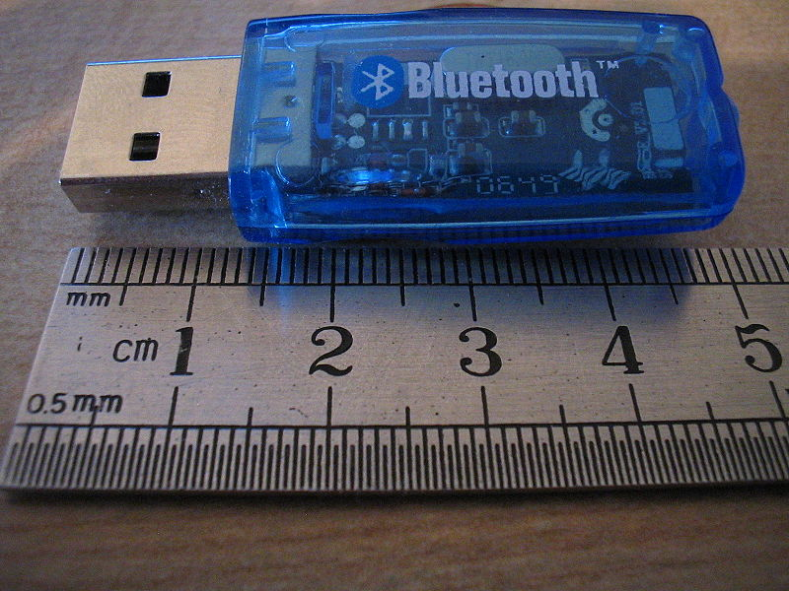
Bluetooth offers data speeds of up to 1 Mbps up to 10 meters.
Unlike IrDA, Bluetooth supports a LAN-like mode where multiple devices can interact with each other.
The key limitations of Bluetooth are security and interference with wireless LANs.
Devices hitting the market that include Bluetooth include cellular phones, PDAs, headphones, and mobile gaming platforms.
Bluetooth USB dongle

Slide 43
Internet Access Technologies
Internet Service Providers (ISPs)
Mainly telecommunications companies
Verizon, AT&T, Sprint
America Online (AOL)
Selecting an ISP
Service hosting
Performance
Cost
Reliability

Slide 44
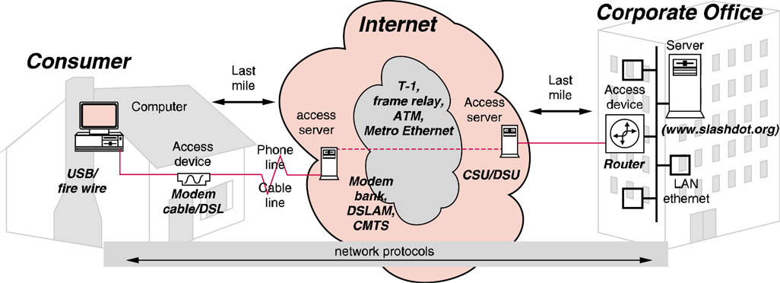
Connecting to the Internet
Dial-up: slow, unreliable
Dedicated (DSL, FIOS, U-Verse, T-1, T-3): up to 25 Gbps down
Cellular/WiMAX: mobile access
Wi-Fi (IEEE 802.11) hotspots: found in coffee houses & airports

Slide 45
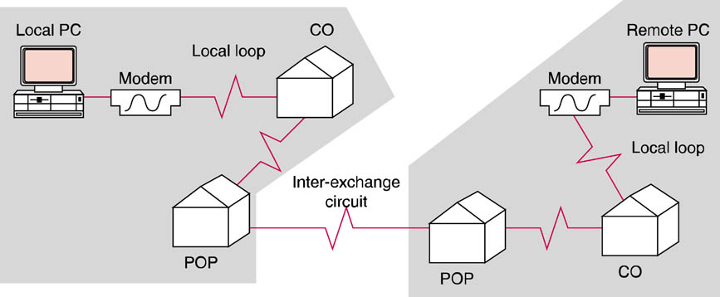
PSTN Architecture
The public dial-up network is accessed using a dial-up modem.

Slide 46
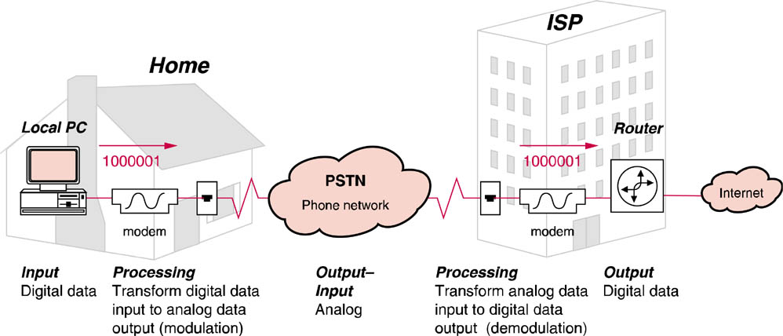
Connecting to the PSTN
The PSTN provides a switched circuit.

Slide 47
Modems and the PSTN
Modem is actually a contraction for Modulator/demodulator
Most local loops that are used for connection to the PSTN to supply switched, dial-up phone service are physically described as two-wire circuits.
Since one of these two wires serves as a ground wire for the circuit, that leaves only one wire between the two ends of the circuit for data signaling.
Dial-up or switched two-wire circuits generate a dial-tone

Slide 48
Modem Standards
Bell standards
V series standards
Non-Standards standards
X2 from 3COM/US Robotics
K56flex from Lucent Technologies

Slide 49
Modem Standards
Modem Standard | Transmission Rate | Baud Rate | Data Compression | Error Correction | Modulation Method
V.90 | 56 Kbps down, 28.8 Kbps up | 3200, 3000, 2400, 2743, 2800, 3429, baud | V.42bis/MNP5 | V.42/MNP4 | Digital downlink & 9QAM &TCM uplink
V.34 | 28.8 Kbps 33.6 Kbps (optional) | 3200, 3000, 2400, 2743, 2800, 3429, baud | V.42bis/MNP5 | V.42/MNP4 | 9QAM &TCM
V.32 ter | 19.2 Kbps | 2400 baud | V.42bis/MNP5 | V.42/MNP4 | 8QAM & TCM
V.32 bis | 14.4 Kbps | 2400 baud | V.42bis/MNP5 | V.42/MNP4 | 6QAM & TCM
V.32 | 9.6 Kbps | 2400 baud | V.42bis/MNP5 | V.42/MNP4 | 4QAM & TCM
V.22 bis | 2400 bps | 600 baud | V.42bis/MNP5 | V.42/MNP4 | 4QAM & TCM
Bell 212A | 1200 bps | 600 baud |  |  | 4PSK
Bell 103 | 300 bps | 300 baud |  |  | FSK

Slide 50
Full-duplex
Full-duplex transmission supports simultaneous data signaling in both directions.
Full-duplex transmission might seem to be impossible on two-wire circuits.
Modems manufactured to the CCITT's V.32 standard (and the later V.34 standard) can transmit in full-duplex mode, thereby receiving and transmitting simultaneously over dial-up two-wire circuits.

Slide 51
Quantization Noise
Created from analog to digital conversion process
Theoretical limit of 56 Kbps can be achieved
FCC limit is 53 Kbps

Slide 52
V.90 Implementation
V.90 has asymetrical data transmission (up/down) transmission rates.

Slide 53
Data Compression
V.42bis
Lempel Ziv algorithm
Increase throughput by a 4:1 (2.5:1) ratio
MNP Class 5
Huffman Encoding
Run-length encoding
Compression ratios of 1.3:1 and 2:1

Slide 54
Error Prevention
Data transmission errors occur when received data is misinterpreted due to noise or interference on the phone lines over which the data message traveled.
Errors can be prevented by:
Reducing the amount of noise or interference on a given transmission line
Employing modulation techniques that are able to adapt to and overcome noisy lines

Slide 55
Digital Subscriber Line (DSL)
One of the faster broadband technologies currently available is Digital Subscriber Line (DSL).
DSL provides an “always on” connection to the Internet over the same copper wires that provide dial-up telephone service.
DSL uses the same copper loop as a POTS line.

Slide 56
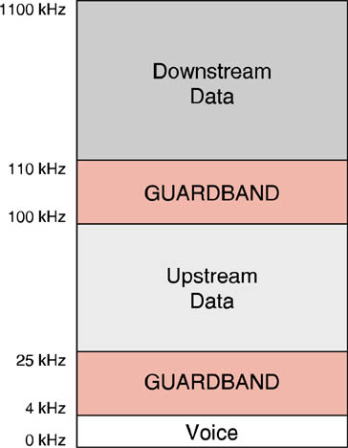
Digital Subscriber Line (DSL)
Frequency Division Multiplexing in DSL

Slide 57
DSL Standards and Technology
Unlike dial-up modems, there is little standardization in the DSL world.
Different vendors have developed different solutions that use different frequencies and modulation schemes.
The only two devices that have to agree on the DSL technology used are the DSL modem and the DSLAM.
Most DSL service providers require customers to rent or purchase DSL modems directly from them.
aDSL, iDSL, sDSL, hDSL, vDSL (see DSL matrix p. 104)

Slide 58
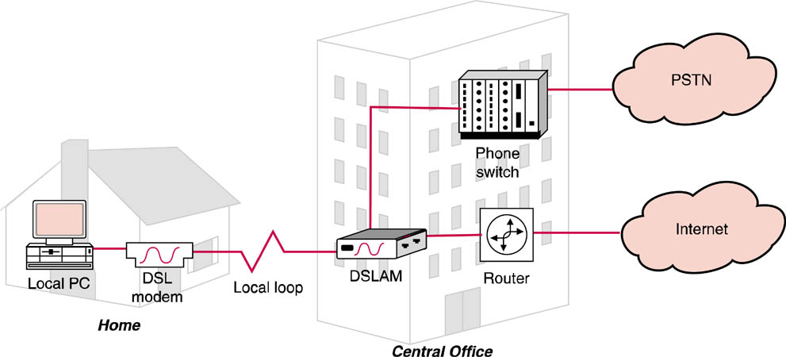
DSL Architecture

Slide 59
Cable Modems
A provider of high bandwidth connectivity to customer premises is the television cable company.
The cable provider’s infrastructure offers a significantly higher bandwidth to the consumer than the local loop provided by the telephone company due to the coaxial cable media used for cable television transmission

Slide 60
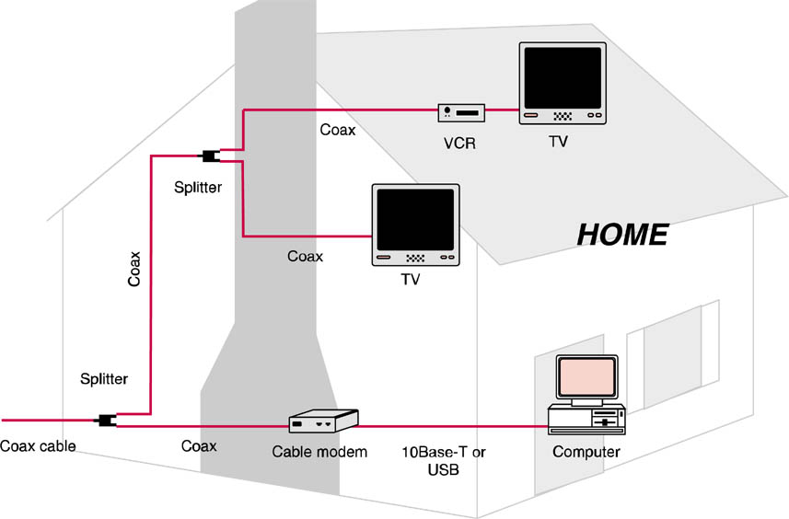
Cable Modem Connection

Slide 61
Cable Data Network

Slide 62
Fixed-Point Wireless
Wi-FI
802.11 a,b,g,n
WiMAX
Worldwide Interoperability for Microwave Access
Cellular
CDMA – 2.5G
EDGE – 3G
EV-DO – 3G (Verizon)

