Slide 1
Chapter 2
Data Communications Concepts
https://cis.BBent.com/Courses/CSIS202/Lessons/2

Slide 2
What We’ll Be Covering
Data Communications Concepts:
Data Communications Architecture
Data Digitization
Data Transmission Techniques
Data Communication Techniques
Error Control Techniques

Slide 3
Overall Data Communications Architecture
Notes:
Various technologies including modems, cable modems, and digital subscriber line technologies can be used as the actual mechanism for accessing the Internet. These technologies, along with the manner in which they implement basic data communications concepts, will be discussed in chapter 3. The technologies depicted in the graphic you see here each represent a portion of the overall end-to-end communication link which we’ll be covering in upcoming chapters.
PC to access device and access device to access server will be covered in chapter 3. Local area networks are covered in chapter 4, access device to access device over the Internet is covered in chapter 6, and the network protocols used for end-to-end communications will be covered in chapters 7 and 8.

Slide 4
Data Digitization
The process of transforming humanly readable characters into machine readable code is character encoding.
Characters are turned into a series of ones and zeroes (bits).
8 bits = 1 byte aka 1 octet
The most commonly used standards are ASCII, EBCDIC, and UNICODE

Slide 5
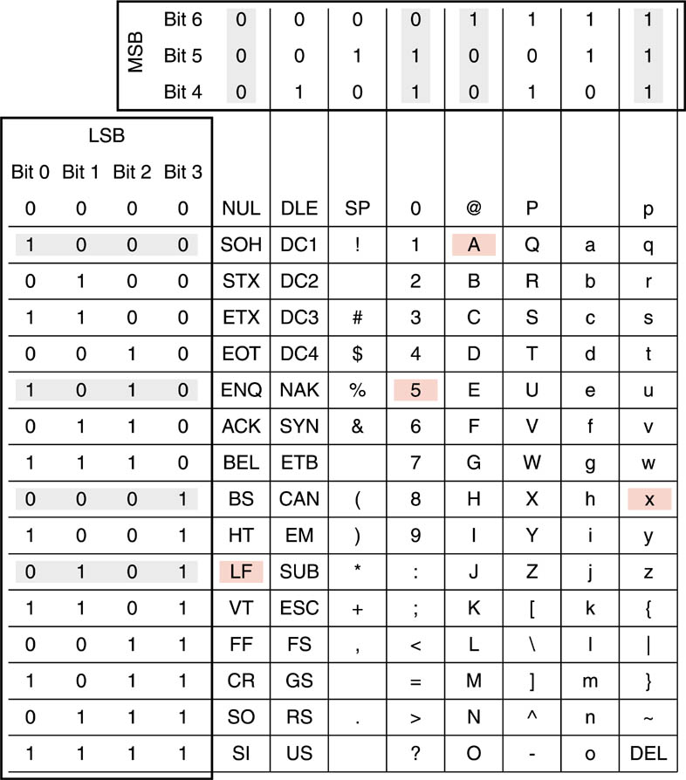
7-Bit ASCII Code table
ASCII encoding is used on most computers today
ASCII table available from Resources page under the “Documents” link

Slide 6
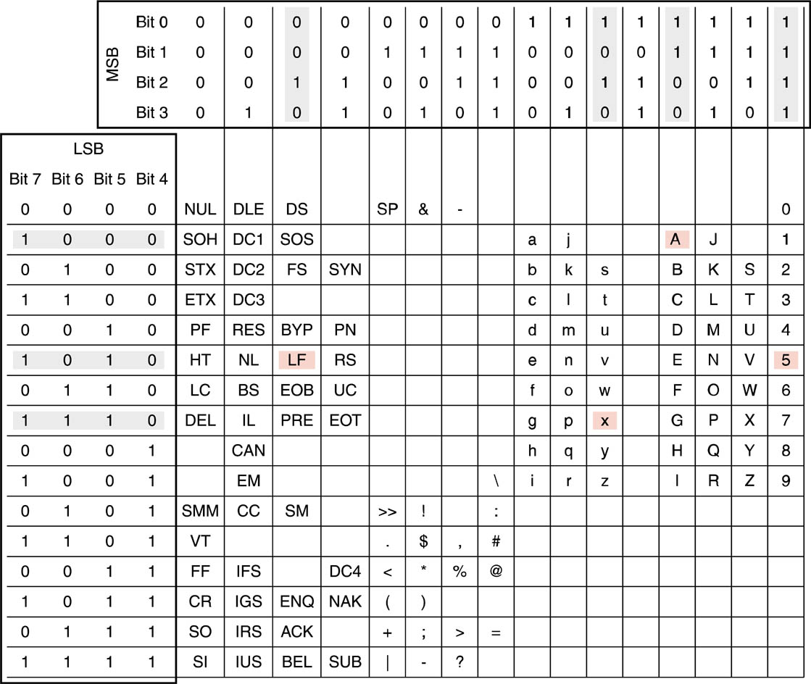
EBCDIC Code Table
EBCDIC is used on IBM Mainframes

Slide 7
Unicode Table
ISO 10646 standard
16 bits = 65,536 characters
Start → Accessories → System Tools → Character Map

Slide 8
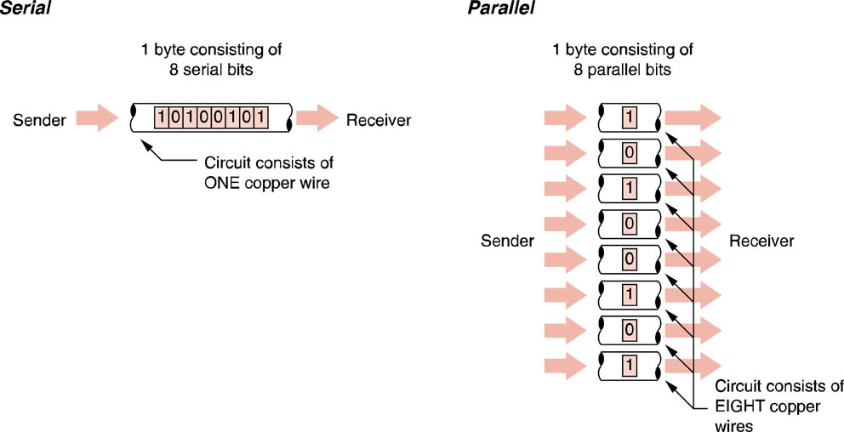
Serial vs. Parallel Data Transmission

Slide 9
Serial vs. parallel Data Transmission
Transmission Characteristic
Serial
Parallel
Transmission Description
One bit after another, one at a time
All bits in a single character transmitted simultaneously
Comparative Speed
Slower
Faster
Distance Limitation
Farther
Shorter
Application
Between two computers, from computers to external devices, local and wide area networks
Within a computer along the computer’s busses, between a drive controller and a hard drive
Cable Description
All bits travel down a single wire, one bit at a time
Each bit travels down its own wire simultaneously with other bits.

Slide 10
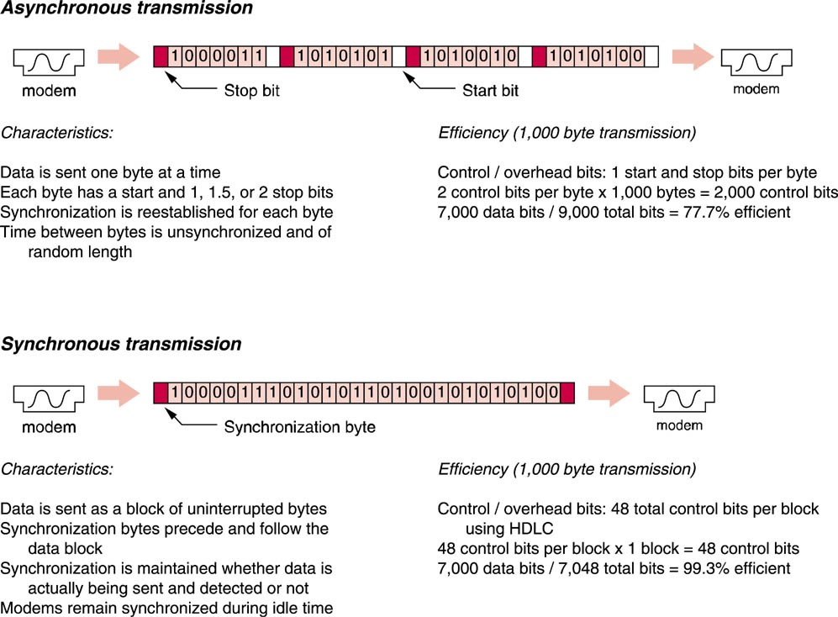
Synchronous vs. Asynchronous transmission

Slide 11
Half vs. Full duplex
Data communications sessions are bi-directional in nature.
There are two environments available for handling this bi-directional traffic: full and half duplex.
In a full duplex communications environment both devices can transmit at the same time.
In a half duplex environment you can only hear or talk at any given point in time.
Given the choice of full or half duplex it is usually better to choose full duplex.

Slide 12
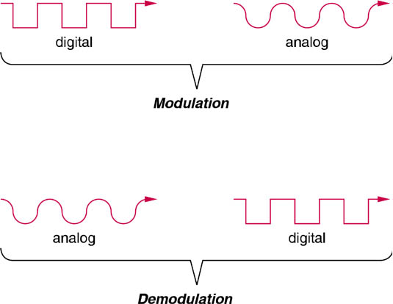
Modulation vs. Demodulation
This process is done by a mo(dulator)dem(odulator)

Slide 13
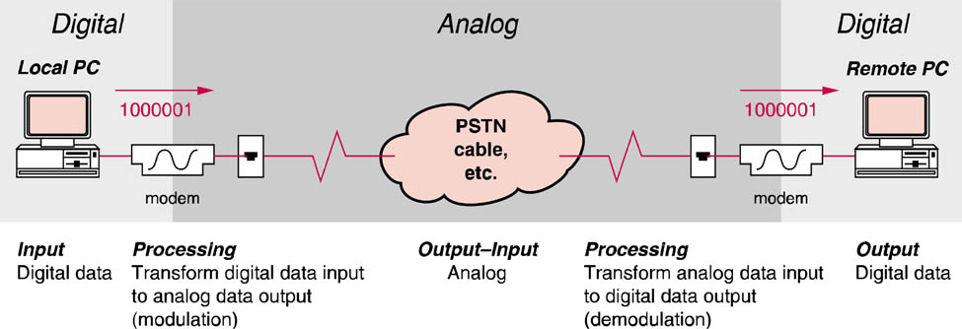
Modem Based Communication Channels
The dial-up modem allows connections through the phone network

Slide 14
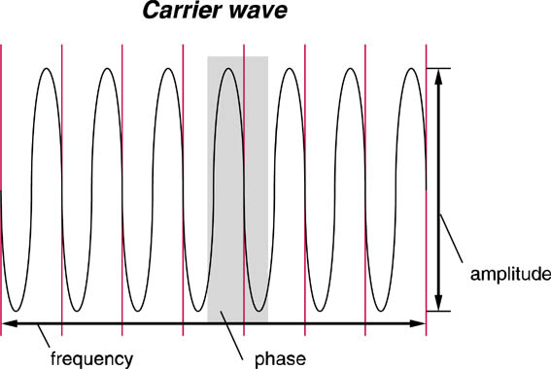
Carrier Wave
There are three properties of a wave that can be modulated or altered:
Amplitude
Frequency
Phase

Slide 15
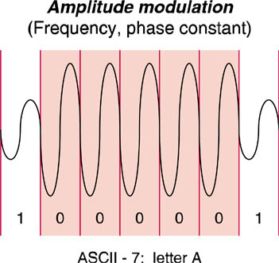
Amplitude Modulation
Each vertical lines separates opportunities to identify a 1 or 0 from another.
These timed opportunities are known as signaling events.
The proper name for one signaling event is a baud

Slide 16
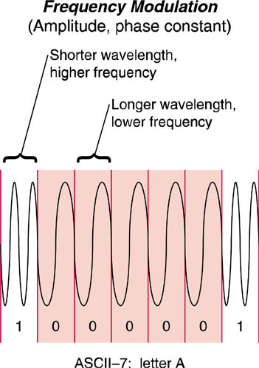
Frequency Modulation
frequency shift keying or FSK

Slide 17
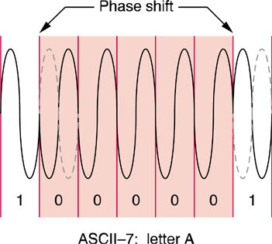
Phase Modulation
phase shift keying or PSK

Slide 18
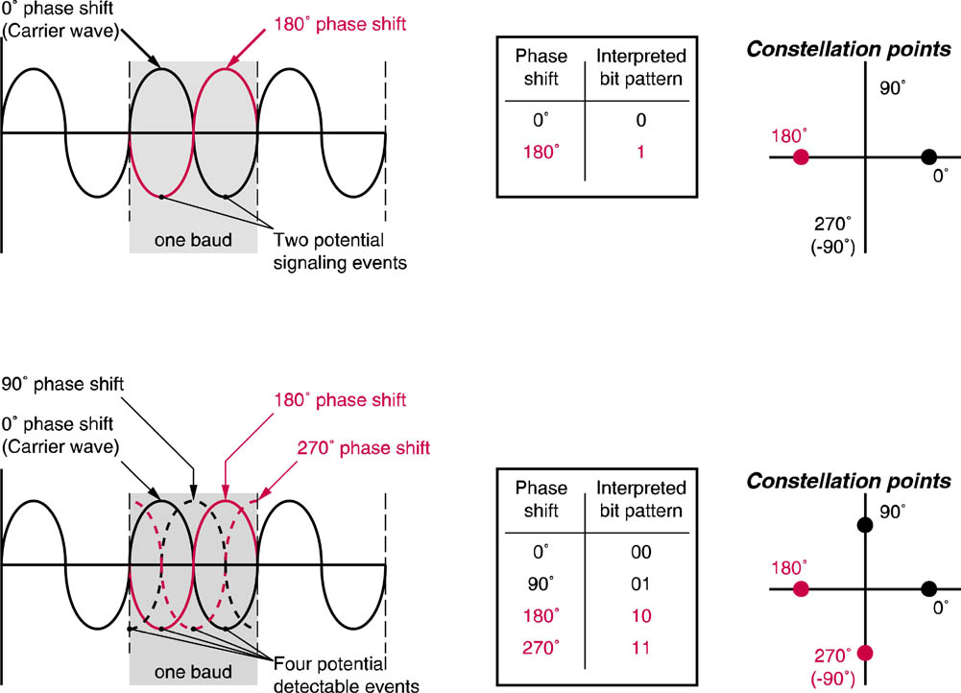
Detecting Phase Shifting
Quadrature Phase Shift Keying

Slide 19
Increasing Transmission Efficiency
There are two ways in which a given modem can transmit data faster:
increase the signaling events per second, or baud rate.
find a way for the modem to interpret more than one bit per baud.

Slide 20
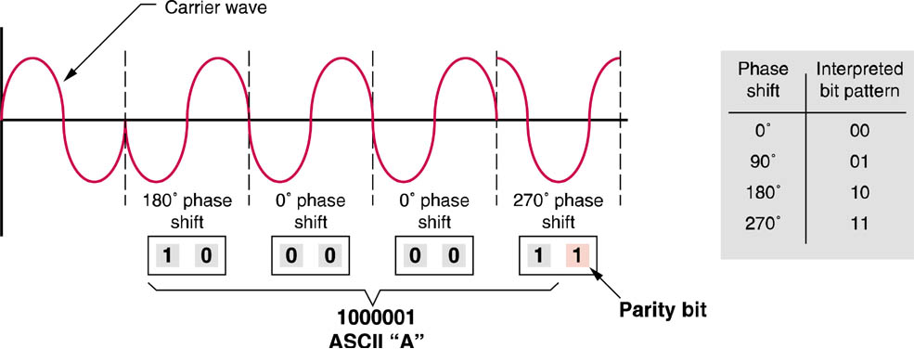
Differential Quadrature Phase Shift keying
This technique improves transmission rate by increasing the number of events per baud

Slide 21
Quadrature Amplitude Modulation
Combines Amplitude Modulation with Phase Modulation

Slide 22
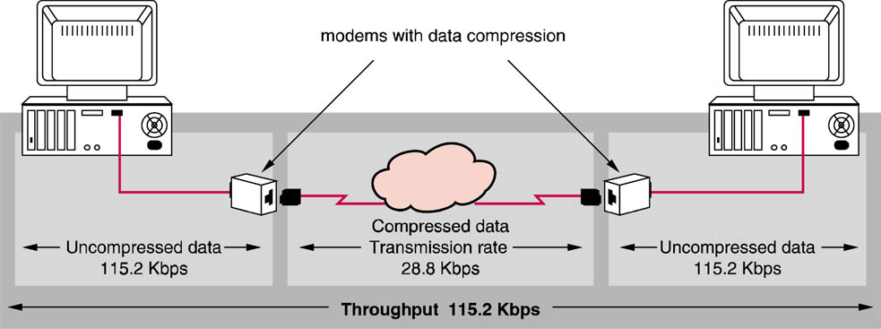
Data Compression
Data compression techniques improve throughput.

Slide 23
Data compression
The sending device replaces strings of repeating character patterns with a special code that represents the pattern.
The code is significantly smaller than the pattern it represents.
This results in the amount of data sent between the sending device and the receiving device to increase.

Slide 24
Packetization
The process of dividing the data steam flowing between devices into structured blocks known as packets.
A packet is a group of bits organized in a pre-determined, structured manner consisting of a piece of the data stream to which management information is added.

Slide 25
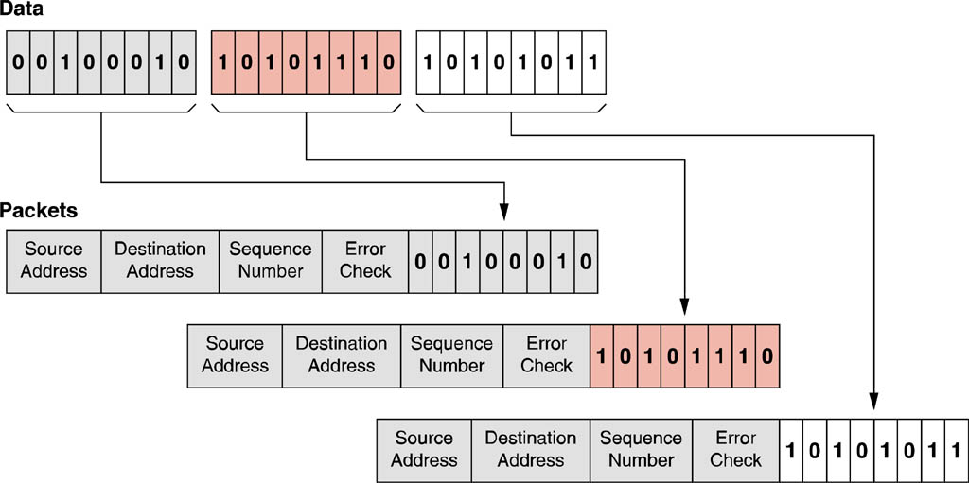
Packetization
This data stream is divided into 3 packets
Note the addition of header information to the data portion

Slide 26
Packetization
The predetermined structure of a packet is critical.
Through the use of standards, devices know the number of bits in each section; the header, data portion and trailer.
Determined by Network Architectures (Ethernet) and Protocols (TCP/IP)

Slide 27
Encapsulation / De-encapsulation
In a layered protocol, each layer adds a header according to the layer’s syntax.
The sending device adds this information in a process of encapsulation
The receiving device reverses the this process (de-encapsulation)

Slide 28
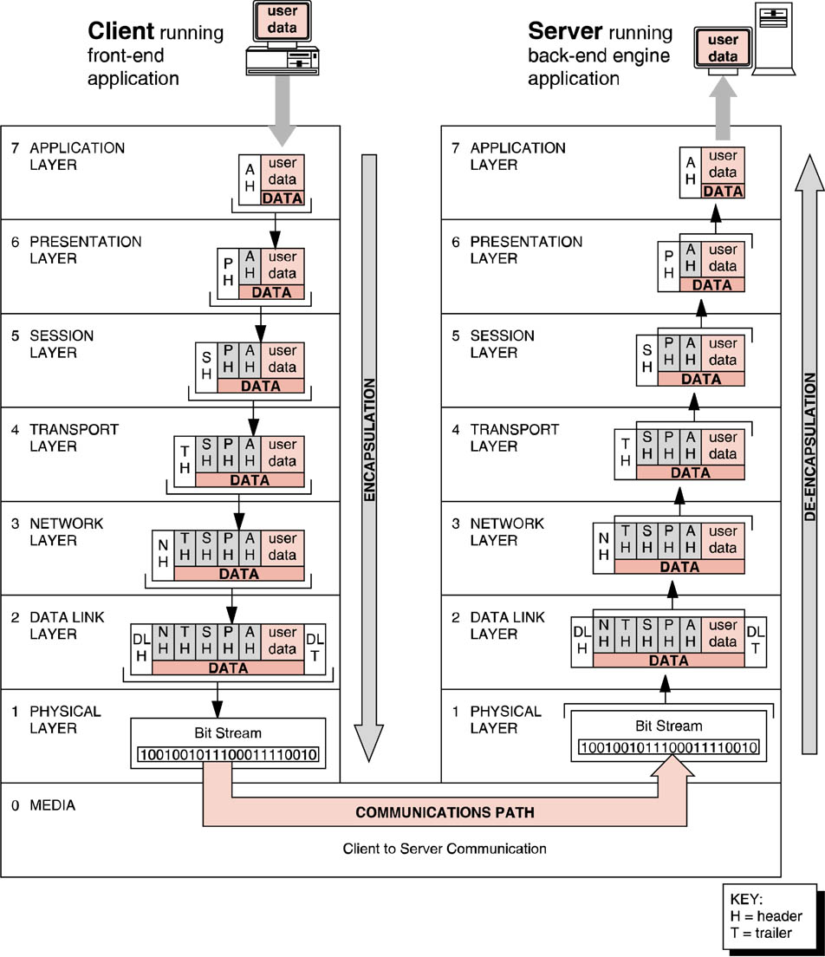
Encapsulation/De-encapsulation in the OSI model

Slide 29
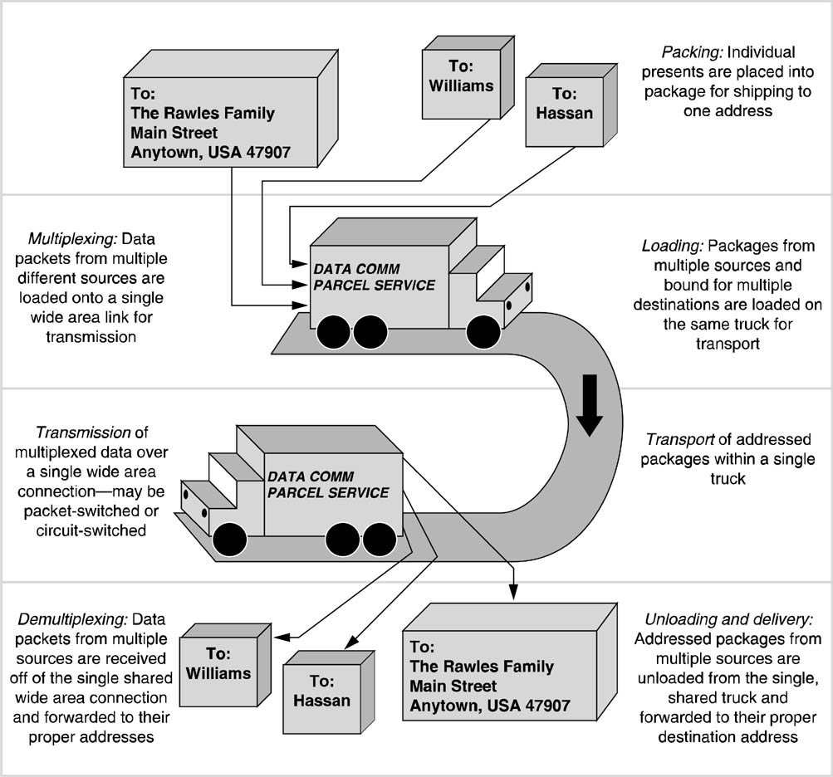
Multiplexing
3 Types:
Frequency Division Multiplexing (FDM)
Time Division Multiplexing (TDM)
Statistical Time Division Multiplexing (STDM)

Slide 30
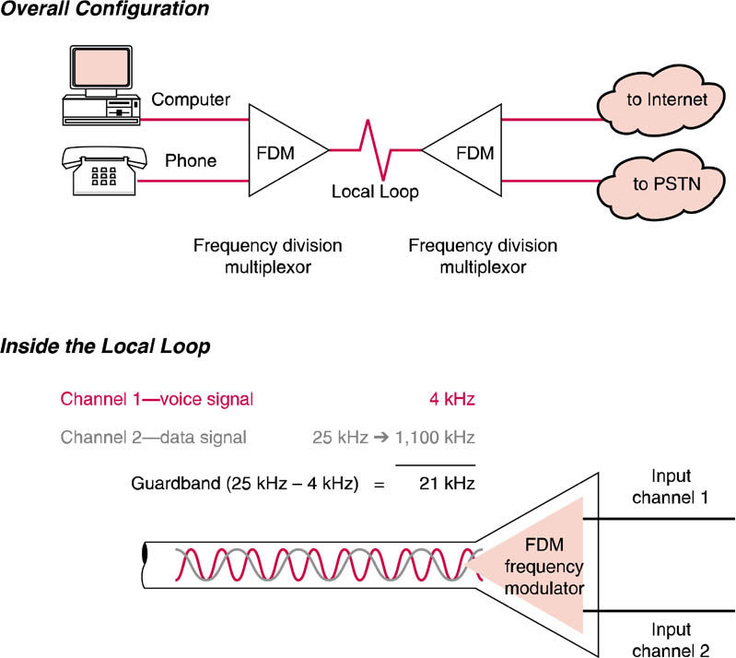
Frequency Division Multiplexing

Slide 31
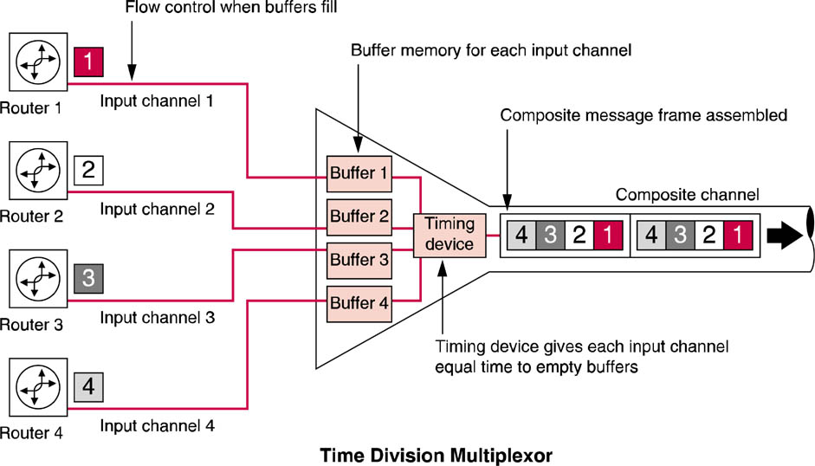
Time Division Multiplexing

Slide 32
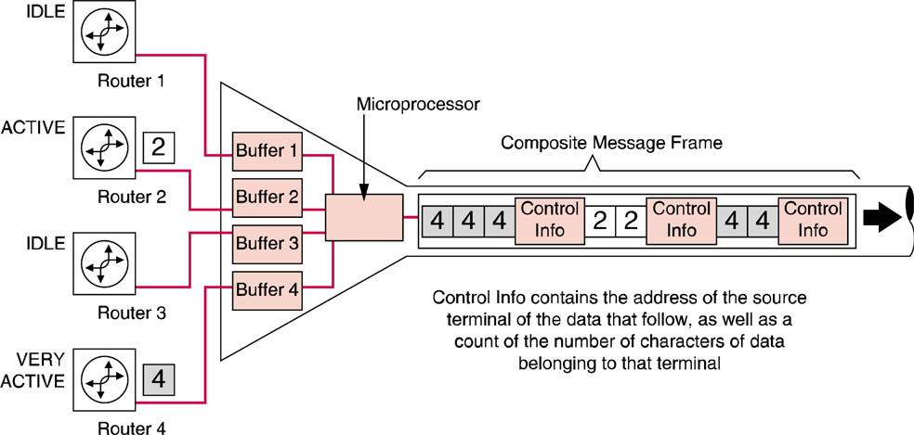
Statistical Time Division Multiplexing

Slide 33
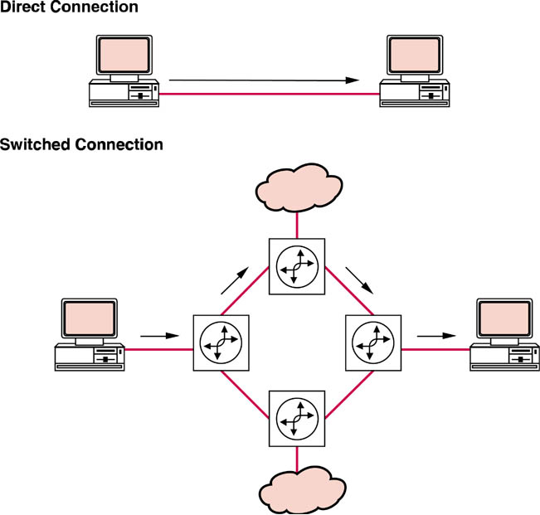
Switching
Switching allows temporary connections to be established, maintained and terminated between sources and destinations

Slide 34
Circuit Switching
The work to create a signal path is done up front; a switch fabric creates a direct path between the source and the destination.
Communication takes place just as if the temporary circuit were a permanent direct connection:
The switched dedicated circuit makes it appear to the user of the circuit as if a wire has been run directly between the communicating devices.

Slide 35
Packet switching
In a packet switched network, packets of data travel one at a time from the message source to the message destination.
The physical path taken by one packet may be different than that taken by other packets in the data stream.
The path is unknown to the end user.
A series of packet switches pass packets among themselves as they travel from source to destination

Slide 36
Circuit vs Packet Switching

Slide 37
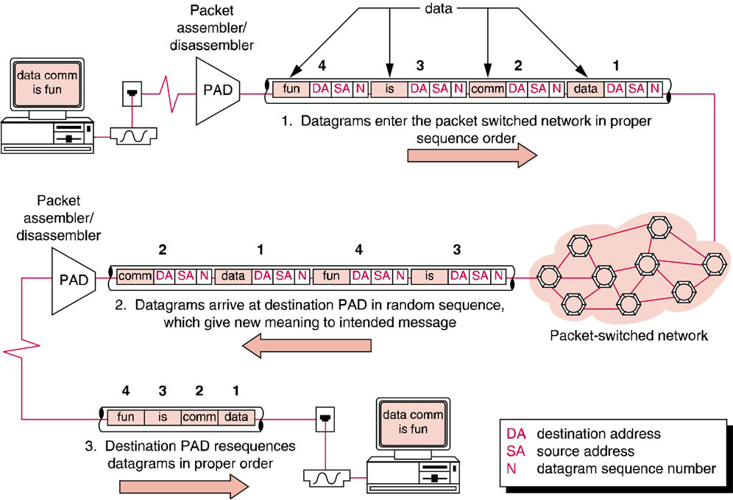
Datagram Delivery on a Packet Switched Network

Slide 38
Connectionless vs. Connection-Oriented Networks

Slide 39
Error Control Techniques
Error Prevention
Error Detection
Error Correction
Flow Control

Slide 40
Error Prevention
Reducing Noise & Interference on Lines Improves Signal to Noise Ratio
Filters
Amplifiers
Repeaters
Adaptive Protocols
Transmission speed is adjusted based on error rates

Slide 41
Error Detection Process
The transmitting and receiving devices agree on how the error check is to be calculated
The transmitting device calculates and transmits the error check along with the transmitted data
The receiving device re-calculates the error check based on the received data and compares its newly calculated error check to the error check received with the data
If the two error checks match, everything is fine. If they do not match, an error has occurred

Slide 42
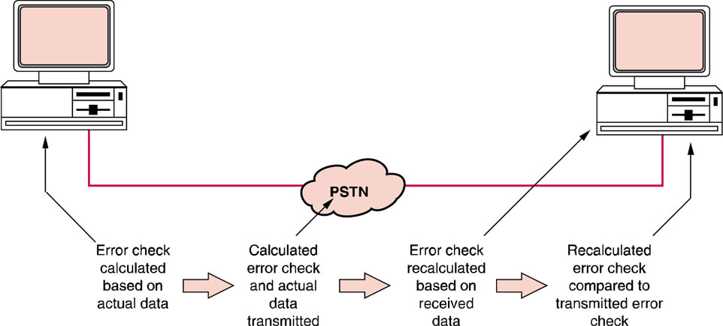
The Error Detection Process

Slide 43
Error Detection Techniques
Parity (VRC)
Longitudinal Redundancy Checks (LRC)
Checksums
Cyclic Redundancy Checks (CRC)

Slide 44
Parity
Parity, also known as a (Vertical Redundancy Check or VRC), is the simplest error detection technique.
Parity works by adding an error check bit to each character.

Slide 45
Parity Checking
Simple parity checking
Also known as Vertical Redundancy Check (VRC)

Slide 46
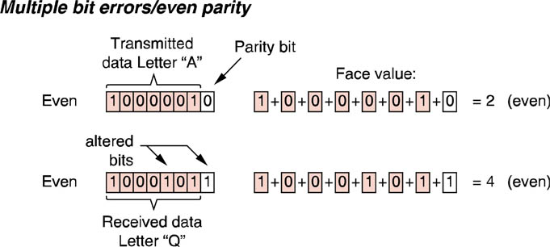
Parity Checking
Parity checks can miss multiple bit errors

Slide 47
Longitudinal Redundancy Check (LRC)
Longitudinal Redundancy Checks (LRC) seek to overcome the weakness of simple, bit-oriented one directional parity checking..
LRC adds a second dimension to parity.

Slide 48
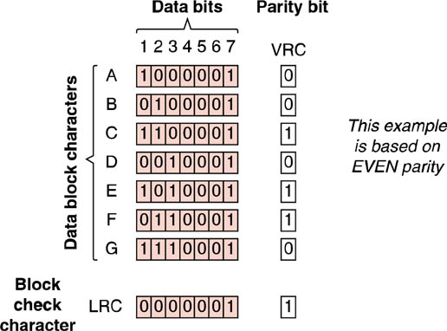
Longitudinal Redundancy Check (LRC)
LRC improves parity checking at the cost of extra data transmitted

Slide 49
Checksums
Checksums are also block-oriented error detection characters added to a block of data characters.
a checksum is calculated by adding the decimal face values of all of the characters sent in a given data block and sending only the least significant byte of that sum.
The receiving modem generates its own checksum and compares the locally calculated checksum with the transmitted checksum

Slide 50
Checksum Calculation
Add ASCII Decimal Value of Characters
Divide by 255
Remainder is the Checksum Character Transmitted
If 128 Letter A’s are transmitted
(A) 65 X 128 = 8,320
8,320/255 = 32 r160
160 in binary = 10100000

Slide 51
Cyclic Redundancy Check (CRC)
Uses Binary Division
16-bit CRC uses a 17-bit divisor
32-bit CRC uses a 33-bit divisor
Error burst up to 1 bit less than CRC can be detected 100% of the time
Larger error bursts at 100 - ½ CRC percent of the time

Slide 52
Error Correction
The receiving device detects the error and requests a re-transmission
The sending device then retransmits the portion that contained the error.
EC Protocol sophistication based on:
How transmission is requested
How much data must be retransmitted
How retransmission time is minimized

Slide 53
Automatic Retransmission Request (ARQ)
Discrete ARQ (ACK/NAK)
Continuous ARQ
Selective ARQ

Slide 54
Discrete ARQ (ACK/NAK)
Also known as “stop and wait”
Receiver sends an Acknowledgement (ACK) if no errors are detected
Receiver sends a Negative Acknowledgement (NAK) if errors are detected
If sender receives ACK it sends next block of data
If sender receives NAK it retransmits original block

Slide 55
Continuous ARQ
Eliminates need for sender to wait for ACK or NAK
Also known as “sliding window” protocol
Sequence number is appended to each block of data sent
Receiver only sends NAK when error is detected & returns sequence number
Sender slides back to sequence number and begins retransmission

Slide 56
Selective ARQ
Continuous ARQ requires retransmission from point of error
Selective ARQ only requires retransmission of sequence number with error

Slide 57
Flow Control
To prevent buffer overflows the receiving device sends a signal to the sending device
The flow control software constantly monitors the amount of free space available in buffer memory and tells the sending device to stop sending data when there is insufficient storage space.
When the buffer once again has room the sending device is told to resume transmitting

