Slide 1
Chapter 11
Network Management
https://cis.BBent.com/Courses/CSIS202/Lessons/11

Slide 2
Managing A Network
Managing a network is a complex process of managing the hardware and software technologies that are linked by networking technologies.
Service Management
IT Infrastructure Management
Systems Administration
Applications, Servers, Desktops, Printers, Users
Microsoft certification courses (NET 120, 121, 122)
Network Management
Routers, Switches, Bridges, Data Transport Services
Cisco certification courses (NET 100, 101, 102)

Slide 3
Service Management
Service management is concerned with the management of IT services and the business processes that depend on them
Benefits/Characteristics of IT services:
Higher quality
Lower cost
Greater flexibility & responsiveness
More consistent service
Faster responses to customer needs
Proactive rather than reactive service definition

Slide 4
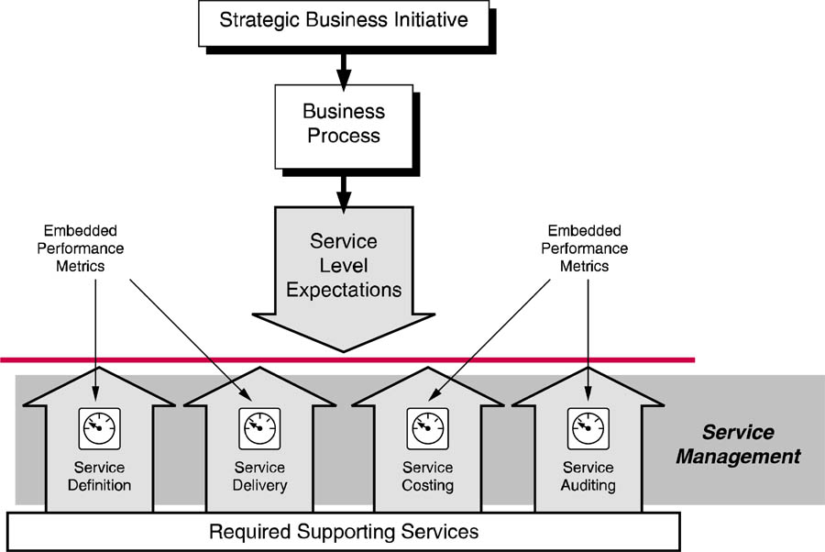
Service Management Architecture
Notes:
These are my notes

Slide 5
Service Definition and Frameworks
Services are defined in terms of:
The processes
Technical expertise (people)
The technology required to deliver those services.
A given service can vary in terms of several characteristics contributing to measurable differences in cost and price:
Complexity
Risk (or lack thereof)
Required service or support level
Level of deviation from basic (“baseline”) service

Slide 6
ISO Management Framework
Categories:
Fault Management
Configuration Management
Performance Management
Security Management
Accounting Management
ISO 7498-4
See page 428

Slide 7
Additional Categories of Service Management
Service Level Management
Incident Management
Problem Management
Change Management
Capacity Management
Asset Management
Availability & Risk Management, Contingency Planning

Slide 8
Service Level Agreements
Services are defined and a given level of service is agreed upon between the customer and the IT services department
The service level agreement clearly describes expected levels of service, how that service will be measured, what that service will cost, and what the consequences will be if the agreed upon service levels are not met

Slide 9
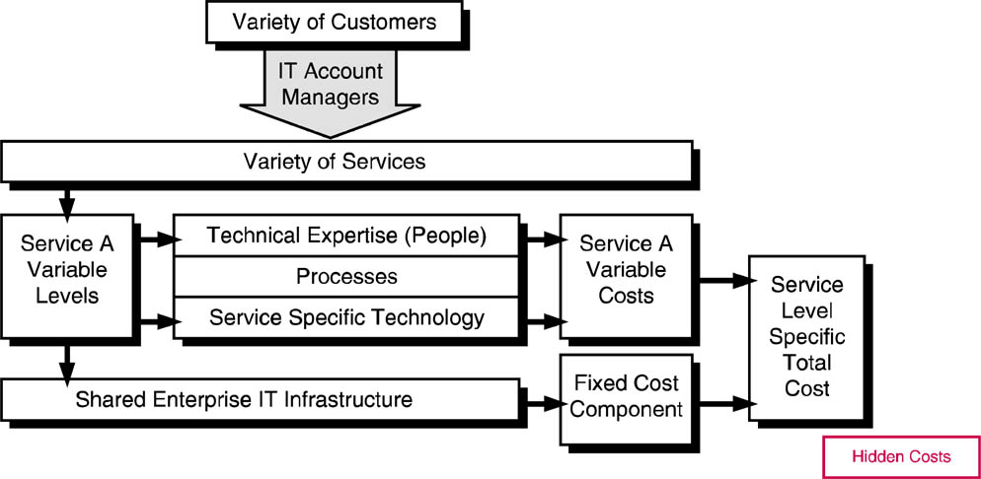
Service Costing
Costing IT services is not a simple matter.

Slide 10
Service Costing
Direct costs: Those that can be directly attributed to the provision of a given service.
Indirect costs: Those that go to support the overall IT infrastructure on which all services depend.
Variable costs: Those that vary directly with the amount or level of service required or purchased.
Fixed costs: Those that do not vary as additional amounts or levels of service are required or delivered.

Slide 11
Elements of IT Infrastructure
Applications & Databases
Desktops, Users, Printers
Servers, Mainframes
Help Desk, Consolidated Services Management
Enterprise Network Management
LAN Management

Slide 12
Elements of IT Infrastructure

Slide 13
IT Infrastructure Management
The achievement of management expectations depends on properly managed components of the IT infrastructure.
An IT infrastructure is made of a combination of separately managed and monitored elements.
These different management tools often do not interoperate or share data.
Multiple different categories of management and monitoring tools are required to ensure end-to-end performance of the overall IT infrastructure.

Slide 14
Application & Database Management
Event & Performance Metrics
Need to be built into applications
“Event” is a database transaction or update
“Instrumentation” refers to embedded performance metrics
“Agents” collect, format & transmit event conditions and performance metrics from applications to the management console
2 primary network variables affecting distributed applications are:
Latency and Bandwidth

Slide 15
Application & Database Management
Application Management Specification (AMS) is a set of management objects that define:
Distribution, dependencies, relationships, monitoring & management criteria, & performance metrics processed by agents
Application Response Measurement (ARM) is an API that can be used by applications developers and can measure several key application statistics.

Slide 16
Application & Database Management
Web-based Enterprise Management (WBEM)
Another possible standard for distributed application management
Integrates SNMP, HTTP & DMI into an application management architecture that can use common Web browser software as its user interface
Developed by IETF

Slide 17
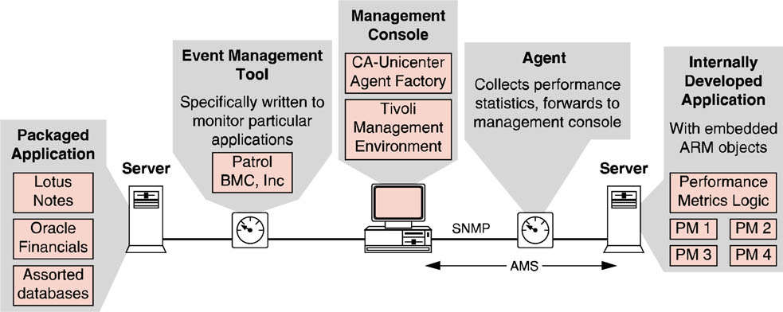
Distributed Application Management Architecture

Slide 18
Enterprise Database Management
IETF database MIB
Major functional areas of consolidated data management:
Global user administration
Heterogeneous data schema & content manipulation
Effective troubleshooting
Support for: Oracle, informix, SQL Server, Adaptive Server, & DB2

Slide 19
Client & Desktop Management
The over­all desktop management architecture is known as the Desktop Management Interface (DMI)
Architecture & protocols are proposed by the Desktop Management Task Force (DMTF)
Concerned with the configuration & support of workstations/clients, their operating systems & assorted hardware like scanners, printers, etc.

Slide 20
DMI Architecture
DMI services layer is the DMI application that resides on each desktop device to be managed. The DMI services layer does the actual processing of desktop management information on the client platform and serves as an interface to two APIs.
The management interface API is designed to interface to the desktop system management program that will consolidate the information from this client with all other desktop information.
The component interface API is designed to interface to the individual application programs or desktop components that are to be managed and monitored on the local client.
Information about the local desktop components is stored locally in a MIF or management information format.

Slide 21
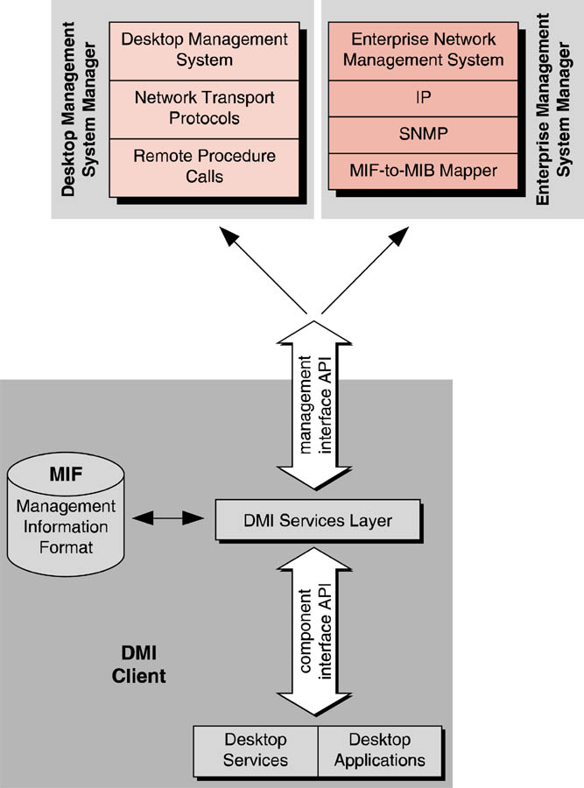

Slide 22
Desktop Management Technology
Desktop management technology from vendors can best be described as suites of associated desktop management applications including:
Hardware & Software Inventory
Asset Management
Software Distribution
License Metering
Server Monitoring
Virus Protection
Help Desk Support
Additional DMI Functional categories on pages 438-439

Slide 23
Mobile Desktop Management
Mobile MIF (for laptops)
Battery Levels
Docking Status
Infrared Ports
Video Display Types
Pointing Devices
Device bays

Slide 24
Configuration Management
Single Sign-On
Directory Services (AD & NDS)
Policy-based Management Tools
Group Policy Objects (GPOs)
User access rights
Startup applications, background colors, corporate approved screen savers
Deny user access to network if virus checking or metering is disabled
Prevent users from installing programs

Slide 25
Help Desk Systems
Trouble ticketing & tracking
Asset management
Change management
Integration with event management systems
Support of business-specific processes & procedures
Call center management
Search engine
Help Desk software functionality pages 442 - 443

Slide 26
Asset Management
Electronic Software Distribution (ESD)
Automatically install software (push)
Update configuration files
Update software
License metering software
Ensures legal usage of software
License optimization
Dynamic allocation
Load balancing
Global license sharing
Licensing Server API (LSAPI)
LAN inventory management software
Gathers information about hardware & software (p446)

Slide 27
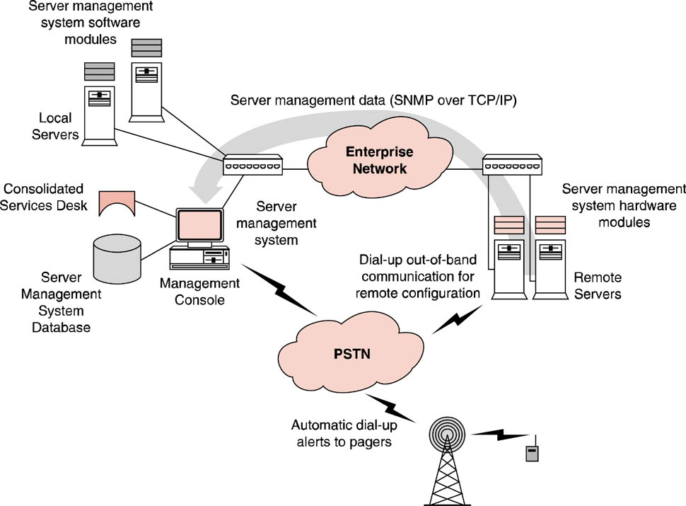
Server Management Architecture
Servers are the workhorses and providers of basic system functionality

Slide 28
Server Management Software
Seeks to ease systems administrators’ chores by effectively monitoring, reporting, troubleshooting, and diagnosing server performance.
Server management software must provide server capacity planning capabilities by monitoring server performance trends and making recommendations for server component upgrades
Some server management software is particular to a certain brand of server, whereas other server management software is able to manage multiple different brands of servers.

Slide 29
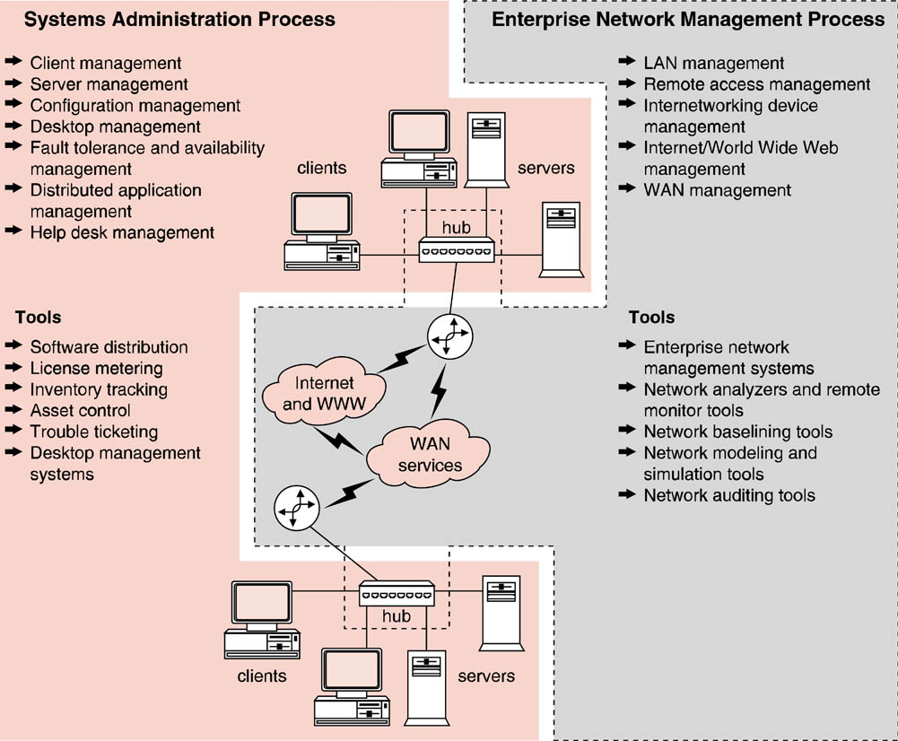
Distributed IT Infrastructure Administration and Management

Slide 30
Consolidated Service Desk (CSD)
Such an approach offers a number of benefits:
As a single point of contact for all network and application problem resolution
The consolidation of all problem data at a single location allows correlation between problem reports to be made
Resolutions to known user inquiries can be incorporated into intelligent help desk support systems
Software upgrades could be centrally handled by electronic software distribution technology.
Network security policies, procedures, and technology can also be consolidated at the CSD.

Slide 31
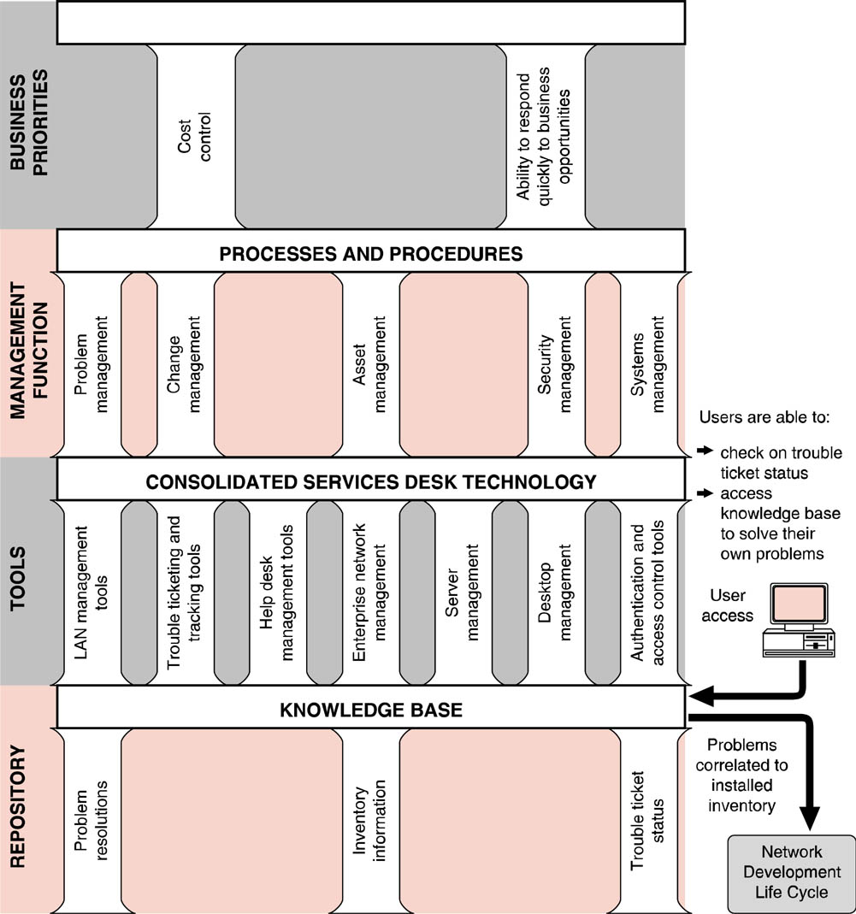
CSD Architecture

Slide 32
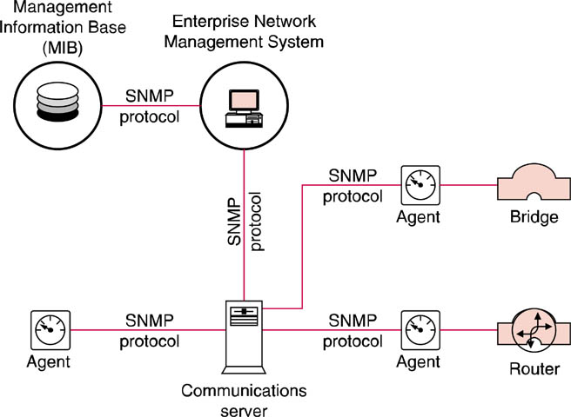
Enterprise Network Management
Enterprise network management is no longer limited to ensuring that a network is available and reliable

Slide 33
QoS
Providing end-to-end delivery service guarantees is referred to as quality of service (QoS).
To provide service management guarantees, networks must be able to ensure that individual applications are delivered according to agreed upon service levels.
Applications must be able to be uniquely identified, and networks must be able to respond to application needs on an individual basis.

Slide 34
Bandwidth Management
Used interchangeably with the term traffic shaping,
Allocation of bandwidth to support application requirements.
These techniques and their associated technologies use either rate control or queuing or a combination of the two.
Traffic shaping devices will NOT improve the performance of latency-constrained applications.

Slide 35
Enterprise Network Management
Agents are software programs that run on networking devices such as servers, bridges, and routers to monitor and report the status of those devices.
Agent software must be compatible with the device that is reporting management statistics

Slide 36
Network Management Information
The network management information gathered must be stored in some type of database with an index and standardized field definitions so that network management workstations can easily access these data.
A MIB, or management information base as these databases are known, can differ in the fields defined for different vendor’s networking devices.
The RMON MIB is a fairly standard MIB
Partly due to the dominance of TCP/IP as the internetworking protocol of choice, SNMP (simple network management protocol) is the de facto standard for delivering enterprise management data.

Slide 37
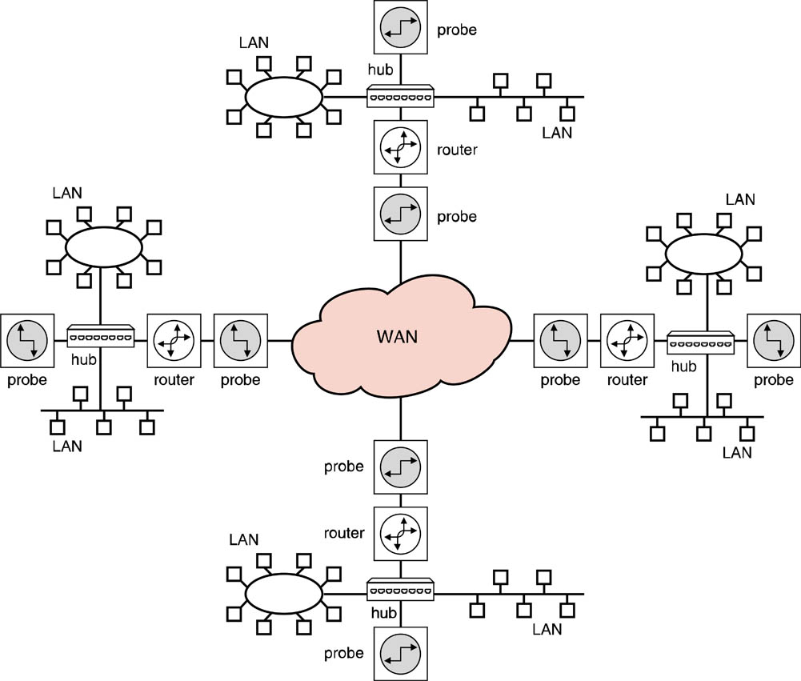
Distributed Device Manager (DDM)
An alternative to a centralized enterprise management console.
Relies on distributed network probes

Slide 38
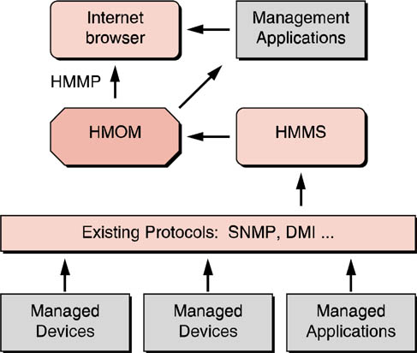
Web Based Enterprise Management
Web-based management could benefit both vendors and users:
Users would have to deal with only one common interface regardless of the enterprise network device that was to be managed.
Vendors could save a tremendous amount of development costs by only having to develop management applications for a single platform
Hypermedia Object Manager (HMOM)
Hypermedia Management Protocol (HMMP)
Hypermedia Management Schema (HMMS)

Slide 39
Web-Based Management
The overall intention of the architecture is that the network manager could manage any networked device or application from any location on the network, via any HMMP-compliant browser.
Existing network and desktop management protocols such as SNMP and DMI may either interoperate or be replaced by HMMP.
All Web-based management information is stored and retrieved by the request broker formerly known as HMOM (hypermedia object manager), now known simply as Object Manager.

Slide 40
Common Information Model
A proposed protocol under development by the DMTF that would support HMMS is known as CIM or common information model
CIM would permit management data gathered from a variety of enterprise and desktop voice and data technology to all be transported, processed, displayed, and stored by a single CIM-compliant Web browser.
Management data to be used by CIM would be stored in MOF (modified object format) as opposed to DMI’s MIF format or SNMP’s MIB format.

Slide 41
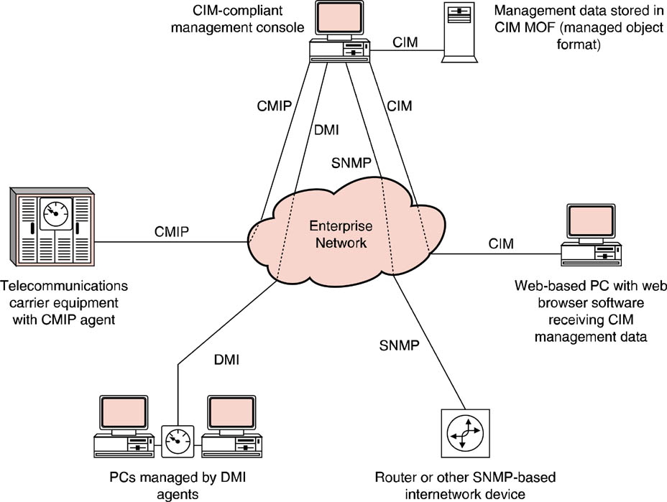
Network Management Data

Slide 42
SNMP Problems
Constant polling
No manager to manager communications
Limited to using TCP/IP
Does not offer any security features

Slide 43
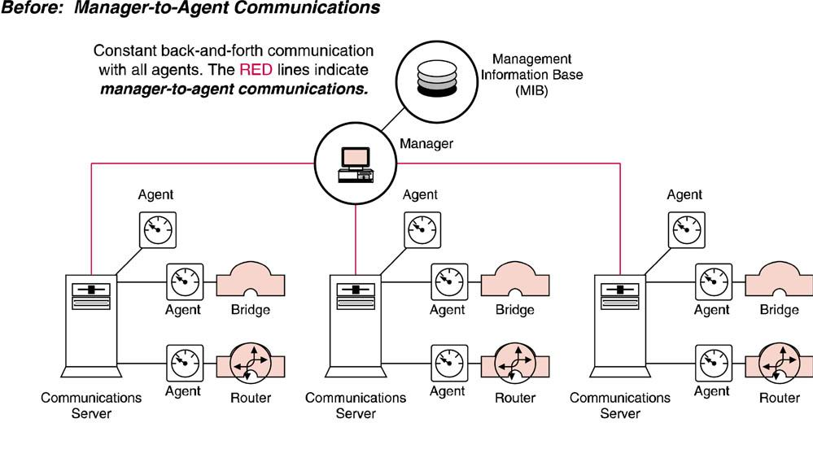
Manager & Agent Communication

Slide 44
SNNP2
SNMP2’s major objectives can be summarized as follows:
Reduce network traffic
Segment large networks
Support multiple transport protocols
Increase security
Allow multiple agents per device

Slide 45
SNMP2 Bulk retrieval mechanism
Managers can retrieve several pieces of network information at a time from a given agent.
Agents have also been given increased intelligence that enables them to send error or exception conditions to managers when request for information cannot be met.
With SNMP, agents simply sent empty datagrams back to managers when requests could not be fulfilled.
The receipt of the empty packet merely caused the manager to repeat the request for information, thus increasing network traffic.

Slide 46
Manager to Manager Communication
SNMP2 allows the establishment of multiple manager entities within a single network.
As a result, large networks that were managed by a single manager under SNMP can now be managed by multiple managers in a hierarchical arrangement in SNMP2.
Overall network traffic is reduced as network management information is confined to the management domains of the individual network segment managers.

Slide 47
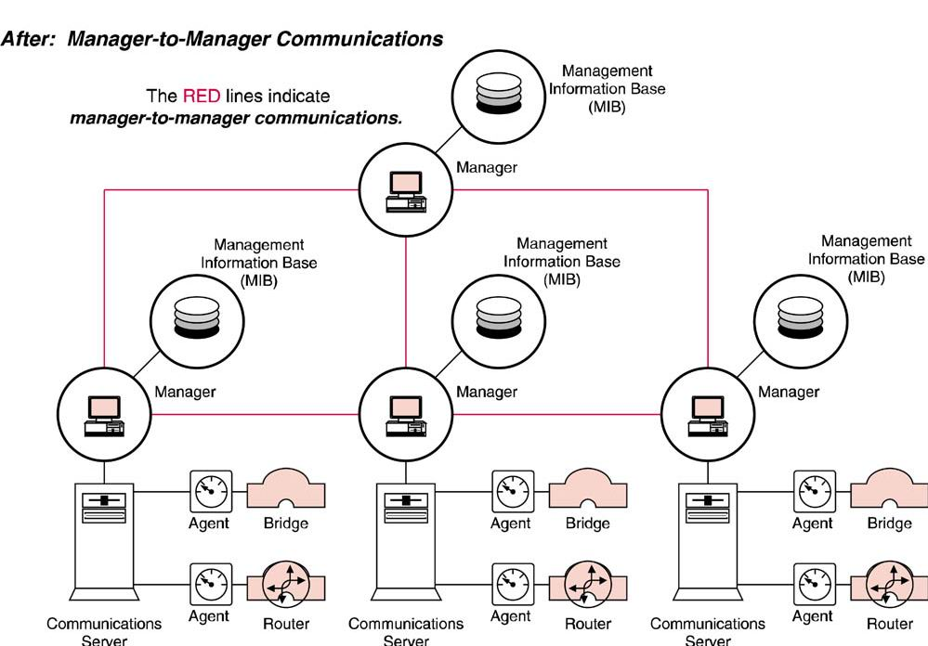
Manager to Manager Communication

Slide 48
RMON2
In addition to monitoring Physical & Data Links layers, RMON2 can analyze Network layer also
Agent software called an RMON probe
Enables network administrators to more precisely pinpoint the exact sources and percentages of the traffic that flows through their enterprise networks
One shortcoming can do WANs - RMON3

Slide 49
RMON3
Offers WAN management
Support for switched networks & Virtual LANs
Measures application program response times
Provides an Application MIB
3 key groups of variables
Definition variables
State variables
Relationship variables

Slide 50
Enterprise Network Management technology
Point Products aka Element managers
Specifically written to address a particular systems administration or network management issue
Frameworks
Offer an overall systems administration or network management platform with integration between modules and a shared database into which all alerts, messages, alarms, & warnings can be stored
Integrated suites
Subset of frameworks, not an “open” framework

Slide 51
Currently Available Technology
Frameworks or Integrated Suites
HP Openview
Computer Associates’ TNG Unicenter
IBM/Tivoli Systems - TME 10
BMC Software Inc. - PartolView
Point Products
3com - Transcend Enterprise Manager
Cisco – Cisco Works
American Power Conversion - PowerNet

Slide 52
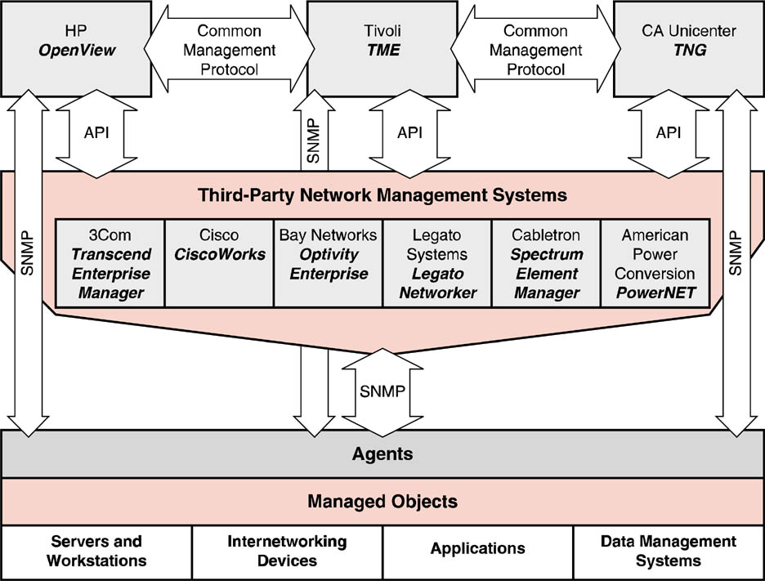
Network Analyzers
LAN and WAN network analyzers are able to capture network traffic in real time without interrupting normal network transmission.
See table p468

